Slide 1
Welcome to Community Relations College!
WE’RE SO GLAD YOU’RE HERE!

Slide 2
Welcome, Introductions & Program Overview
Community Relations College

Slide 3
Meet the Facilitators!
Beth Torres
Illinois Zeta
Director Community Relations
dcr@pibetaphi.org
Rachael Tully
Virginia Zeta
Collegiate Regional Director
crd4@pibetaphi.org
Adam M. Bantz
Assistant Director of Literacy & Programs
abantz@pibetaphi.org

Slide 4
Our Special Guests
Lindsey Scheetz
Mississippi Gamma
Foundation Donor & Volunteer Engagement Manager
Cassidy Nieves
Michigan Gamma
Headquarters Marketing Director

Slide 5
Introductions
Name
Chapter and school
Community you belong to
Something brining you joy

Slide 6
Engagement & Resources
Facilitators
PowerPoint
Workbook
…and each other!

Slide 7
Ground Rules for the Weekend
You’re here to better your chapter!
Make the most of the weekend!
Apply what you learn!
Follow the agenda!
Others?

Slide 8
Agenda
Part I: Welcome | Friday, 8-9 p.m.
Part II: Community Partnership & Philanthropy | Saturday, 9-11:45 a.m.
Part III: Strategic Communications & Brand Management | Saturday, 1:15-3 p.m.
Part IV: Strategic Planning & Goal Setting | Saturday, 4:14-6:15 p.m.

Slide 9
Learning Outcomes
Identify how to develop relationships with organizations and community partners aligned with chapter values.
Articulate the difference between fundraising, service and philanthropy as key components of community relations.
Assess their chapter’s communication and philanthropic efforts and identify opportunities for growth and development.
Employ community relations practices that actively and effectively contribute to an inclusive and engaging member experience.

Slide 10
communityrelations#@pibetaphi.org
…where the # is the region your chapter is located in

Slide 11
Additional Takeaways
Start all your Vice President Community Relations (VPCR) endeavors by asking, “Who is the community we are seeking to engage, and how does this relate to them?”
Your resources include your people! The members you will meet at College Weekend, your Alumnae Advisory Committee (AAC) counterpart and your Community Relations Specialist.
You were elected to serve as the VPCR for a reason. Be confident; and be bold!

Slide 12
Identifying & Relating to Our Communities
Community Relations College

Slide 13
Reflection Questions
Why do we, focus on community?
How has community been an integral part of Pi Phi’s history?
How do you think positive community relations will impact the future success of Pi Beta Phi?

Slide 14
Community Lenses
Geography
Identity
Affinity

Slide 15
What communities are you connected with?

Slide 16
Announcements
Breakfast starts at 8 a.m. in the Grand Ballrooms on the fourth floor.
Community Relations College resumes at 9 a.m. in this room.
Take note of possible time zone changes on your devices.
Get some rest!

Slide 17
Community Relations Track
Positive Community Partnerships

Slide 18
Partnerships are purposeful, lasting, mutually beneficial relationships with stakeholders aimed toward collaborating to understand and address the core problems facing relevant communities.

Slide 19
Reflection Questions
Your Goals:
Are you looking to offer your members a service opportunity?
Are you trying to address a specific problem in your campus community?
Are you trying to alleviate a burden in your greater community?
Your Partner’s Goals:
What are they hoping to accomplish?
How can you help them?
Are you a value add to their endeavor?
Are you listening to their needs?

Slide 20
Asset-Based Framework
Avoids viewing situations, people or community from a ‘deficit’ lens—focusing on what's missing or wrong
Emphasizes language that centers strengths and potentials
Focuses on existing assets and building off them

Slide 21
Asset-Based Partnership Reflection
At your table, think about a partnership your chapter has—or one you would like to develop.
Consider and discuss…
Goals you have
Goals they might have
Assets your chapter brings
Assets the organization has
Assets that exist in the community

Slide 22
Philanthropy, and Service and Fundraising… Oh, My!
Community Relations College

Slide 23
Defining Philanthropy
The desire to promote the welfare of others, expressed especially by generous donations to good causes
A form of altruism that consists of private initiatives for the public good, focusing on quality of life

Slide 24
Defining Service
Sharing your time and talents to address a need in your community
Connects your skills and abilities with a real-world issue
Usually hands-on in nature

Slide 25
Defining Fundraising
Raising funds to be donated to a worthy cause
Similar to—but not necessarily synonymous with—philanthropy

Slide 26
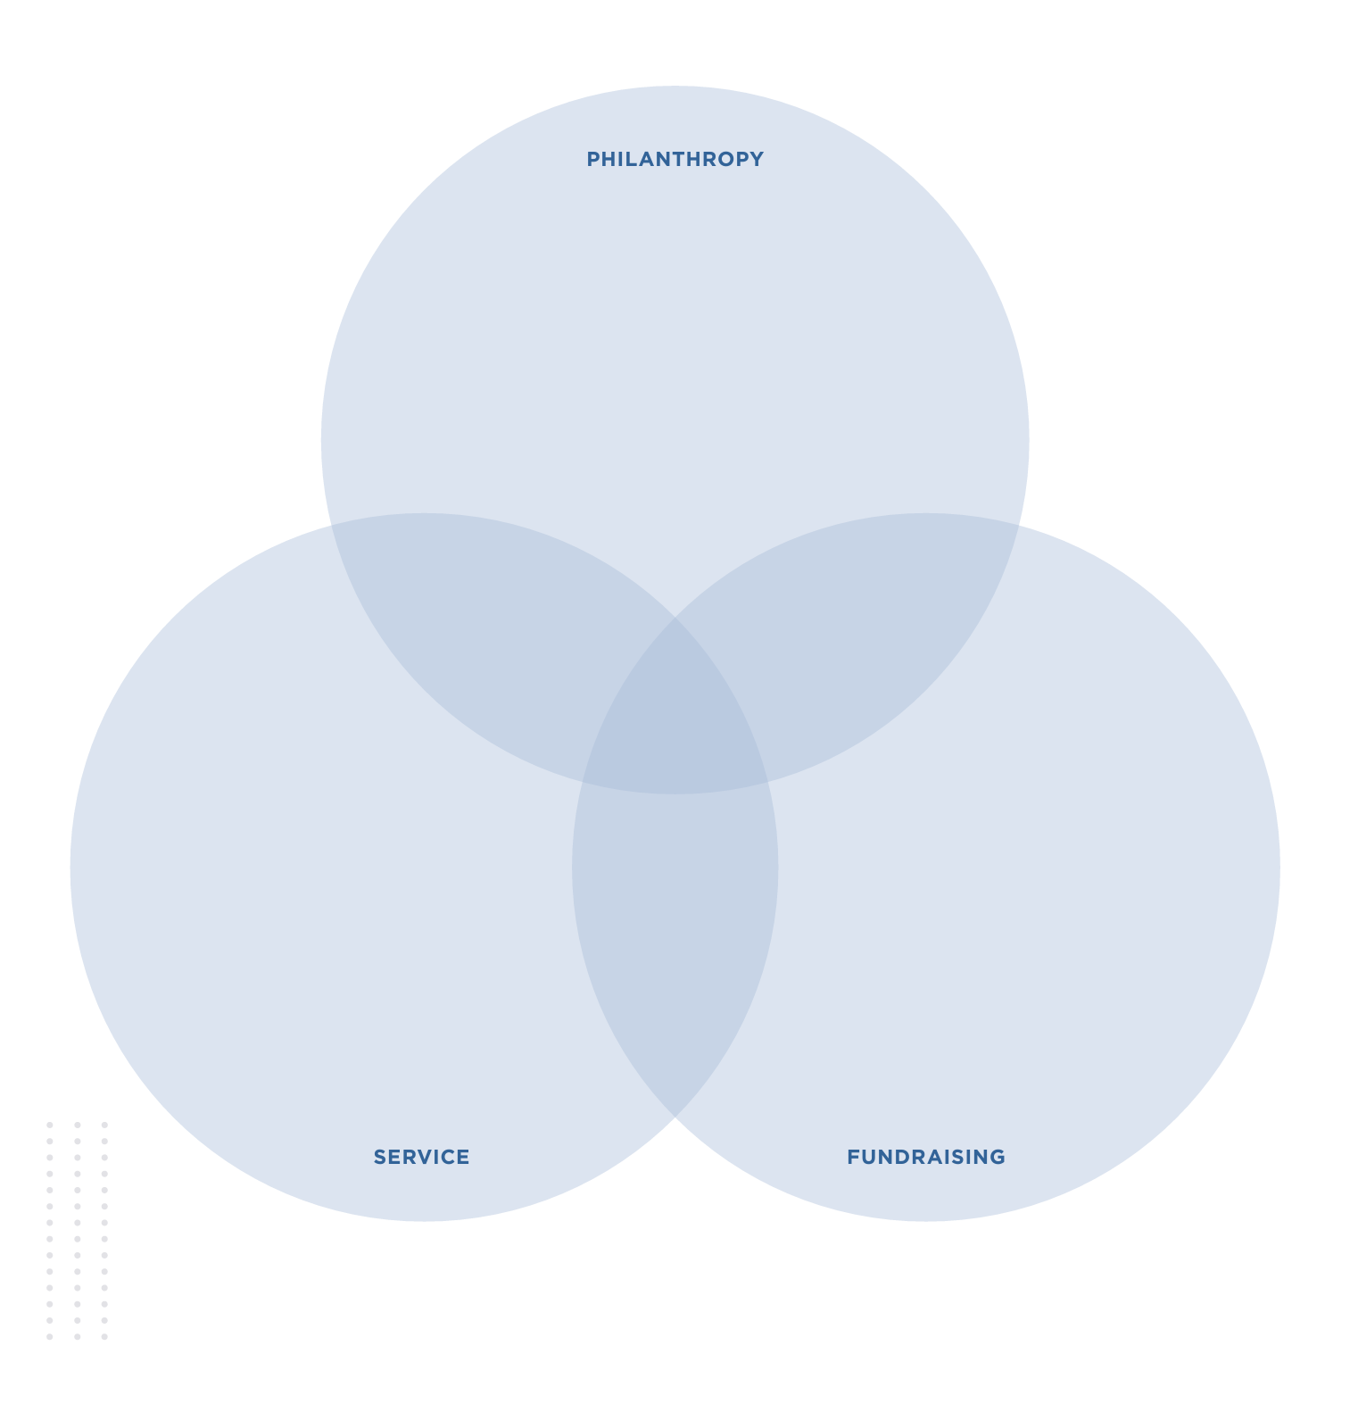
Venn Diagram Activity
Place your chapter’s initiatives into the diagram to create a visual representation of what your chapter’s current priorities are when it comes to philanthropy, service and fundraising.

Slide 27
Read > Lead > Achieve® Overview
Community Relations College

Slide 28
Read > Lead > Achieve®
Read > Lead > Achieve is Pi Beta Phi’s philanthropic effort, which inspires a lifelong love of reading that can unlock true potential, creating a more literate and productive society.
Read > Lead > Achieve is not…
An organization
A philanthropic partner
An entity

Slide 29
Three Pillars of Read > Lead > Achieve®
Participate…
in literacy service projects
Donate…
to The Literacy Fund by hosting fundraising events
Advocate…
for literacy in our communities

Slide 30
Participate

Slide 31
Champions are Readers®
Champions are Readers (CAR) is Pi Beta Phi’s unique reading enrichment program for students in pre-kindergarten through third grade.
Creates interactive reading and mentoring relationships
Engages children in positive reading experiences
Accommodates varying academic needs

Slide 32
Bringing CAR to Your Community
Connect with a local school, after-school program or community program serving pre-kindergarten through third grade students
Identify the number of students and their reading level
Determine date(s) and time(s) for participation
Submit the online CAR Supplies Order Form at pibetaphi.org/CAR
A free book for each student participant to take home
An Implementation Guide for the chapter organizer
Student Activities Folders for each student participant

Slide 33
Pi Beta Phi Literacy Grants
Through the Pi Beta Phi Literacy Grant program, chapters and alumnae clubs can nominate local organizations and community partners for a $2,000 grant to purchase new books and school supplies for children in need.
Identify a local organization or community partner
Notify the partner of your intent to nominate them
Request that the organization register for its free First Book® membership
Complete the online nomination form at pibetaphi.org/literacy-grants

Slide 34
Advocate

Slide 35
Donate

Slide 36
Pi Beta Phi Foundation Overview
Community Relations College

Slide 37
About Pi Beta Phi Foundation
Pi Beta Phi Foundation is uniquely focused on helping Pi Beta Phi fulfill its mission—promoting friendship, developing women of intellect and integrity, cultivating leadership potential and enriching lives through community service.
Note: Pi Beta Phi Foundation is NOT the same as Read > Lead > Achieve®.
The Foundation funds all literacy initiatives through The Literacy Fund.
When you are fundraising, the beneficiary is Pi Beta Phi Foundation.

Slide 38
The Literacy Fund
The Foundation financially supports Read > Lead > Achieve programs and initiatives through The Literacy Fund, including…
Arrow in the Arctic
Champions Are Readers
Endowment Funds
Fraternity Day of Service
Local Impact Grants
Pi Beta Phi Literacy Grants

Slide 39
Local Impact Grants
Host a fundraiser for The Literacy Fund
Nominate a literacy-focused organization in your community via the Foundation Giving Form
BetaBase > Chapter Forms > Foundation Giving Form
Make donation to The Literacy Fund
Receive a dollar-for-dollar match on 25% of your donation allocated to your local community partner

Slide 40
Local Impact Grant Example
The Indiana Gamma Chapter hosts Lemonade for Literacy and raises $4,000 for The Literacy Fund.
The chapter identifies Indy Reads as a local literacy nonprofit in need of financial support.
IN Gamma applies for a Local Impact Grant.
The nomination is accepted, and Pi Beta Phi Foundation writes a check to Indy reads in the amount of $2,000.
$1,000 (25% of IN Gamma’s $4,000 donation)
+ $1,000 (dollar-for-dollar match by the Foundation)
= $2,000 Local Impact Grant

Slide 41
Asking for Support
What would you say when someone asks you why gifts to The Literacy Fund at Pi Beta Phi Foundation are important/make an impact?

Slide 42
The Literacy Fund at Pi Beta Phi Foundation fuels our Read > Lead > Achieve® programs and initiatives to help create a more literate and productive society through the power of reading.
Please join us at our annual fundraising event, Lemonade for Literacy, on February 25 to enjoy some lemonade with community members, learn about literacy rates and support a meaningful cause.

Slide 43
We are partnering with Ready Readers, a nonprofit that expands literacy for young children in low-income communities, to increase third grade reading proficiency levels in the St. Louis area.
You can help make an impact by donating any of the selected materials to Ready Readers.

Slide 44
Arrow in the Arctic
Arrow in the Arctic supports reading in Canada’s northern library systems: the Yukon, Northwest Territories and Nunavut.
Gifts to Arrow in the Arctic help purchase books for northern libraries, bilingual educational materials and videos, reference books, collections of stories by native authors and educational programming.

Slide 45
The Friendship Fund

Slide 46
The Friendship Fund
The Friendship Fund is the primary way the Foundation fulfills its mission and ensures the future of the Pi Beta Phi sisterhood.
Programs supported include…
College Weekend
Critical Conversations® ​
Leading with Values® ​
Leadership Institute
Leadership Development Consultant (LDC) Program

Slide 47
Additional Foundation Funds
The Diversity and Inclusion Leadership Fund
Chapter House Improvement (CHIP) Funds
Educational Area Program (EAGP) Funds
Emma Harper Turner Fund
Heritage and Holt House Operations
Scholarships

Slide 48
Monthly Chapter Evaluations (MCE)
Meeting Expectations Standards:
Makes donation to The Literacy Fund at Pi Beta Phi Foundation of at least 10 fundraised dollars per chapter member
Exceeding Expectations Standards:
Makes donation to Pi Beta Phi Foundation’s Friendship Fund of at least 10 fundraised dollars per chapter member
Exceeds donation to The Literacy Fund of at least 10 fundraised dollars per chapter member
Nominates an organization to receive a Local Impact Grant

Slide 49
Thank You!
Lindsey Scheetz
Mississippi Gamma
Donor & Volunteer Engagement Manager
lscheetz@pibetaphi.org
pibetaphi.org/foundation
BetaBase > Chapter Forms
> Foundation Giving Form

Slide 50
Philanthropy & Fundraising Events
Community Relations College

Slide 51
Primary Events
Large-scale events promoted within your campus and greater community
Usually includes both fundraising and advocacy efforts
Sometimes take the form of a “Philanthropy Week”

Slide 52
Secondary Events
Raises awareness and includes a fundraising component
Smaller scale in nature and might be as simple as tabling or selling a glass of lemonade

Slide 53
Mock Philanthropy/Fundraising Event
At your table, determine whether you are hosting a primary or secondary philanthropy event—and then identify what that event will be.
Take about 2-3 minutes to develop this initial plan.

Slide 54
Mock Philanthropy/Fundraising Event
At your table, determine whether you are hosting a primary or secondary philanthropy event—and then identify what that event will be.
Take about 2-3 minutes to develop this initial plan.
Who is the beneficiary?
Who are we partnering or engaging with?
Is there an opportunity for a Local Impact Grant?

Slide 55
Questions to Consider
How does this event relate to the attendees?
How does this event fill a need on your campus or in your greater community?
How does this event align with the interests of your chapter and campus community?
How can you incorporate literacy education or advocacy?
What are your metrics of success—funds raised, number of participants and campus engagement, for example?
How does this event align with the interests of your members?
Have you talked with leaders in your community to identify their needs?

Slide 56
Risk Management
Have you consulted with your Vice President Risk Management (VPRM)?
Your VPRM will help identify if your event is high risk and what forms, contracts and plans need to be completed.

Slide 57
Finance
What are your estimated financial targets?
Are you splitting proceeds with a co-hosting organization?
Does your chapter have time left in the semester to vote to approve your donation?

Slide 58
PR/Marketing
What communities are you hoping to engage with this event?
How will you promote the event? Do your promotional materials identify the organization receiving the donation?
Will you be creating apparel or merchandise for this event?
Consider post-event communications.
Thank you notes
Fundraising updates on socials

Slide 59
Roles & Responsibilities
Who is all is involved in event planning and execution?
Who is responsible for what?
Is everyone included?
Delegation is your friend!

Slide 60
Questions to Consider
How does this event relate to the attendees?
How does this event fill a need on your campus or in your greater community?
How does this event align with the interests of your chapter and campus community?
How can you incorporate literacy education or advocacy?
What are your metrics of success—funds raised, number of participants and campus engagement, for example?
How does this event align with the interests of your members?
Have you talked with leaders in your community to identify their needs?

Slide 61
Post-Event To-Dos
Finalize all tabs of the Fundraising Tracking Sheet within 10 days of the event.​​
Report expenses and proceeds to the chapter.​​
Vote on donation during a regular chapter meeting.​​
A motion should be made during new business and reflected in the meeting minutes.​
Partner with Vice President Finance/Housing to complete the Foundation Giving Form in BetaBase.

Slide 62
Announcements
Lunch starts at noon in the Grand Ballrooms on the fourth floor.
Community Relations College resumes at 1:15 p.m. in this room.
Take a brain break!

Slide 63
Strategic Communications 101
Community Relations College

Slide 64
Strategic Communications
A strong communications plan is based in strategy and focused on a goal.
Shares your overall brand with the community
Helps you develop relationships with audiences within your communities
Keeps important stakeholder groups up to date on important chapter happenings

Slide 65
Why do you think strategic communications is important to the Community Relations Team? How is strategic communications different from and similar to concepts like PR and marketing?

Slide 66
Importance of Strategic Communications
Understanding our brand and developing a strategy helps us decide:
What information to share
Who to share it with
How to share it
This should be a holistic approach that considers the entire year and is carried out wherever your chapter has a presence:
Social media/website
Events
Recruitment

Slide 67
Brand Management & Chapter Brands
Community Relations College

Slide 68
The Pi Beta Phi Brand
The Pi Beta Phi brand is the way we present our organization to the world—everything we say, do and promise.
Our brand represents our unique image and must be communicated clearly, consistently and carefully.
The Pi Beta Phi brand encompasses three entities:
Pi Beta Phi Fraternity for Women
Pi Beta Phi Foundation
Pi Beta Phi Fraternity Housing Corporation

Slide 69
The Pi Beta Phi Brand
Tagline: Shorthand for our promise
Friends and Leaders for Life
Promise: Our unwavering commitment to our members and friends
To promote friendship, develop women of intellect and integrity, cultivate leadership potential and enrich lives through community service.
Pillars: How we deliver
Develop friends, build leaders, dedicated for life

Slide 70
The Pi Beta Phi Brand
Personality: Our tone and how we express our brand
As true friends, we are purposeful, intentional and values-driven—inspiring ourselves and others to take passionate action.
Values:
Integrity
Lifelong Commitment
Honor & Respect
Personal & Intellectual Growth
Philanthropic Service to Others
Sincere Friendship

Slide 71
Your Chapter’s Brand
Expresses what your chapter says, does and promises as part of the Pi Beta Phi sisterhood​
Should be consistent and align with Pi Phi’s brand​
Reflects the unique character and personality of your chapter within Pi Beta Phi

Slide 72
Questions for Consideration
What words and attributes describe your chapter? Why are they important to your chapter?
What elements are unique to your chapter, and your chapter alone? In all of Pi Phi? On your campus?
What is your chapter’s voice?

Slide 73
Pi Phi Pillars
Promotes Friendship
Develops Leaders
Inspires Lifelong Commitment

Slide 74
What is the role of the Vice President Community Relations (VPCR) in brand management? How and with whom will you connect and collaborate?

Slide 75
The Role of Social Media
Community Relations College

Slide 76
Platforms
For each platform you use, answer:
WHO: Who is your current audience on this platform?
WHAT: What is the purpose of this platform? Are you using it to post about events, spotlights, recruitment?
WHEN: When do you post? Once a week? A month?
HOW: How are you representing Pi Phi on these platforms?

Slide 77
What makes a great social media post?

Slide 78
Chapter Social Media Check-In
Tie back to the words and attributes you identified in your chapter brand conversation.
Reflect your entire membership rather than the voices/perspectives of a few individuals.
Find photos that are representative of your entire membership.
Make people feel the energy in each photo!
Jump on the trend in a way that makes sense to your chapter.

Slide 79
Times of Heightened Social Media Attention
Posts of this nature should be handled differently than any day-to-day post because of their potential impact.
Chapter Emergencies and Crises
Death or life-threatening injury of a member
Chapter facility risks
Campus safety issues, such as a lockdown

Slide 80
Times of Heightened Social Media Attention
Posts of this nature should be handled differently than any day-to-day post because of their potential impact.
National/International Movements, Causes or Events
Should be agreed upon and representative of the entire chapter.
Thoughtfully consider why you would make a post:
Has it affected members of your chapter?
Has it affected members of your campus fraternity/sorority community?
What is the tie to Pi Phi?
You likely are not the thought leaders or expert on the matter!

Slide 81
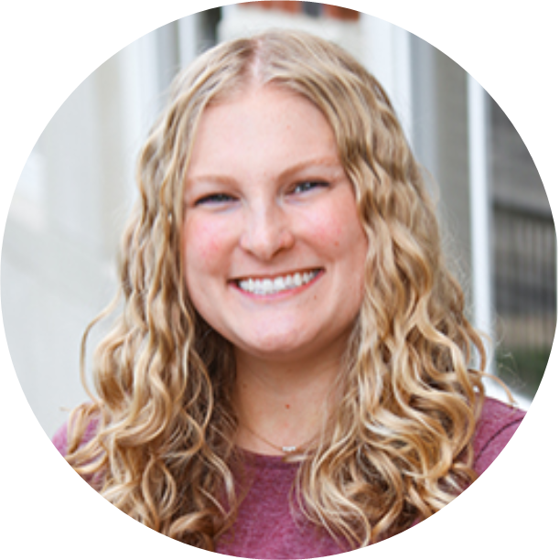
Thank You!
Cassidy Nieves
Michigan Gamma
Headquarters Marketing Director
communications@pibetaphi.org

Slide 82
Announcements
Take a brain break!
Snacks are available in the Grand Foyer on the fourth floor.
Community Relations College resumes at 1:15 p.m. in this room.

Slide 83
Strategic Communications Plans
Community Relations College

Slide 84
Chapter Websites
Update at least once per academic term
Consider who visits the site
Members
Potential new members
Alumnae
College/university personnel
Community leaders
Identify the expectations/needs of those audiences

Slide 85
Submissions to The Arrow®
Features your chapter to a Pi Phi-specific audience
Serves as an “exceeds expectations” standard for the MCE
Three Deadlines
October 1 for the Winter issue
February 1 for the Spring issue
June 1 for the Summer issue

Slide 86
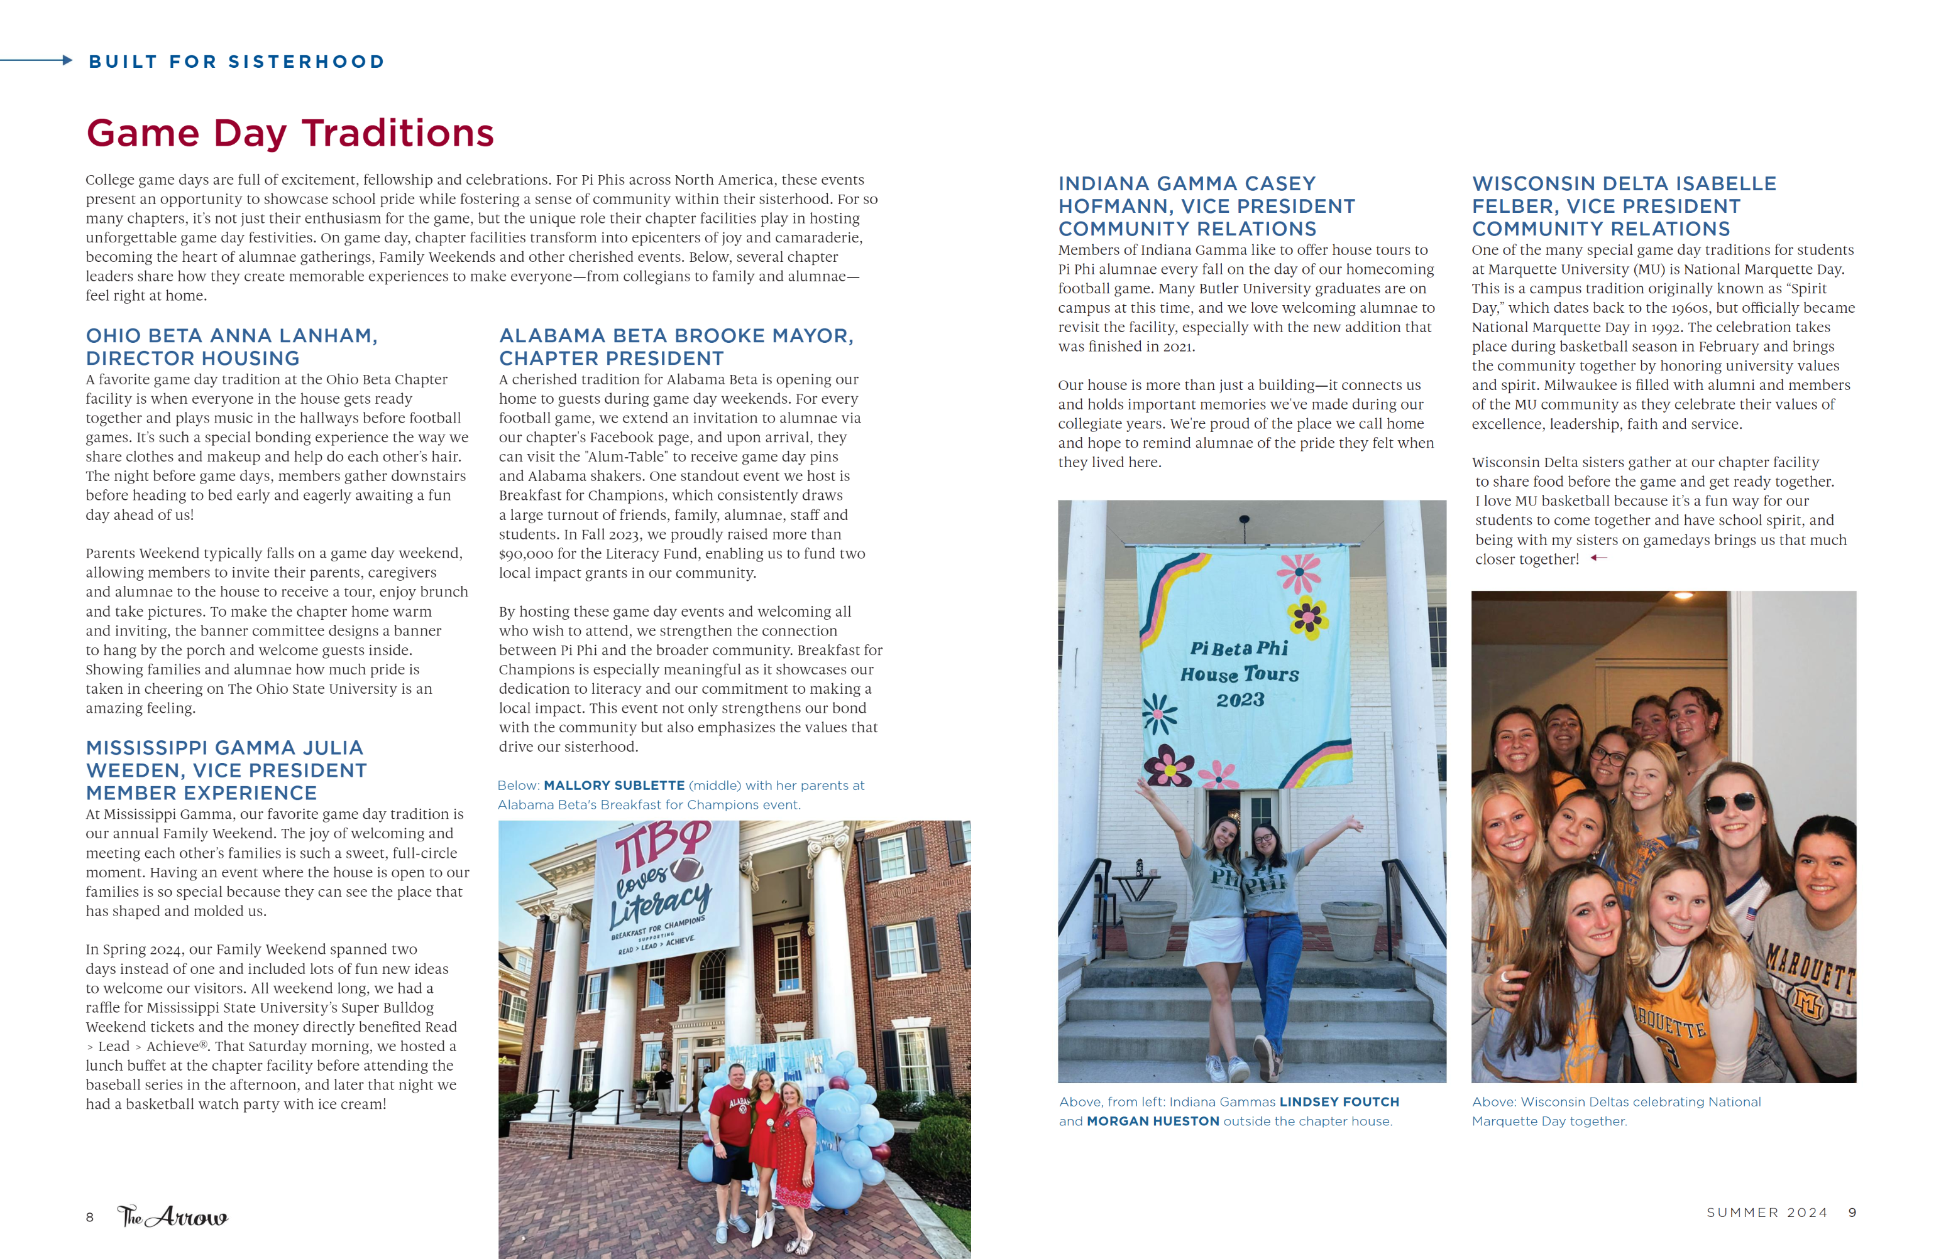

Slide 87
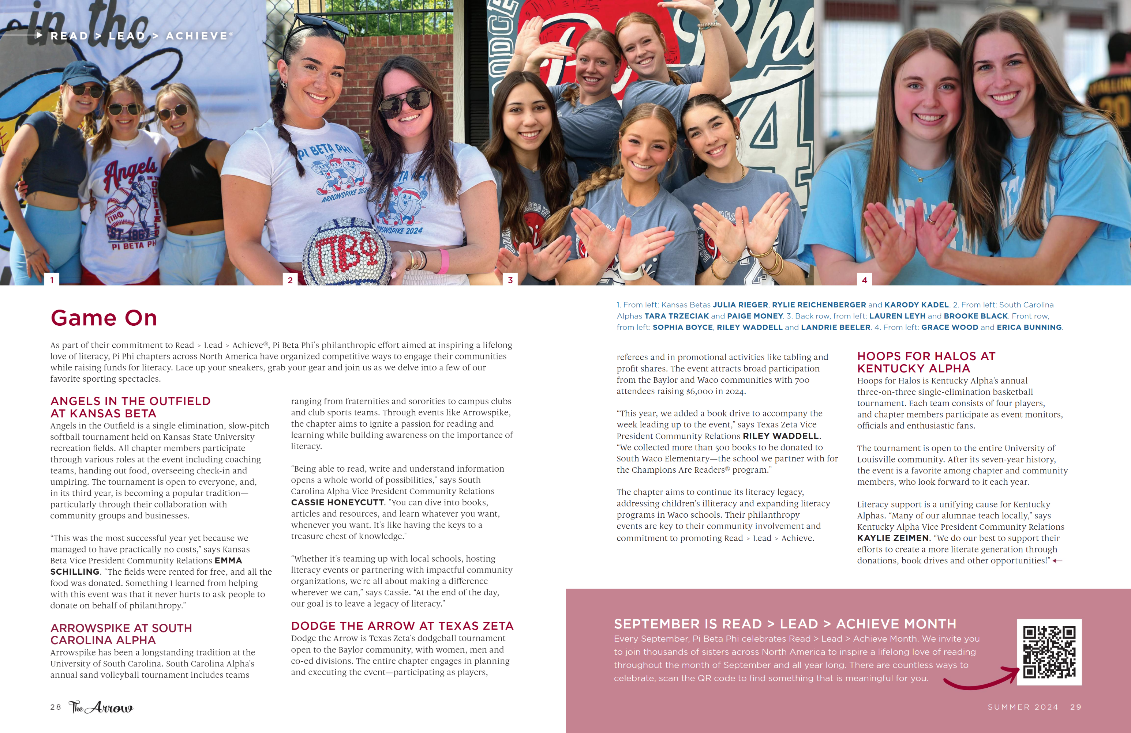

Slide 88
Submissions to The Arrow
Features your chapter to a Pi Phi-specific audience
Serves as an “exceeds expectations” standard for the MCE
Three Deadlines
October 1 for the Winter issue
February 1 for the Spring issue
June 1 for the Summer issue

Slide 89
Recruitment Videos
Reflection of your chapter’s brand
Accessible to audiences well beyond its release
Opportunity for partnership with Recruitment Team

Slide 90
Discussion Prompts
Think back to when you were a Potential New Member (PNM):
• What do you remember about the videos you saw?
• What stood out to you about great ones?
• What about the not-so-great ones?

Slide 91
Chapter Newsletters
Audience varies—and is in your control
Opportunity to target an audience you aren’t successfully engaging through other mediums

Slide 92
Tips for Developing Your Plan
Determine the Strategy: A bigger goal you want to accomplish
Develop Tactics: The specific steps you’ll need to take​
Consider the Audience: Who do you want to reach?​
Find your Channels: The tools you have available to reach your audiences​
Think through Content: What do you want to say? How do you want your audience to respond?​
Decide the Timing: What are your milestones and important dates?​
Measure: How will you measure success?

Slide 93
Community Partnerships Revisited
Community Relations College

Slide 94
Service/Nonprofit
Define goals for partnership​
Research ​
What barriers exist?​
What is your timeline?​
Outreach ​
Consistent communication

Slide 95
Business/Sponsorship Partnerships
Opportunity to leverage mutually beneficial relationships
Can be challenging—and sometimes risky—to navigate
Requires collaboration with AAC and Community Relations Specialist (CRS)

Slide 96
Sponsorship Approval Process
VPCR works with CRS to determine if partnership meets requirements
Chapter votes to approve the partnership, requiring a simple majority
Chapters vote is reflected in meeting minutes

Slide 97
Opportunities for partnership are everywhere!

Slide 98
Action Planning
Community Relations College

Slide 99
Action Planning
If you could only accomplish ONE thing in the next year, what would it be?
Why is this important to you? To your chapter?
What is the immediate reward for achieving this?
What is the long-term impact of this achievement?

Slide 100
SMART Goals
Using the SMART goal framework will ensure our goals are:
Specific
Measurable
Achievable
Results-oriented
Time-bound

Slide 101
SMART Goal Example
Ontario Alpha Chapter will establish a positive community partnership with Little Readers by committing to 10 members volunteering for two (2) hours each week throughout the spring 2025 term.

Slide 102
Announcements
Pink Party Dinner starts at 7 p.m. in the Grand Ballrooms on the fourth floor.
Get ready for a silent disco and a Pi Beta Phi Cookie Shine!
Breakfast starts at 8 a.m. in the Grand Ballrooms on the fourth floor.
Sunday Workshops start at 9 a.m. in their designated rooms.

Slide 103
THANK YOU!

