Slide 1
Welcome to the Finance/Housing College!
Please find your table by looking for your name tent on the tables.

Slide 2
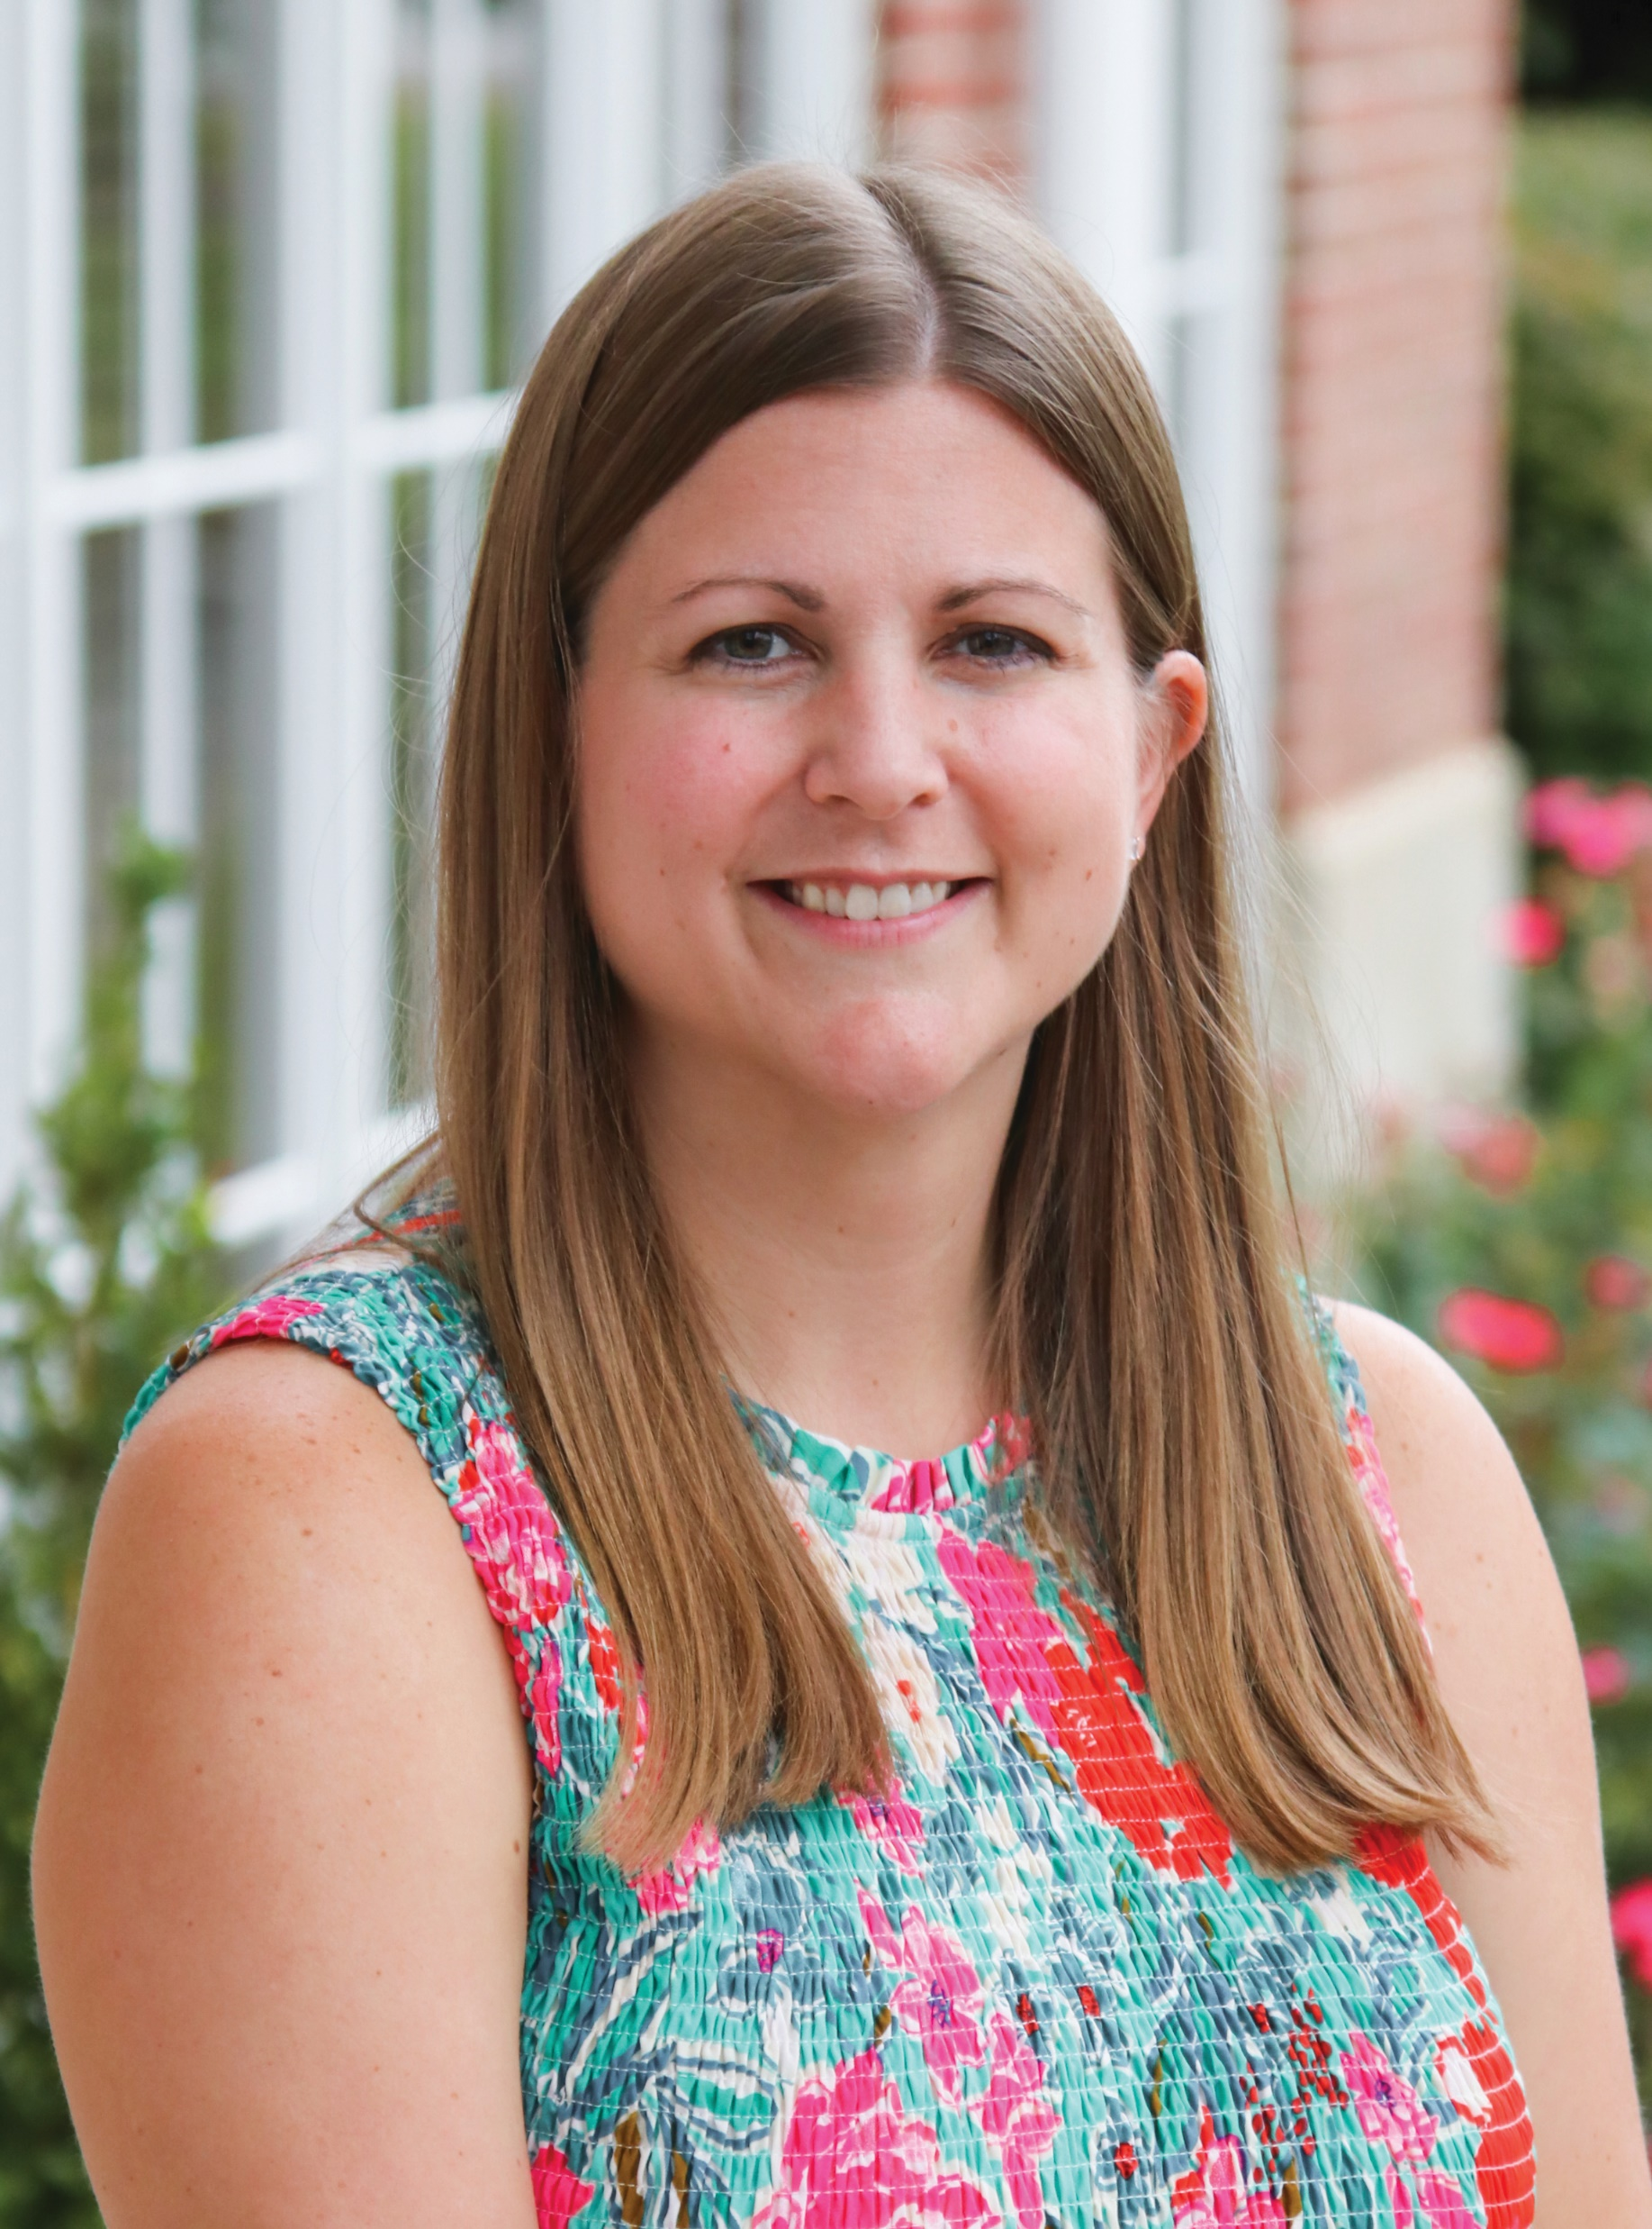
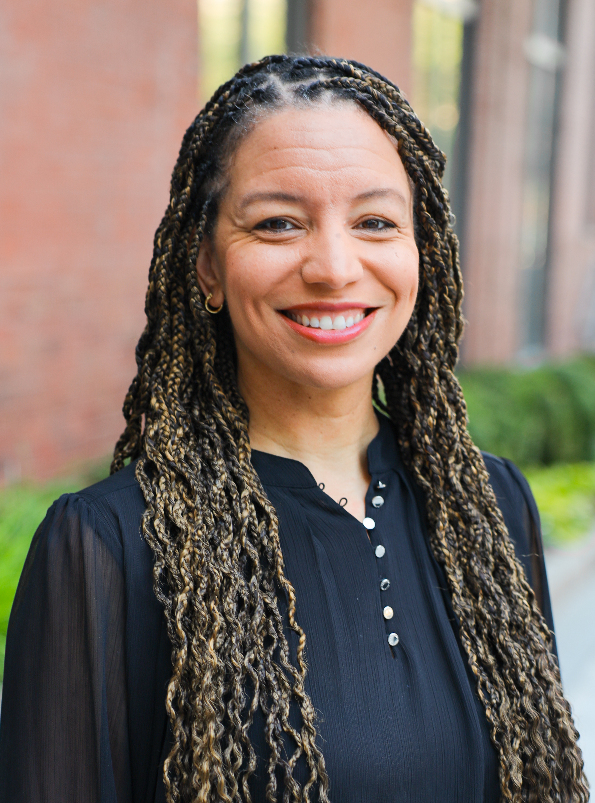
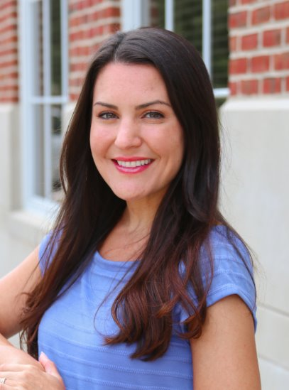
Meet Your Facilitators
Amanda Reid Austin
Michigan Alpha
Director Finance Housing
dfh@pibetaphi.org
Arianna Rodriguez
Delta Gamma
Assistant Director of Housing
arodriguez@pibetaphi.org
Liza Hallsten
Alpha Chi Omega
Assistant Director of Housing
lhallsten@pibetaphi.org

Slide 3
Learning Objectives

Slide 4
Learning Objectives
Identify and develop best practices in finance/housing that actively and effectively contribute to the overall financial health of your chapter.
Educate members on Pi Phi’s financial policies and procedures and their financial responsibility to the chapter and the Fraternity.
Address difficult member finance/housing situations while positively holding members accountable through policies and procedures.
Understand the relationship between the Vice President Finance/Housing and the Vice President Operations.
Understand Housing policies and procedures as it relates to the Director Housing role, while serving as a mentor to them.

Slide 5
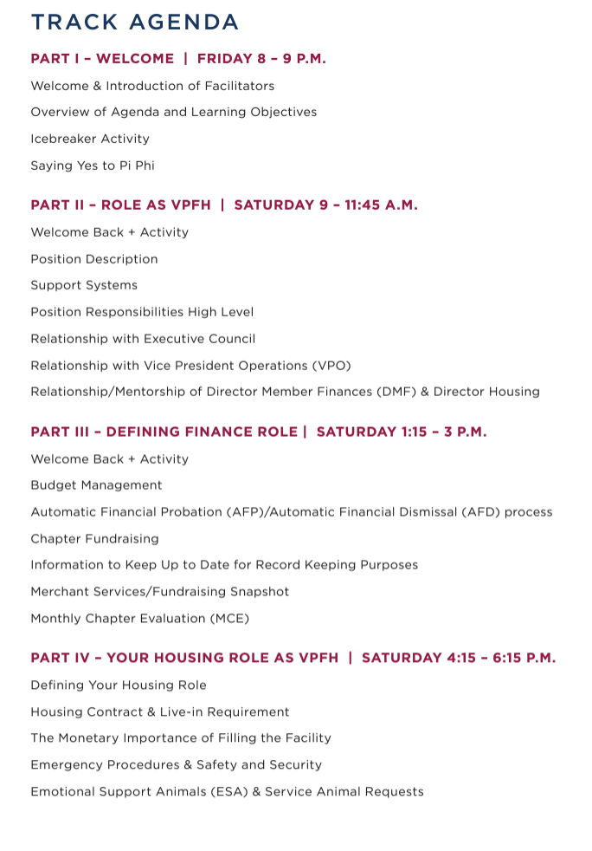
Agenda

Slide 6
Let’s Mingle!
Name
Chapter
Hometown
Year in school
Major

Slide 7
Table Names

Slide 8
Activity
Find 3 things everyone at your table has in common.
Cannot be related to gender, race, or chapter leadership position
Next, find another table to absorb and find 2 things everyone in the group has in common.
Next absorb another table and find 1 thing that everyone in the group has in common.
Continue this process until you all are 1 big group.

Slide 10
Saying “Yes” to Pi Phi
Why do you say yes to Pi Phi?
Who helps you say yes to Pi Phi?
How do you encourage others to say yes to Pi Phi?

Slide 11
Welcome Back!
Finance/Housing College

Slide 12
Group Poll
Raise your hand if you are brand new in this role?
Raise your hand if you served in the Director Housing (DH) or Director Member Finance (DMF) role last year.
Raise your hand if you served in another chapter leadership team position last year?
Raise your hand if this is your first leadership role in Pi Phi?
Raise your hand if this is your first leadership role in college?

Slide 13
Vice President Finance/Housing
Job Description

Slide 14
Vice President Finance/Housing Responsibilities
Adheres to local and Fraternity financial policies.
Creates and monitors a chapter budget, serving as the chair of the Budget Committee.
Approves and signs all chapter checks in accordance with Fraternity financial policies.
Supports the Automatic Financial Probation (AFP) and Automatic Financial Dismissal (AFD) processes by notifying members of their standing with the Fraternity.
Collaborates with the DH to be a liaison between the chapter and the Chapter House Corporation (CHC) or Fraternity Housing Corporation (FHC) and local employees (e.g. House Director and chef/food service).
Educates on and enforces all Pi Beta Phi and campus housing policies, obligations and benefits of facility occupancy.

Slide 15
Supporters
AAC Finance/Housing Advisor
AAC Housing Advisor*
Special Assessments Chair
Finance/Housing Specialist
Fraternity Director Finance/Housing
Chapter Finance Staff at Headquarters
Assistant Directors of Housing at Headquarters
House Directors
FHC/CHC
Director Member Finances
Director Housing

Slide 16
Finance/Housing Advisor Responsibilities
Completes bank and purchase card reconciliations monthly no later than the 10th of the month or as soon as the statement(s) are received.
Signs chapter checks as an authorized second signer on chapter bank accounts.
Approves purchase card transactions including new card orders and adding funds to individual cards.
Approves chapter purchases per threshold requirements as noted in chapter bylaws.
Reviews and approves chapter budget prior to submission to Finance/Housing Specialist for final approval.
Reviews and approves payment plan requests submitted by the Director Member Finances (DMF) or VPFH, if your chapter does not have a DMF.
Manages delinquent member accounts and takes appropriate action as necessary.
Reviews member invoices entered by the DMF.
Reviews and signs “Member Housing Residency Request Form” for all housing requests.

Slide 17
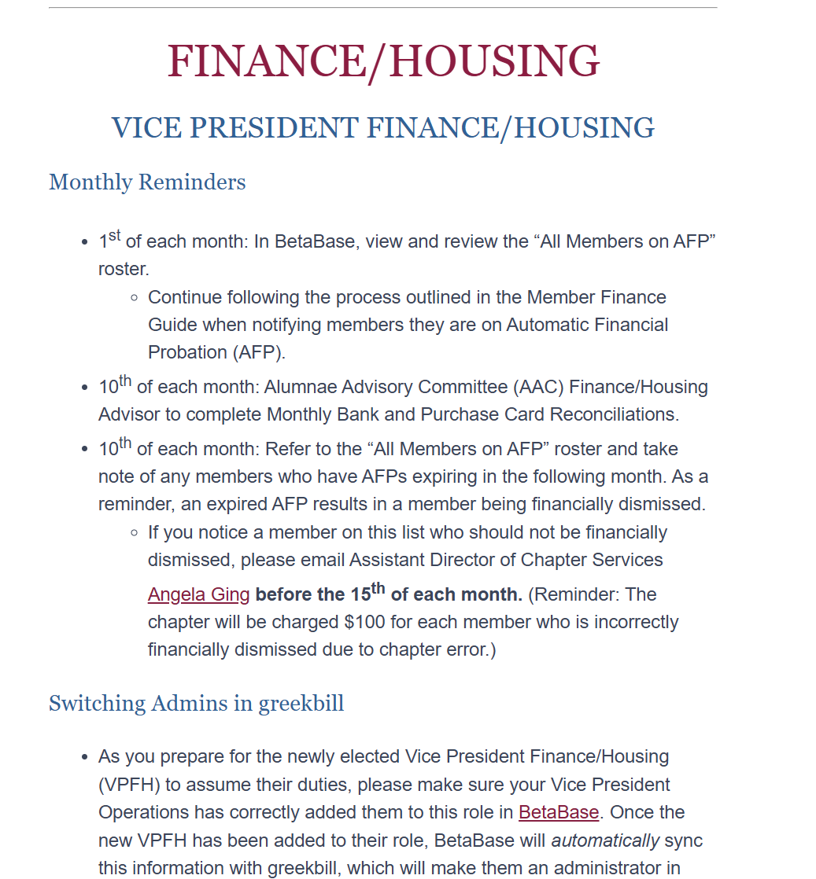
Wine & Silver Blue News

Slide 18
Let’s Practice!

Slide 19
Scenario #1
Your bank and purchase card reconciliations need to get done by the 10th of the month. It is now the 8th of the month and they have not been done yet. Who should you reach out to for support with this?

Slide 20
Scenario #2
The chapter would like the chefs to make special cookies for Bid Day. Who should your Director Housing reach out to for support for this request?

Slide 21
Scenario #3
Your chapter is getting ready to initiate your New Members on the 22nd of the month. Your Director Member Finances has added all of their New Member Dues and Fees to their accounts, but these charges will not show up on their accounts until the first day of the following month with the regular billing cycle. You need these charges pushed through sooner than that date so that your New Members can pay their Dues and Fees and be initiated on time. Who should you reach out to to get these charges pushed through and posted to their accounts sooner than the first day of the following month?

Slide 22
Scenario #4
You are an FHC chapter that does not have a House Director. The Live In members need some household items such as toilet paper and dish soap. Who should your Director Housing reach out to to get these supplies ordered for the chapter?

Slide 23
Scenario #5
After logging into greekbill, you notice a mysterious charge has been added to all of your members’ accounts. You know that you didn’t add the charge, and after checking with your DF and AAC F/H, you can confirm that they did not add the charge either. Who should you reach out to for support for this issue?

Slide 24
Scenario #6
A member has fallen on hard times and is requesting to be placed on a payment plan. Who should you reach out to to approve the payment plan?

Slide 25
VPFH Relationship with Other Chapter Leadership Team (CLT) Officers

Slide 26
Collaboration With Other CLT Members
Chapter President: She will be a co-signer on the checks, so she will rely on the VPFH to explain what she is signing.
VP Operations: Reviews and updates the House Rules annually in coordination with the Vice President Operations (VPO). You will also work with the VPO on Membership Status changes.
VP Community Relations: Works together on Philanthropy events and donations that are made from fundraising efforts.
VP Recruitment: Provide financial information that will need to be provided to Potential New Members (PNMs).

Slide 27
Helpful Budgeting Forms
Proposed Budget Request Form:
This form is used to determine any charges in officer budgets from year-to-year
Budget Acknowledgement Form
Each officer should have signed this form after the chapter’s final budget has been approved.
Officer Budget Tracking Form
An optional tracking system, if other tracking system is not already set in place by the chapter.

Slide 28
Relationship With DMF & DH

Slide 29
Questions?

Slide 30
Welcome Back!
Finance/Housing College

Slide 31
Automatic Financial Probation (AFP) + Automatic Financial Dismissal (AFD) Process

Slide 32
Automatic Financial Probation (AFP)
Members are automatically placed on AFP if their invoice is not paid within 31 days of the invoice date (except for members that are on a payment plan).
Once a member’s outstanding balance reaches $50, they are placed on AFP.

Slide 33
Automatic Financial Probation (AFP)
When a member is placed on AFP, the following consequences are put in place for them:
Loss of social privileges
No voice, no vote
Loss of officer position if applicable

Slide 34
Invoicing Timeline
August 1 – Member is invoiced
August 30 – Invoice is due
August 31 – Invoice is past due, member placed on AFP, Late Fee of $35 issued (for balances over $50)

Slide 35
Monthly Tasks
1st of each month: In BetaBase, view and review the “All Members on AFP” roster.
Continue following the process outlined in the Member Finance Guide when notifying members they are on Automatic Financial Probation (AFP).
10th of each month: Refer to the “All Members on AFP” roster and take note of any members who have AFPs expiring in the following month. As a reminder, an expired AFP results in a member being financially dismissed.
If you notice a member on this list who should not be financially dismissed, please email the Chapter Services Coordinator before the 15th of each month. (Reminder: the chapter will be charged $100 for each member who is incorrectly financially dismissed due to chapter error.)

Slide 36
Automatic Financial Dismissal (AFD)
After a member has been on AFP for six (6) months, they will be automatically dismissed from Pi Beta Phi.
This procedure happens automatically via BetaBase. Notice of AFD will be sent via email to the member on the 15th of the previous month before their dismissal.

Slide 37
Per the Constitution & Statutes
Section 20. Reinstatement. A member may be initiated into Pi Beta Phi Fraternity only one time. Resigned or dismissed initiated members may be considered for reinstatement:
A. Upon payment of any money owed chapter.
B. Upon payment of a reinstatement fee as determined by Grand Council. (Currently set at $340)
C. Upon completion of a waiting period as determined by Grand Council. (Currently 4 years after dismissal date)
D. Upon approval of the Grand Vice President Finance/Housing for those financially dismissed or a majority vote by ballot of Grand Council for all other reinstatements.

Slide 38
Budget Management

Slide 39
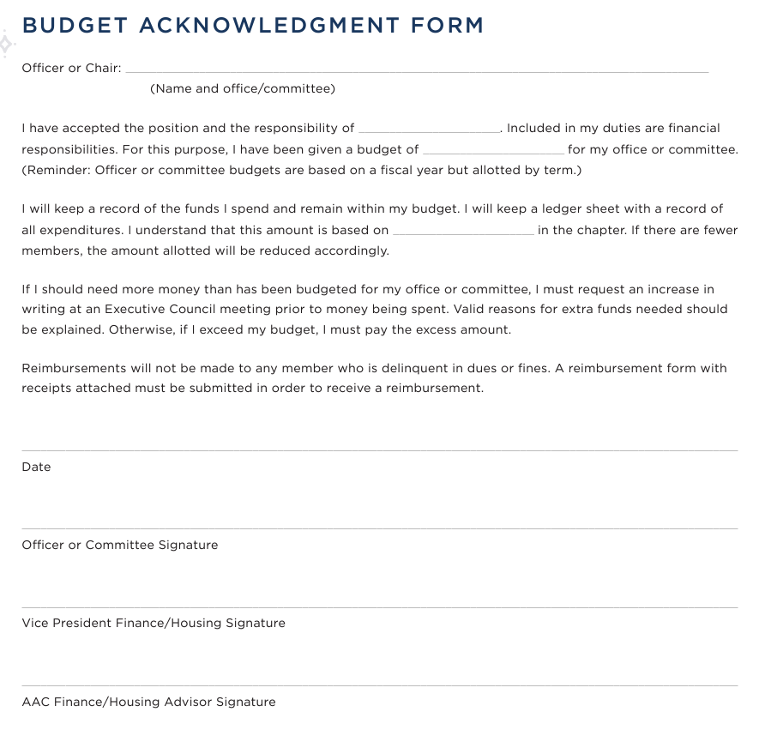
Budget Acknowledgement Form

Slide 40
Officer Budget Tracking Form

Slide 41
The Budget Cycle
Fall – budget template is distributed to chapters to complete
By November 1, send to FHS for review
After returned, will need to be presented to the chapter and then voted upon
It will go into effect on July 1

Slide 42
Chapter Fundraising

Slide 43
Fundraisers
Total Fundraising income
- Fundraising Expenses
_____________________________________
Charitable Contributions

Slide 44
Post-Fundraising Event Process
Within 10 days of a fundraising event, event information should be submitted to the Headquarters Finance and Foundation staff via the Foundation Giving Form, which can be found in BetaBase under Chapter Forms.
Staff members will review your GreekBill balances and information submitted in the Foundation Giving Form to.
Staff members will reach out to Community Relations and Finance/Housing Teams to:
Approve and accept the donation, or
Request additional information
For tax purposes, money raised is categorized by
Event
Member vs. Non-Member income
Cash vs. Non-Cash donations

Slide 45
Questions?

Slide 46
Monthly Chapter Evaluations (MCE)

Slide 47
Monthly Chapter Evaluations (MCE)
The purpose of the Monthly Chapter Evaluation (MCE) is to provide a clear roadmap outlining Pi Beta Phi’s expectations of collegiate chapters and to encourage meaningful reflection of chapter accomplishments on a regular basis.
The MCE is used to provide feedback on opportunities within the chapter and to determine which chapters will be recognized through Fraternity awards at the end of the calendar year.

Slide 48
Meeting Expectations Standards
Reviews officer budget to actuals for each term and works with officers who are close to or over their budget to ensure overspending does not happen.
Headquarters charges are accurately entered into greekbill monthly.
Submits required documents to Headquarters and/or the Regional Team by the set deadlines including chapter financial records and annual budget.
Chapter Budget Committee meets more than once to review the Budget to Actual Report and recommend adjustments as necessary.
Reviews members on AFP roster in BetaBase monthly and sends the notice of AFP to members via certified mail. The chapter facility is filled to capacity (for chapters with housing facilities)

Slide 49
Exceeding Expectations Standards
Presents a financial education program focused on topics outside the scope of Pi Beta Phi financial policies
Ensures consistent monthly communication or meetings are conducted with the Chapter House Corporation/Fraternity Housing Corporation

Slide 50
Tips & Reminders

Slide 51
Defining Your Housing Role

Slide 52
Job Responsibilities That Pertain to Housing
Collaborating with the Director Housing to be a liaison between the chapter and CHC/FHC, local employees such as your House Director and food service, and the University if applicable.
Assigning housing contracts, collecting the Member Housing Residency Request forms, forming the operational housing list, reviewing and updating the house rules and the monetary importance of filling the chapter facility.
Ensuring a safe and secure housing environment and educating and enforcing all Pi Phi and campus housing policies including emergency procedures.
ESA & Service Animal Requests.

Slide 53
CHC & FHC
Your Chapter House Corporation or Fraternity Housing Corporation (depending on your facility) is the housing corporation that operates your facility. Think of them as the landlords in a landlord/tenant relationship.
A Chapter House Corporation (CHC) is a group of volunteers that are alumnae of Pi Phi that volunteer their time to operate the facility.
The Fraternity Housing Corporation (FHC) is staff at Headquarters that do the same as CHC, but this is their day-to-day job.

Slide 54
When Should I Reach Out to My CHC or FHC Liaison?
Facility related issues that were reported a while ago to HD that go unresolved
House Director issues in general
Emergencies that happen at the facility
Relationship building- monthly meeting.
You’ll want to ensure you are scheduling monthly meetings with CHC/FHC
Budgeting- Chapter/CHC or FHC Agreement
Wish List items
Communicating Move in/out dates
CAPEX projects which are larger projects such as remodels or renovations
Planning for events at the facility
Ensure your CHC/FHC have a chapter calendar so they are aware of any events that are occurring at the facility.

Slide 55
Chapter Agreements

Slide 56
Chapter Agreements

Slide 57
House Fund Fee
The House Fund Fee is a one-time fee that is paid by each newly initiated member per the Constitution and Statutes. It is due to the CHC/FHC within 30 days after the New Member is initiated. The House Fund Fee is required by the Constitution & Statutes regardless of facility type.

Slide 58
Questions?

Slide 59
Working With Your House Director
At your table, come up with a few ideas of instances when you or your Director Housing would need to work with your House Director.

Slide 60
Working With Your House Director
Schedule weekly or bi-weekly meetings.
Facility related issues that require maintenance or repair
Email ASAP to ensure your HD is notified. Emailing is the best form so you can track the message and include others on it.
Food service issues.
Move in/out dates.
Emergencies that happen at the facility.
Planning for events at the facility.
Make sure HD has a chapter calendar, so they are aware of any events that are occurring at the facility.

Slide 61
Housing Contracts & Live In Requirement

Slide 62
Housing Resources
Housing Contract Guide
House Rules Template
Member Housing Residency Request Form
Point System Guide
Resident Room Agreement Form

Slide 63
Pi Beta Phi Live In Requirement
“Following university regulations, all collegiate initiated members of the chapter shall be required to live in the chapter facility or other quarters where chapter members are housed together, if space available, and pursuant to the terms of the housing contract, unless special permission to live elsewhere has been granted by the Alumnae Advisory Committee or the Regional Team."
(Pi Beta Phi Statutes, Article IX)

Slide 64
Key Housing Dates
By September 1 – VPFH & DH should explain the Member Housing Residency Request Form to all members and New Members.
By September 15 – The Member Housing Residency Request Forms (MHRRF) should be filled out and turned into the VPFH.
By September 30 – The Alumnae Advisory Committee (AAC) approves/denies live-in and live-out requests using completed MHRRFs.

Slide 65
Housing Contract Guidelines
Housing contracts are for the full school year. Half-year contracts are allowed by exception only through approval by the FHS.
Housing contracts are signed within greekbill.
Members who plan to study off campus or abroad for a portion of the school year may “share” contracts to ensure every bed is full throughout the school year. Each member involved must sign their own contract on greekbill.

Slide 66
Key Housing Dates
By September 1 – VPFH & DH should explain the Member Housing Residency Request Form to all members and New Members.
By September 15 – The MHRRF should be filled out and turned into the VPFH.
By September 30 – The AAC approves/denies live-in and live-out requests using completed MHRRFs.
By October 30 – The VPFH updates housing contracts in greekbill with chapter-specific information.
In November – Headquarters staff will review and approve the housing contract in greekbill.
By January 20 (for Fall Recruiting chapters) - All housing contracts for the following academic year must be signed in greekbill.
By April 20 (for Spring Recruiting chapters) – All housing contracts for the following academic year must be signed in greekbill.

Slide 67
Member Housing Residency Request Form (MHRRF)

Slide 68
Dispensations can be granted by AAC for the following circumstances:
Financial Dispensation
Member shows a dire need to cut expenses by moving home, etc.
Medical Dispensation
Member provides a note from a medical professional on official letterhead indicating that living in the house would be detrimental for the member’s health.
Emotional Support Animal needs

Slide 69
Housing List

Slide 70
Point System
GPA
Attendance
Office held/ committees chaired
Semesters/quarters lived in the house already

Slide 71
Operational Housing List

Slide 72
Operational Housing List
List all members from greatest number of points to least number of points.
Remove members from the list that have been granted dispensation to live-out of the house due to medical or financial reasons.
Match up any Fall study abroad and Spring study abroad members to create a shared full-year contract. If you are unable to match up a Fall study abroad member with a Spring study abroad member, these members will move to the bottom of the housing list as the chapter must prioritize filling full-year housing contracts over half-year contracts.
Document all members that have requested to live-in (leave blank for members that have expressed desire on the MHRRF to be released from their housing obligation).

Slide 73
Housing Contracts
Pi Beta Phi provides Housing Contract templates for chapters to utilize based on the specific house scenario that best fits each chapter (CHC/FHC owned facility, University owned facility.)
The contract that is appropriate for your facility will be uploaded by greekbill and available for you to fill out by August of each year.

Slide 74
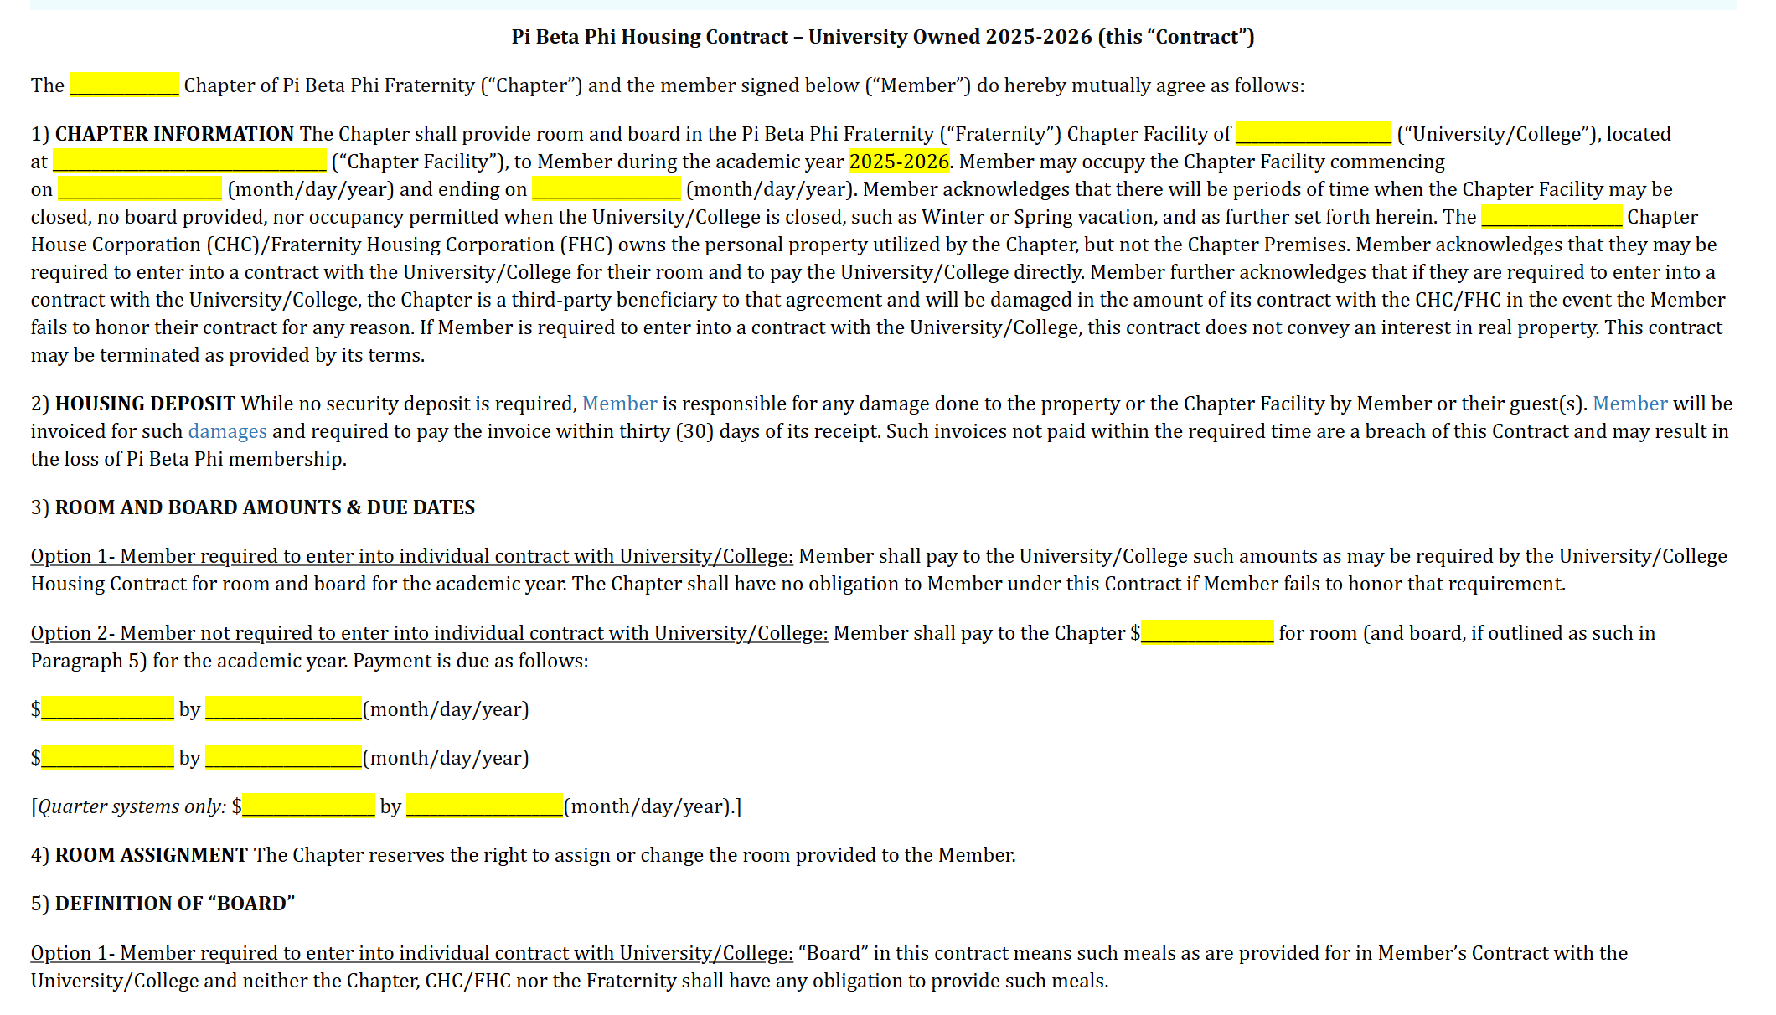
Housing Contract Template

Slide 75
The Monetary Impact of Filling the Chapter Facility

Slide 76
Room & Board
“Room” covers the cost of living in the facility.
“Board” covers the cost of food.
Charged in one fee in the Housing contract.

Slide 77
Member Obligations - Housing

Slide 78
Offering singles – charging more for this type of room
Increasing R&B – financial analysis, when was the last time we increased this? Are our #s comparable to others on campus?
Increasing the facility fee – financial analysis, when was the last time we increased this? Are our #s comparable to others on campus?
Getting to the route of the problem – why don’t members want to live in?
Discuss with your CHC/FHC - are there issues with the facility, bedrooms, etc.?

Slide 79
Connect with your AAC Counterpart and FHS on ways to control this issue. Set up a meeting – let's solve this issue now!

Slide 80
Questions?

Slide 81
Emergency Procedures & Safety

Slide 82
Top 5 Chapter Housing Related Emergencies
Fire
Water leak
Gas leak
Weather-Related Emergency
Intruder

Slide 83
Discuss each of these Chapter Housing Related Emergencies
What should you do first?
Who do you contact?
How do you resolve the issue?
What follow up is needed?
Fire
Water leak
Gas leak
Weather-Related Emergency
Intruder

Slide 84
How To Be Prepared for Facility Emergencies
Intruder in the facility – not propping doors. Do not let any vendors in that you do not recognize – ask them to wait outside and get your HD.
Candles- Doing room checks, holding members accountable if you see a candle in their room.
Standing water – make sure you know where the water main shut off valve is! Ask your HD!
Natural Disaster – Have a plan in place, emergency water/food/first aid. Know exactly what to do in each kind of emergency.
Gas – know who to call in a gas emergency! Know where the gas shut off is.

Slide 85
Questions?

Slide 86
ESA & Service Animal Requests

Slide 87
Service Animals : Any dog that is individually trained to do work or perform tasks for the benefit of an individual with a disability. Other species of animals, whether wild or domestic, trained or untrained, are not considered service animals. [ Definition taken from the American with Disability Act]
Emotional Support Animal (ESA): An animal that performs a service or alleviates one or more disability-related symptoms.

Slide 88
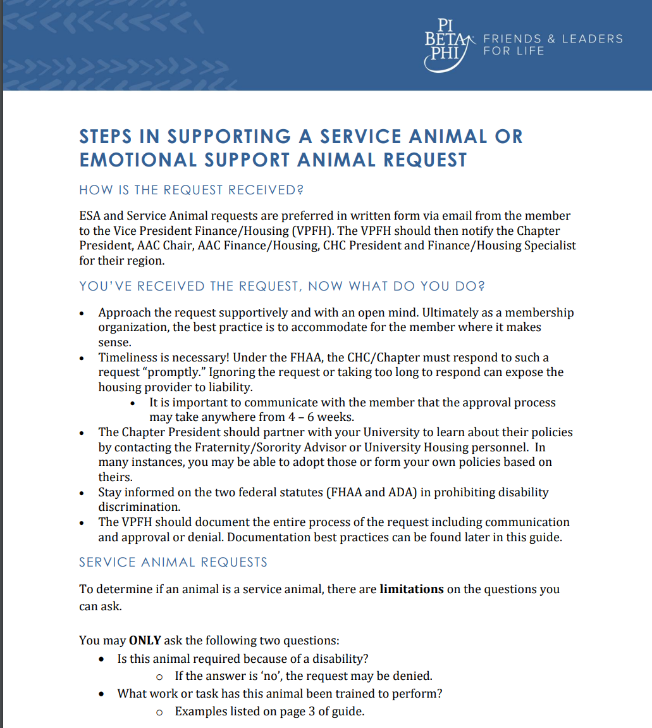
Service Animal Request Process

Slide 89
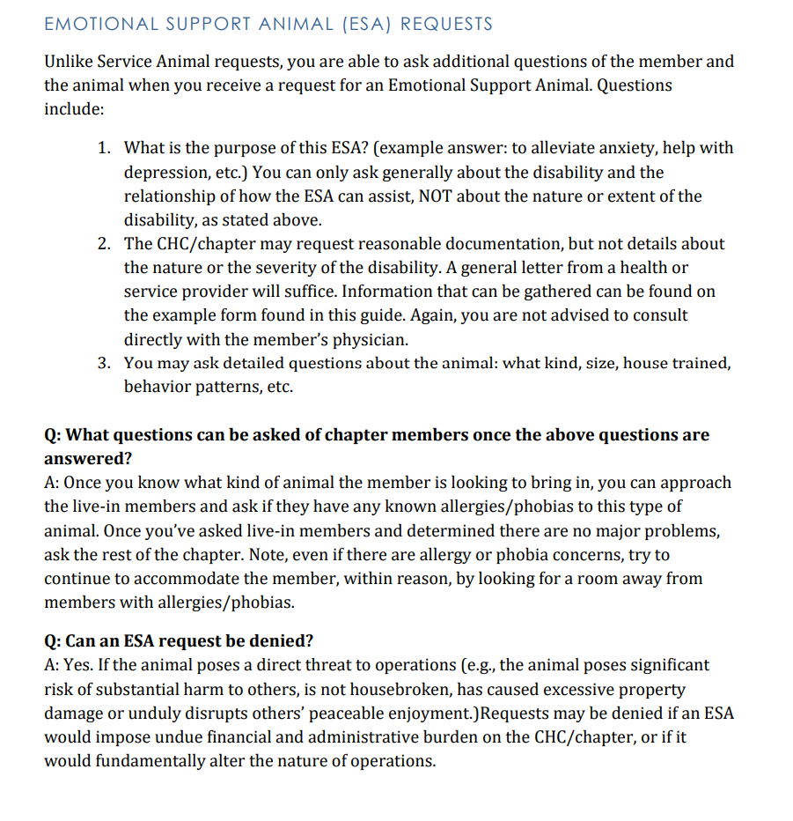
Emotional Support Animal Request Process

Slide 90
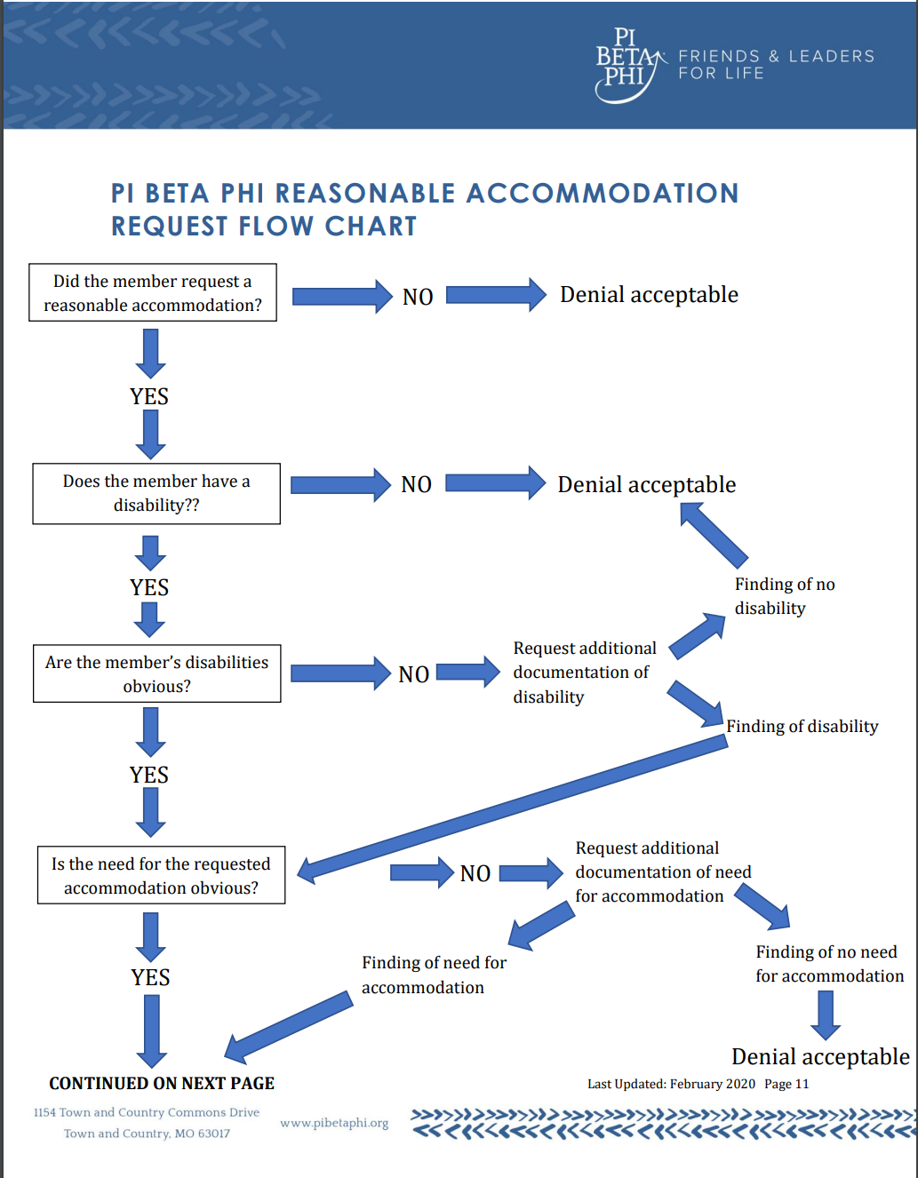
Emotional Support Animal Request Process

Slide 91
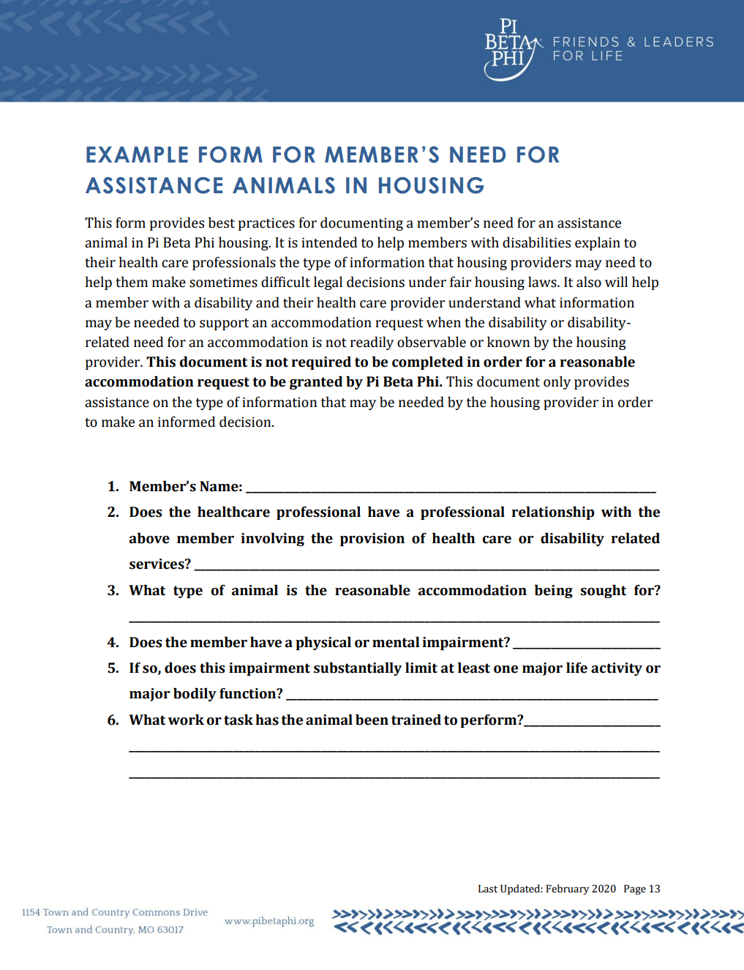

Slide 92
Key Take Aways
SA and ESA requests are VERY different. Make sure you follow the correct protocol for each.
Time is of the essence! Keep the process moving. It’s recommended that you give the member an answer within 2 weeks of the request (pending any additional information needed).
Do not ask any inappropriate questions! Make sure you are sticking to the questions in the guide.
You, AAC or CHC cannot reach out directly to the member’s doctor to request more information.
Do not share any medical information with other members or the chapter – you can let them know of the ESA/SA request and if it’s been approved or denied and what kind of animal and where it will be residing.
FHC is here to help! Don’t hesitate to reach out to your FHS and the ADH that supports your region.

Slide 93
Questions?

Slide 94
Wrap Up

Slide 95
Question 1
What is your full name? What does your name mean to you?

Slide 96
Question 2
Share with your partner a little bit about what family means to you? Who is in your family or who do you consider family?

Slide 97
Question 3
What is a time where you felt most confident in yourself? How can you translate that experience into your role as VPFH?

Slide 98
Question 4
What is one obstacle you think you might face in this role?

Slide 99
Question 5
What are you most looking forward to in this role?

Slide 100
Question 6
What is one thing from this weekend that you plan to take back to your chapter?

Slide 101
Question 7
What do you do to bring joy into your life?

Slide 102
Question 8
What do you feel you will uniquely bring to your role as VPFH?

Slide 104
THANK YOU!

Slide 110
Vice President Finance/Housing
Job Description

