Slide 1
Table Assignments
Chapter | Table
Alabama Beta | 13
Alabama Gamma | 12
Arizona Alpha | 13
Arizona Beta | 8
Arkansas Alpha | 13
California Beta | 7
California Delta | 6
California Epsilon | 12
California Eta | 6
California Kappa | 5
California Zeta | 10
Colorado Alpha | 13
Colorado Delta | 5
Connecticut Alpha | 7
D.C. Alpha | 4
Delaware Alpha | 8
Florida Alpha | 1
Florida Beta | 11
Florida Delta | 11
Chapter | Table
Florida Epsilon | 6
Georgia Alpha | 12
Idaho Alpha | 3
Illinois Alpha | 1
Illinois Eta | 1
Illinois Theta | 2
Illinois Zeta | 7
Indiana Alpha | 2
Indiana Beta | 8
Indiana Delta | 7
Indiana Epsilon | 3
Indiana Zeta | 1
Iowa Beta | 1
Iowa Gamma | 5
Iowa Zeta | 7
Kansas Alpha | 11
Kansas Beta | 6
Kentucky Alpha | 4
Kentucky Beta | 10
Chapter | Table
Louisiana Alpha | 9
Louisiana Beta | 12
Michigan Alpha | 3
Michigan Beta | 7
Michigan Gamma | 8
Minnesota Alpha | 4
Mississippi Alpha | 4
Mississippi Beta | 13
Mississippi Gamma | 10
Missouri Alpha | 12
Missouri Gamma | 2
Montana Alpha | 5
Nebraska Gamma | 5
New York Delta | 6
New York Eta | 5
North Carolina Alpha | 8
Ohio Alpha | 4
Ohio Beta | 8
Ohio Kappa | 3
Chapter | Table
Oklahoma Alpha | 9
Oklahoma Beta | 9
Oregon Alpha | 4
Pennsylvania Gamma | 3
South Carolina Alpha | 13
South Carolina Beta | 12
Tennessee Delta | 2
Tennessee Gamma | 9
Texas Alpha | 11
Texas Beta | 10
Texas Delta | 11
Texas Epsilon | 2
Texas Eta | 11
Texas Gamma | 9
Texas Zeta | 10
Utah Alpha | 10
Vermont Beta | 3
Virginia Zeta | 6
Wisconsin Epsilon | 1

Slide 2
Operations College
College Weekend 2025

Slide 3
Facilitators
Marie Westom
Oregon Gamma
Director Operations
do@pibetaphi.org
Julia Furtaw
Michigan Gamma
Region 2 Collegiate Regional Director
crd2@pibetaphi.org
Hannah Meador
Iowa Gamma
Headquarters Assistant Director of Chapter Services
hmeador@pibetaphi.org

Slide 4
Table Introductions
Name
Chapter and College/University
Favorite Pi Phi Memory

Slide 5
Learning Outcomes
Develop a deeper understanding of Pi Beta Phi reporting requirements and their impact on chapter operations
Support the Director Leadership through the steps of the elections process and promoting leadership development in the chapter
Conduct a collaborative bylaws and bylaws addendum review process including an equitable and inclusive points system
Identify and manage a variety of membership status changes
Define your role as the First Vice President

Slide 6
Agenda for the Weekend!
Friday | Saturday
Welcome/Overview First Vice President Duties | Administrative Responsibilities Membership Status Changes Bylaws and Bylaws Addendum Review Process BetaBase! Holding Effective Meetings Supporting the DL LNC & the Elections Process Operations Bingo Takeaways & Wrap-Up

Slide 7
Housekeeping Items
Use your workbook
Be engaged & ask questions
Microphone
Keep our space tidy
Take care of yourself
Question bowl

Slide 8
Activity: 10 Things
Grab a handout from the middle of your table!

Slide 9
Why did you join Pi Beta Phi? Why do you stay? Why did you say “yes” to Vice President Operations (VPO)?

Slide 10
First Vice President Duties

Slide 11
Duties
Presiding at Chapter meetings, Executive Council meetings or Chapter Leadership Team meetings
Presiding over ceremonies (Pledging, Initiation, etc.)​
Executing Emergency Procedures and contacting the Pi Beta Phi Emergency Hotline in the event of a chapter or member emergency

Slide 12
Documents to Review
The Pledging Ceremony and Initiation Ceremony booklets​
Memorized! ​
Meetings and Voting Guide​
Emergency Procedures

Slide 13
Emergency Procedures
Examples of emergency situations
Serious injury​
Drug or alcohol-related medical emergency​
Life-threatening medical hospitalization of a member​
Member death​
Campus lockdown​
Natural disaster​
Chapter-facility emergency ​
Water main break, fire, crime-related activity, etc.

Slide 14
Emergency Procedures
Roles in an emergency​
Chapter President (CP) assumes command in an emergency.​
Be prepared in case the CP is unavailable or unable to lead.​
Alumnae Advisory Committee (AAC) Chair will assist the Chapter President.​
Be prepared with your AAC Chair’s phone number programmed in your phone.​
Chapter members must follow the CP’s instructions and cooperate fully. ​
Chapter President becomes the spokesperson if necessary. The AAC Chair can serve as back-up.​
Consult AAC, Fraternity officers and Headquarters staff before releasing any information.

Slide 15
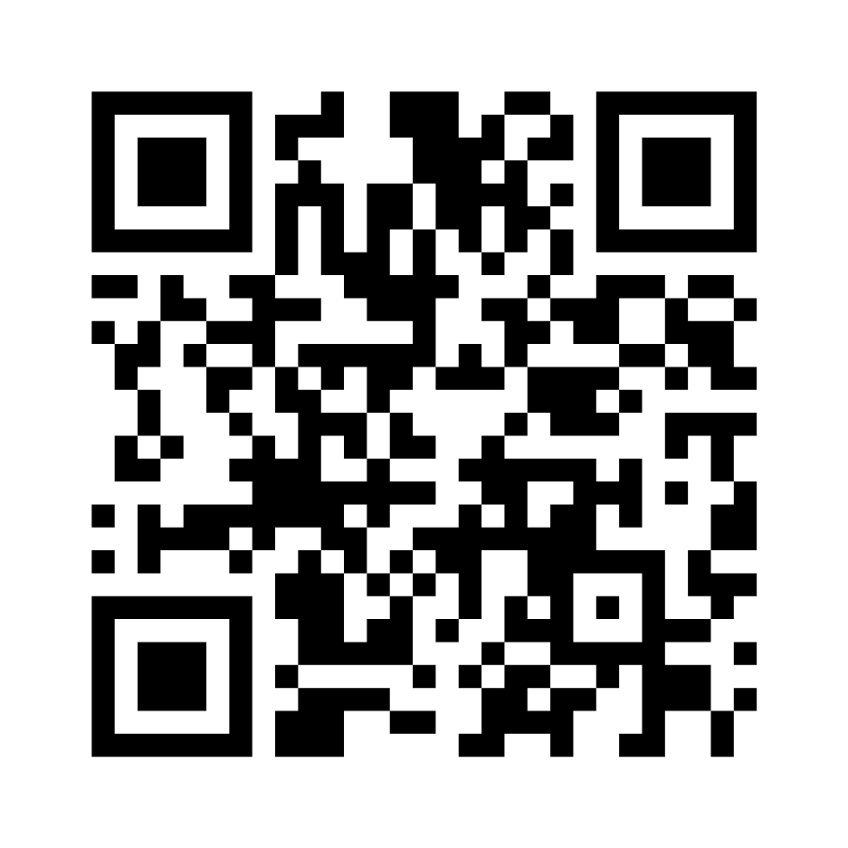
Menti Time!

Slide 16
Emergency Procedures
Order of Calls​
Emergency Services as appropriate—Police, Fire Department, etc. ​
Do NOT contact parents!​
AAC Chair, or another AAC member.​
Phone call or message to college/university staff member responsible for Fraternity/Sorority Life (if applicable).​
Pi Beta Phi Emergency Hotline: (636) 236-9463

Slide 17
Day 1: DONE!

Slide 18
Welcome to Day 2!
The Core of Vice President Operations!

Slide 19
Recap: Administrative Responsibilities
Keeping track of the chapter’s point system​
Tracking attendance and member excuses for events​
Assisting the CP in preparing agendas for meetings​
Enforcing Parliamentary Procedure during meetings​
Acting as Recording Secretary by recording meeting minutes​
Counting votes during meetings​
Acting as Corresponding Secretary by organizing communication​
Coordinating the annual signing of the Member Obligations

Slide 20
Point Systems

Slide 21
Point Systems
Collaborate with Exec and the Chapter Leadership Team (CLT) to list all activities.
Estimate time commitment required for each activity and prioritize them by level of importance.
Add up all possible points for the semester and decide on a reasonable level of participation for the average chapter member.
Explain new point system clearly to chapter members at first chapter meetings of the semester or the term.
Update the chapter’s bylaws addendum with updated point system.

Slide 22
What are some methods your chapters use to keep track of points?

Slide 23
Point Systems
See examples on pages 44-49 of your workbook
Check out the Point Systems Guide in the Resource Library
Ask your Operations Specialist!
Take note of key resources on Page 50 of your workbook!

Slide 24
Attendance and Excuses
Tracking member attendance is important to notice trends of member involvement​.
Clearly communicate the process for submitting excuses at the beginning of the term.​
Become familiar with your chapter’s bylaws and what is considered a valid excuse for missing events.​
Be consistent with what is outlined in the bylaws and across all members.

Slide 25
Attendance and Excuses
If your chapter uses fines…​
You are responsible for communicating with the Vice President Finance/Housing (VPFH) so they can invoice the members appropriately.​
You should only be fining for missing mandatory events as outlined in the bylaws​.
Check in with your Exec to see if this is still a good fit.

Slide 26
Corresponding Secretary
As VPO, you should ensure transparent communication between chapter leadership and members.​
Consider the best method—email, weekly newsletter, Facebook group, etc.​
Ask your members what they prefer!

Slide 27
Member Obligations
You will coordinate the annual signing of the Member Obligations with all chapter members.
Track completion in BetaBase.
Provide frequent reminders to members.
Direct technical questions to betabase@pibetaphi.org.

Slide 28
True or False
It’s okay to subtract points as a consequence as long as we don’t fine members too.

Slide 29
True or False
It’s okay to subtract points as a consequence as long as we don’t fine members too.

Slide 30
True or False
Valid excuses must be outlined in the chapter bylaws.

Slide 31
True or False
Valid excuses must be outlined in the chapter bylaws.

Slide 32
True or False
New Members should not sign their Member Obligations until they’re initiated.

Slide 33
True or False
New Members should not sign their Member Obligations until they’re initiated.

Slide 34
Membership Status Changes

Slide 35
Chapter Rosters
Maintained in three places
BetaBase
Greekbill
Collaborate with VPFH and/or Director Member Finance (DMF)!
College/University

Slide 36
Question 1: All Pi Beta Phi members in good standing fall into one of three categories:
New Members, initiated members and alumnae
Pledges, initiated members and alumnae
New Members, active members and alumnae
New Members, active members and alumni

Slide 37
Question 1: All Pi Beta Phi members in good standing fall into one of three categories:
New Members, initiated members and alumnae
Pledges, initiated members and alumnae
New Members, active members and alumnae
New Members, active members and alumni

Slide 38
Question 2: When a Potential New Member accepts their bid and is pledged into Pi Phi, they become a New Member. A New Member:
Can become an initiated member of Pi Phi through the Initiation Ceremony
Can become a Continuing New Member when Exec and AAC vote to not initiate and hold the New Member over due to not meeting initiation requirements.
Can break their own pledge by providing written notice to the Chapter Leadership
Can be voted upon by the chapter to break the New Member’s pledge.
All of the above.

Slide 39
Question 2: When a Potential New Member accepts their bid and is pledged into Pi Phi, they become a New Member. A New Member:
Can become an initiated member of Pi Phi through the Initiation Ceremony
Can become a Continuing New Member when Exec and AAC vote to not initiate and hold the New Member over due to not meeting initiation requirements.
Can break their own pledge by providing written notice to the Chapter Leadership
Can be voted upon by the chapter to break the New Member’s pledge.
All of the above.

Slide 40
Membership Status Changes
When a member…​
Leaves the college/university​
Returns to the college/university​
Graduates​
Stays for a fifth year​
Studies abroad ​
Transfers colleges/universities​
Resigns​
Does not uphold their financial obligation​
Is dismissed​
Applies for Undergraduate Alumna Status (UAS)

Slide 41
Question 3: Which outcome for a member who is leaving the college or university is TRUE.
Member is financially current and does not have a current housing contract > marked as “Alumna” in BetaBase > alumna in bad standing.
Member is not financially current and owes money > marked as “Resigned” in BetaBase > no longer a member of Pi Phi.
Member is not financially current > marked as an “Alumna” in BetaBase > alumna in bad standing.
Member has a signed housing contract > marked as “Alumna” in BetaBase > alumna in good standing

Slide 42
Question 3: Which outcome for a member who is leaving the college or university is TRUE.
Member is financially current and does not have a current housing contract > marked as “Alumna” in BetaBase > alumna in bad standing.
Member is not financially current and owes money > marked as “Resigned” in BetaBase > no longer a member of Pi Phi.
Member is not financially current > marked as an “Alumna” in BetaBase > alumna in bad standing.
Member has a signed housing contract > marked as “Alumna” in BetaBase > alumna in good standing

Slide 43
Leaves the university/college
Member is placed on Automatic Financial Probation (AFP), and the VPO marks them as “No Longer Enrolled.” AFP process takes its course and the member could eventually be Financially Dismissed from the Fraternity.
Owes $ for any reason including housing contract
Member wants to leave or does not come back to campus for ANY reason
No longer a member of Pi Beta Phi
Collegiate Initiated Member
Financially current, no housing contract issues
VPO marks them as “No Longer Enrolled” in BetaBase, automatically an alumna.
Alumna Member
Notes:
Emilia

Slide 44
Question 4: True or False. A member must express in writing to the Grand Vice President Collegians to return to the chapter after returning to the college/university.
True
False

Slide 45
Question 4: True or False. A member must express in writing to the Grand Vice President Collegians to return to the chapter after returning to the college/university.
True
False

Slide 46
Returning from withdrawal or leave of absence
After a leave of absence, member returns to the college/university at which they were initiated or affiliated and may apply to return as an active, undergraduate member.
Does not wish to apply to return to the chapter.
Alumna Member
Alumna Member
AAC approves their return.
Collegiate Initiated Member
Applies in writing to the AAC to return to the chapter.
AAC does not approve their return.
Alumna Member
Notes:
Emilia
Thoughts: AAC needs to approve the return

Slide 47
When a Member Graduates!
Chapter marks member “Graduate” in BetaBase (after selecting “No Longer Enrolled”), they are billed for her alumna dues
Graduates at any time!
Collegiate Initiated Member
Alumna Member

Slide 48
Question 5: What is the option for a member who does not graduate in 4 years & must complete a 5th year in order to earn their degree.
They remain an undergraduate member after informing the Director Lifelong Membership
They become an alumna and be automatically granted 5th Year Undergraduate Alumnae Status
They remain an undergraduate member after informing the VPO.
A & B
B & C

Slide 49
Question 5: What is the option for a member who does not graduate in 4 years & must complete a 5th year in order to earn their degree.
They remain an undergraduate member after informing the Director Lifelong Membership
They become an alumna and be automatically granted 5th Year Undergraduate Alumnae Status
They remain an undergraduate member after informing the VPO.
A & B
B & C

Slide 50
5th Year Undergraduate Alumnae Status
Chapter marks member “Graduate” in BetaBase, they are billed for her alumna dues
Graduates at any time!
Alumna Member
Collegiate Initiated Member
Can remain undergraduate member after providing information in writing to VPO
Collegiate Initiated Member
Does not graduate in 4 years and will be on campus for another term or entire 5th year to complete their degree
Automatically a 5th Year UAS and becomes alumna member. Chapter marks member “5th Year UAS” in BetaBase and is billed for their alumna dues
Alumna Member
Notes:
Angela

Slide 51
Question 6: A member decides to study abroad for the semester or term. How would you mark them in BetaBase?
If the member studying abroad as part of a campus program is still enrolled as a student at your university or college, you would mark them as “Studying Abroad.”
If the member is studying abroad through a program that is not affiliated with your college or university and is not enrolled as a student at the institution should be marked as an “Alumna.”
If the member studying abroad as a part of a campus program is still enrolled as a student at the college or university, there is no action for you in BetaBase.
B&C
A&B

Slide 52
Question 6: A member decides to study abroad for the semester or term. How would you mark them in BetaBase?
If the member studying abroad as part of a campus program is still enrolled as a student at your university or college, you would mark them as “Studying Abroad.”
If the member is studying abroad through a program that is not affiliated with your college or university and is not enrolled as a student at the institution should be marked as an “Alumna.”
If the member studying abroad as a part of a campus program is still enrolled as a student at the college or university, there is no action for you in BetaBase.
B&C
A&B

Slide 53
Transfers to a campus without a Pi Phi chapter
Chapter VPO marks her as “No Longer Enrolled” in BetaBase, automatically is an alumna
Transfers to another campus with no Pi Phi chapter (does not owe any $)
Collegiate Initiated Member
Alumna Member
Transfers to another campus with no Pi Phi chapter (does owe $)
Mark member as “No Longer Enrolled” in BetaBase. AFP process will take its course, and they will eventually be financially dismissed from the Fraternity.
No longer a member of Pi Beta Phi
Notes:
Emilia

Slide 54
Transfers to a campus with a Pi Phi chapter
They do not have to affiliate, remains an Alumna.
VPO marks them as “No Longer Enrolled” in BetaBase
Transfers to another campus with a Pi Phi chapter (does not owe any $)
Automatically is an Alumna upon leaving campus
Collegiate Initiated Member
Seeks affiliation
Votes yes, Affiliation ceremony
Collegiate Member
Transfers to another campus with a Pi Phi chapter (does owe $)
Must meet chapter’s requirements for affiliation
Permission from original chapter, Notice of Transfer and Affiliation Form, chapter vote
Votes no, CP reaches out and encourages her to take advantage of alumnae opportunities, connects them with local alumnae
Mark member as “No Longer Enrolled” in BetaBase. AFP process will take its course and they will eventually be financially dismissed from the Fraternity
Alumna Member
No longer a member of Pi Beta Phi
Notes:
Emilia
*Cannot be marked as an affiliate on eReports until previous chapter marks her as NLE

Slide 55
Question 7: Why would a member who wants to resign not be eligible for resignation?
The member is not financially current (owes money to the chapter)
The member has a signed housing contract
The member is on General Probation
All of the above
A&B

Slide 56
Question 7: Why would a member who wants to resign not be eligible for resignation?
The member is not financially current (owes money to the chapter)
The member has a signed housing contract
The member is on General Probation
All of the above
A&B

Slide 57
Question 8: How many days do members have to request resignation before they will be held financially to the dues and fees for that academic term?
10 days
14 days
7 days
21 days

Slide 58
Question 8: How many days do members have to request resignation before they will be held financially to the dues and fees for that academic term?
10 days
14 days
7 days
21 days

Slide 59
Question 9: What are the options for a member who does not uphold their financial obligations?
A member with an outstanding invoice of at least $50 will be placed on Automatic Financial Probation (AFP).
A member pays their outstanding balance and is back in good standing.
The member will be Automatically Financially Dismissed (AFD) after being on AFP for 6 months.
The member can opt for Immediate Financial Dismissal (IFD).
All of the above.

Slide 60
Question 9: What are the options for a member who does not uphold their financial obligations?
A member with an outstanding invoice of at least $50 will be placed on Automatic Financial Probation (AFP).
A member pays their outstanding balance and is back in good standing.
The member will be Automatically Financially Dismissed (AFD) after being on AFP for 6 months.
The member can opt for Immediate Financial Dismissal (IFD).
All of the above.

Slide 61
Pays balance owed
Collegiate Initiated Member
Automatic Financial Probation begins on day 30 unpaid, process is in effect.
Financially dismissed from the Fraternity after 6 months
Does not pay bills owed to chapter
Collections
Collegiate Initiated Member
Member chooses Immediate Financial Dismissal
Discontinues any further invoicing by the chapter or Fraternity but will not eliminate unpaid balances
No longer a member of Pi Beta Phi
Notes:
Emilia
Thoughts: If sent to collections, still responsible for 10% and 50%. Cannot have a HC to go IFD
Pre-Collections – May begin after 61 days

Slide 62
Question 10: What must take place in order for a member to be dismissed?
A unanimous chapter vote is held and then approved by the Grand President.
A majority chapter vote and then approved by the Grand President.
A majority chapter vote and then approved by the Grand Vice President Collegians.
A unanimous chapter vote and then the Grand Vice President Collegians approves.

Slide 63
Question 10: What must take place in order for a member to be dismissed?
A unanimous chapter vote is held and then approved by the Grand President.
A majority chapter vote and then approved by the Grand President.
A majority chapter vote and then approved by the Grand Vice President Collegians.
A unanimous chapter vote and then the Grand Vice President Collegians approves.

Slide 64
Dismissal
Reinstatement for resignation or any kind of dismissal is only possible through application to Grand Council after a waiting period of at least 4 years after graduation.
Chapter votes to dismiss from Fraternity for acts not aligned with Pi Beta Phi, GVPC approves
Chapter submits Dismissal Form
Collegiate Initiated Member
No longer a member of Pi Beta Phi
Notes:
Emilia

Slide 65
Undergraduate Alumnae Status

Slide 66
Question 9: Which of the following is not a qualifying reason for UAS?
Ill physically and/or due to their mental health as certified by a physician (doctor’s note)
Documented extreme or unforeseen financial stress
Academic requirements such as not meeting a university policy regarding minimum credit hours to remain in a student organization
Applying to graduate school

Slide 67
Question 9: Which of the following is not a qualifying reason for UAS?
Ill physically and/or due to their mental health as certified by a physician (doctor’s note)
Documented extreme or unforeseen financial stress
Academic requirements such as not meeting a university policy regarding minimum credit hours to remain in a student organization
Applying to graduate school

Slide 68
Undergraduate Alumnae Status
Approved Reasons
Ill physical/mental health as certified by a physician (doctor’s note)
Documented extreme or unforeseen financial stress
Academic Requirements
Provide proof of college/university academic policy requiring a minimum amount of credit hours to be involved in a student organization
Affiliation Concerns
Student Teaching/Internship
Distance of internship/school must be greater than 50 miles or 1 hour from campus
Other reasoning approved by AAC, Operations Specialist and Headquarters

Slide 69
Undergraduate Alumnae Status
Denied Reasons
Heavy course load
“Advanced” programs on campus
Applying to graduate school (if a member is considered a graduate student and not undergraduate, they would not qualify for UAS and would be marked as “graduated” upon entering the program)
A change in priorities is not a reason for UAS to be granted

Slide 70
Undergraduate Alumna Status Process
Ill health as certified by a physician
Extreme or unforeseen financial stress
Academic requirements, e.g. student teaching, internship for credit, not enough credit hours
Affiliate member
Other reason approved by Headquarters
VPFH/DMF and AAC review the application
Can apply for Undergraduate Alumna Status one term in advance of when it will take effect. UAS application is submitted on BetaBase and alumna dues are paid.
Alumna Member
Collegiate Initiated Member
Headquarters approval
Headquarters reviews application
Headquarters denial
Collegiate Initiated Member
Notes:
Emilia
Note: When denial is issued, there may be an opportunity to resubmit (i.e., may have been denied b/c more info is needed or due to an admin issue)
**AAC Operations oversees this process now instead of Chair
Reminder: This Membership Status Guide Visual is also in the RL!!!

Slide 71
Membership Status Changes Scenarios
A member took a medical leave from the college/university last year but is now back on campus. Tables 1 & 2 What is her current status, and what are her options? ​
A member has been non-responsive to communication and the VPO finally gets in contact with her. She discloses that she's been struggling with mental health and does not want to pay her dues for the previous semester. ​Tables 3-5 What should the chapter do? ​
A member wants to resign and submits her resignation paperwork, but she is on AFP. Tables 6-8 What can she do? ​
A New Member cannot pay her New Member dues prior to 7 days of Initiation. ​Tables 9-11 What are her options? ​
Member is about to graduate in May, and that will be her 3rd month ​of AFP. ​Tables 12 & 13 What happens?

Slide 72
Questions?

Slide 74
Chapter Bylaws
Bylaws & Bylaws Addendum

Slide 75
Constitution and Statutes
Policy and Position Statements
Member Conduct, Alcohol and Drugs, Non-Discrimination, Anti-Hazing, Chapter Facility Safety and Visitation, Alumnae and Parent Involvement in Recruitment, and Parents’ Clubs.
Member Obligations and Other Governing Documents
Chapter Bylaws
and Addendum

Slide 76
Bylaws Addendum
Internal, private sections that should not be contained in the chapter bylaws​
Membership selection procedures​
Financial information​
Member accountability procedures (fines and consequences)​
If bylaws are requested for review, the bylaws addendum should not be submitted.​

Slide 77
Bylaws Review Process

Slide 78
Bylaws Review Process
Locate the most up-to-date version of the bylaws that has been approved.​
Make proposed changes using the “track changes” feature in Microsoft Word. ​
Note: You will eventually input the proposed changes into the fillable template.​
Review proposed changes with AAC/Exec.​
Insert proposed changes into the fillable template for Regional Team review.​
The Regional Team will review and approve/deny proposed changes.

Slide 79
Bylaws Review Process
6. Approved changes should be presented to the chapter at a chapter meeting.
7. At the following chapter meeting, the chapter may vote on these changes.
8. The final copy with chapter-approved changes should be sent to the Regional Team within one month of original deadline.
9. Upload the final approved copy into BetaBase, without tracked changes or visible edits.
10. Let your Operations Specialist know if a change was not approved by the chapter. Ensure the final copy does not include a change that was not approved.​
11. Send a PDF copy of the bylaws and addendum via email to all initiated members. Post a hard copy in a private chapter space. Remind members this document is internal and cannot be shared!

Slide 80
How to Make the Process Collaborative
At the beginning of the process, let Executive Council know to begin thinking of potential changes within their Specialty Teams.​
At the next Chapter Leadership Team meeting, initiate a discussion about potential bylaws changes.​
Collaborate with the Inclusion Team to consider the equity and inclusiveness of the current bylaws as well as proposed changes.​
Connect with the Member Conduct Committee to gain insight about behavior trends in the chapter.​
Hold office hours to allow other members to propose changes or learn more about the process.​

Slide 81
Best Practices
Utilize your AAC Operations Advisor and your regional Operations Specialist if you have questions during the process.​
Review the Bylaws Guide in the Resource Library prior to beginning the process.​
Start the process early and allow time for each step to be completed. ​
Don’t wait for the annual review! Propose changes throughout the year, as necessary. ​

Slide 82
Automatic Consequences
An automatic consequence allows the Member Conduct Committee to meet with the member to…​
Discuss their behavior​
Remind them of Pi Phi’s expectations​
Inform and explain the automatic consequence

Slide 83
Questions?

Slide 84
BetaBase!

Slide 86
Holding Effective Meetings

Slide 87
What is the purpose of Pi Phi meetings? What are the benefits?

Slide 88
Frequency of Meetings
Weekly
Chapter Meetings
Executive Council Meetings (CP + VPs)
Specialty Team Meetings (VP + Directors)
Monthly
AAC/Executive Council Meetings (AAC + CP + VPs)
Chapter Leadership Team Meetings (CP + VPs + Directors)
When Necessary
All-House or Joint Meetings (Initiated + New Members)
Committee Meetings

Slide 89
Chapter Meetings
Chapter President presides at each meeting
Must use Parliamentary Procedure and follow the correct order of business
With your tablemates, see if you can list the correct order of business that should happen at every chapter meeting using the sheet on your table.
Hint: you will see there are some points of the list already included!

Slide 90
Chapter Meetings Order of Business
Call to order
Opening Ritual
Roll call (unless attendance was taken as members entered the room)
Reading and adoption of minutes of previous meeting
Reading from the Pi Beta Phi Constitution and Statutes, Chapter Bylaws and/or Policy and Position Statements
Reports of officers and committees
Unfinished business from the previous meeting
Presentation of names for Membership (if applicable for COB)
Balloting on election to Membership (if applicable for COB)
New Business
Election of Officers (if applicable)
Installation of Officers (if applicable)
Closing Ritual
Adjournment

Slide 91
What makes a chapter meeting effective?

Slide 92
Effective Meetings
Holding chapter meetings in a comfortable, businesslike environment
Presenting an agenda and following it
Keeping chapter meetings within 45 minutes to 1 hour
Enforcing parliamentary procedure and limiting lengthy discussions
Providing fun surprises for members – giving out prizes, etc.
Limiting the use of cell phones

Slide 93
Executive Council Meetings
Held weekly
Should include an agenda
Attended by the Chapter President and seven Vice Presidents
Other officers may be invited to the beginning or end of the meeting for a special purpose

Slide 94
Executive Council Meetings
Best practices include…​
Holding meetings in a private location in the chapter facility or on campus​
Ensuring all Vice Presidents meet with their Specialty Team Directors before the meeting​
Setting an agenda ahead of time and staying on track​
Tabling discussions that are lengthy and need to be re-visited at a later meeting​
Scheduling meetings to maximize attendance of all Exec members​
Sending the agenda out to attendees prior to the meeting

Slide 95
Specialty Team Meetings
Upcoming deadlines and events in the next 2–3 weeks​
Reports for the next chapter meeting​
Information to be discussed by Executive Council​
Goals for the week​
Progress on the goals from last week​
Recent challenges and wins​
Questions the Director has

Slide 96
What makes a specialty meeting effective?

Slide 97
Effective Meetings
Good notetaking
Active listening
Creating an agenda in advance
Recording action items
Providing feedback
Brainstorming and discussing ideas together

Slide 98
AAC/Exec Meetings
Awards nominations​
Appointment of officers​
Approval of the slate of officers​
Dispensation requests​
Membership issues and Member Accountability votes​
Voting on eligibility of New Members for Initiation​
Specialty Team reports from Vice Presidents​
Monthly Chapter Evaluation progress and goals​
University/Panhellenic agreements or relationship issues​
Housing issues, House Director Selection

Slide 99
Chapter Leadership Team Meetings
Held monthly for the entire Chapter Leadership Team (CP + VPs + Directors)​
Agenda items:​
Upcoming chapter activities​
Upcoming deadlines​
Areas of improvement​
Progress on team goals​
Confidential chapter business should not be discussed

Slide 100
What meetings do you want to focus on improving within your chapter?

Slide 101
Parliamentary Procedure

Slide 102
Motions
Making a motion
Amending a motion
Reconsidering a vote
Adjourning a chapter meeting
And more!

Slide 103
Handling a Motion
Making the motion
Seconding the motion
Stating the motion
Debating the question
Putting the question
Announcing the results of the vote

Slide 104
Meeting Minutes

Slide 105
Reviewing Meeting Minutes
January 20, 2025
Chapter President called the meeting to order.
Reports of officers and committees were given:
VPO, VPME and DSE had no reports.
VPR reminded everyone of the upcoming recruitment workshop.
VPFH gave the financial report. Provided a reminder to pay dues.
Panhellenic Delegate reminder chapter about recruitment counselor applications for upcoming recruitment.
There was no unfinished business.
New Business: A 2022 initiated member moved that the chapter send a donation of $2000 to the Foundation. The motion passed.
Chapter President adjourned the meeting.

Slide 106
Reviewing Meeting Minutes
Turn to Page 62 of your workbook

Slide 107
Meeting Minutes
Take full and accurate notes during meetings.​
Type minutes and place a hard copy in the appropriate meeting minutes binder.​
Minutes for different types of meetings should be stored separately.​
Write minutes in the third person, using full names. ​
Include the names of persons making motions but not seconding.​
Enter corrections into the left-hand margin, if applicable.​
Minutes should not reflect the VPO’s opinion.​
Minutes should be kept concise and brief—keep to the facts.

Slide 108
Meeting Minutes
Minutes should not be posted in public.​
Minutes should be placed in a private area of the chapter facility or the VPO’s room to sign. ​
For chapters without a facility, you may need to bring the meeting minutes binder to chapter meetings each week or hold office hours on campus to allow members to review the minutes.​
Completed minutes should never be emailed in their entirety to chapter members.

Slide 109
Supporting the Director Leadership

Slide 110
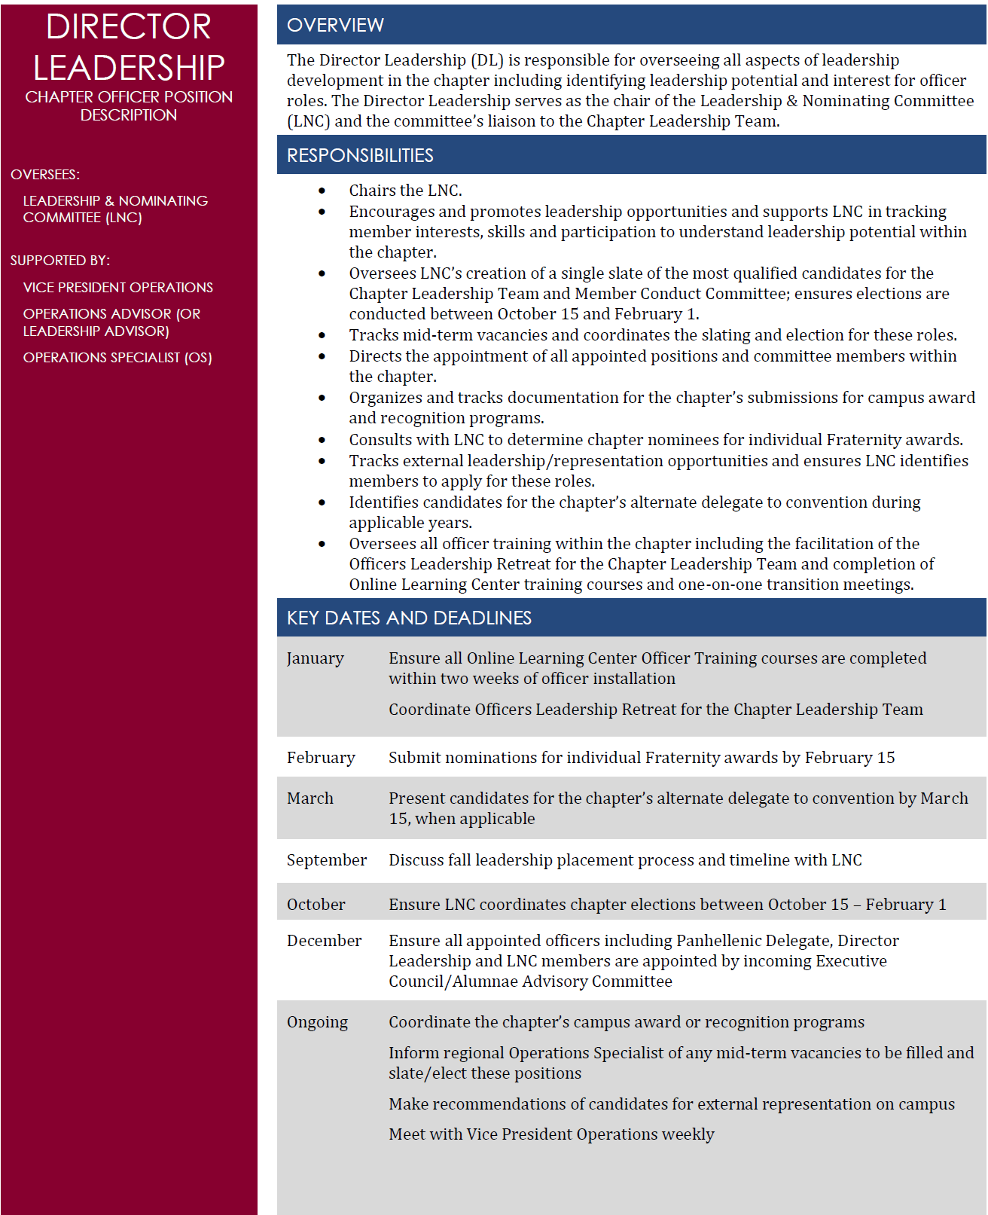

Slide 111
What could you discuss with the Director Leadership during your weekly meetings?

Slide 112
Officer Training
Fraternity Overview Course | Effective Leadership Strategies | Position-Specific Course
For all officers Covers an overview of the Fraternity | For Executive Council (CP + VPs) Covers expectations, servant leadership, delegation, facilitation, tips to reduce stress | For all officers (assigned based on position) Covers position-related responsibilities and procedures

Slide 113
Officers Leadership Retreat
For Executive Council and the Chapter Leadership Team​
It’s important to appoint a Director Leadership quickly after elections; they will need time to prepare to lead the retreat​
CP, Director Leadership and AAC facilitate activities​
Goal setting​
Calendar planning​
And more!

Slide 114
Best Practices
Touching base weekly
Reporting to Exec on what the Director Leadership & Leadership Nominating Committee (LNC) are working on
Giving timely praise and feedback
Ensuring LNC is always planning ahead
Bringing suggestions and ideas to the table

Slide 115
Leadership and Nominating Committee

Slide 116
How is Leadership Nominating Committee (LNC) Selected?
Selected and appointed by Executive Council and AAC​
The “Ideal LNC member”​
Members can submit names of good candidates for LNC to Exec/AAC​
Members currently serving on the Chapter Leadership Team or planning to pursue a position should not serve on LNC​
Composition of the committee is designated in your chapter’s bylaws​
The names of LNC members should be announced to the chapter once they accept their appointment

Slide 117
Key Responsibilities
More than just elections?
LNC keeps track of member interests, skills, activities and campus involvement.
Why is this beneficial?

Slide 118
Key Responsibilities
LNC keeps track of external leadership and representation opportunities on campus and encourages members to apply.

Slide 119
Key Responsibilities
LNC determines chapter nominations for individual Fraternity awards.
Due February 15!

Slide 120
How can LNC identify potential leaders?

Slide 121
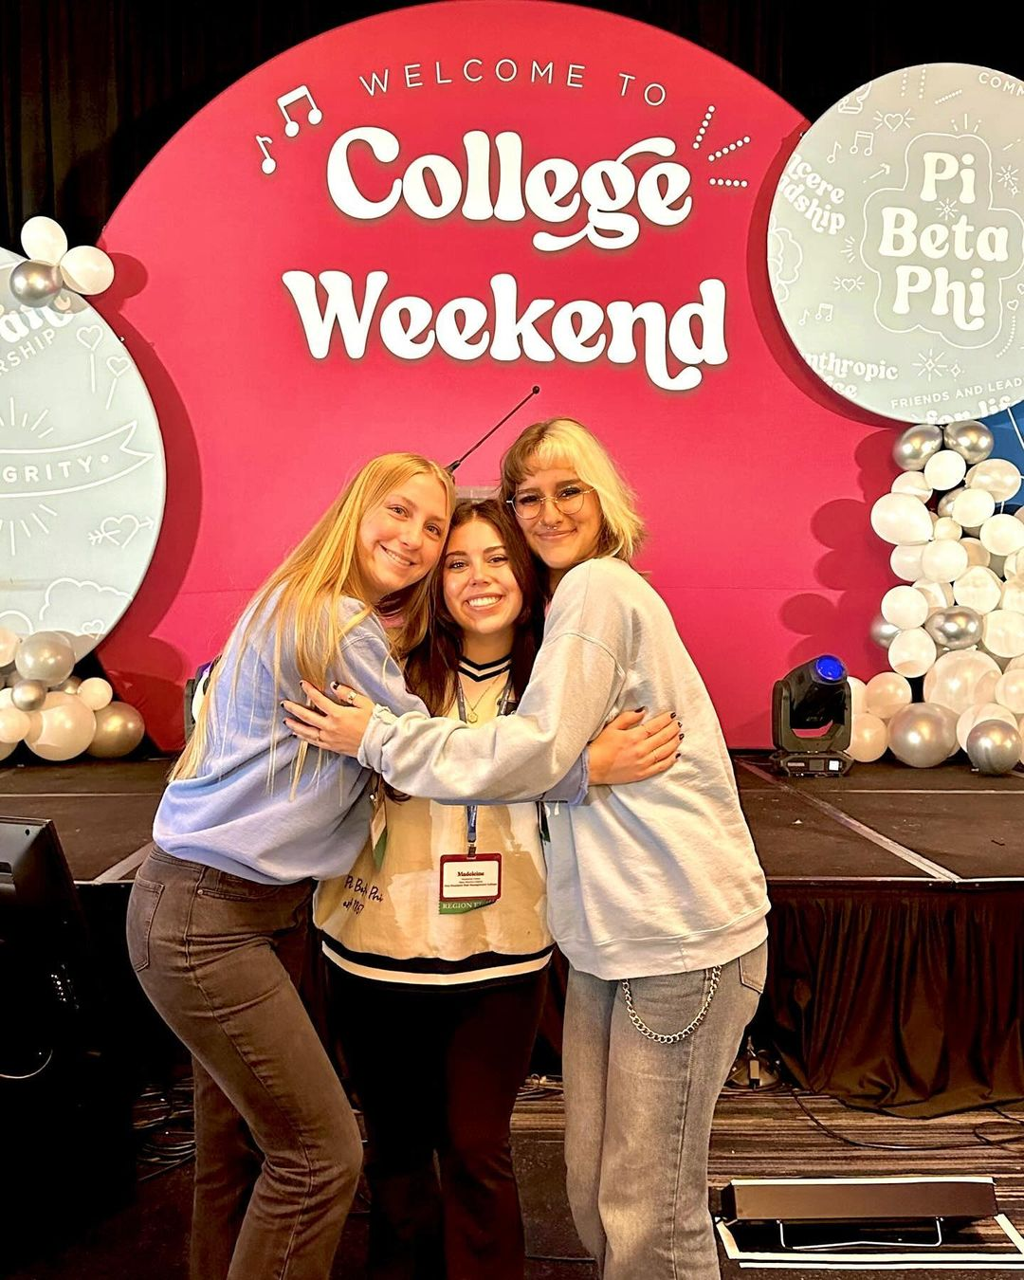
Time for a break!

Slide 122
Sisterhood Activity

Slide 123
Activity
Write down three ideas that you’re excited to implement as VPO

Slide 124
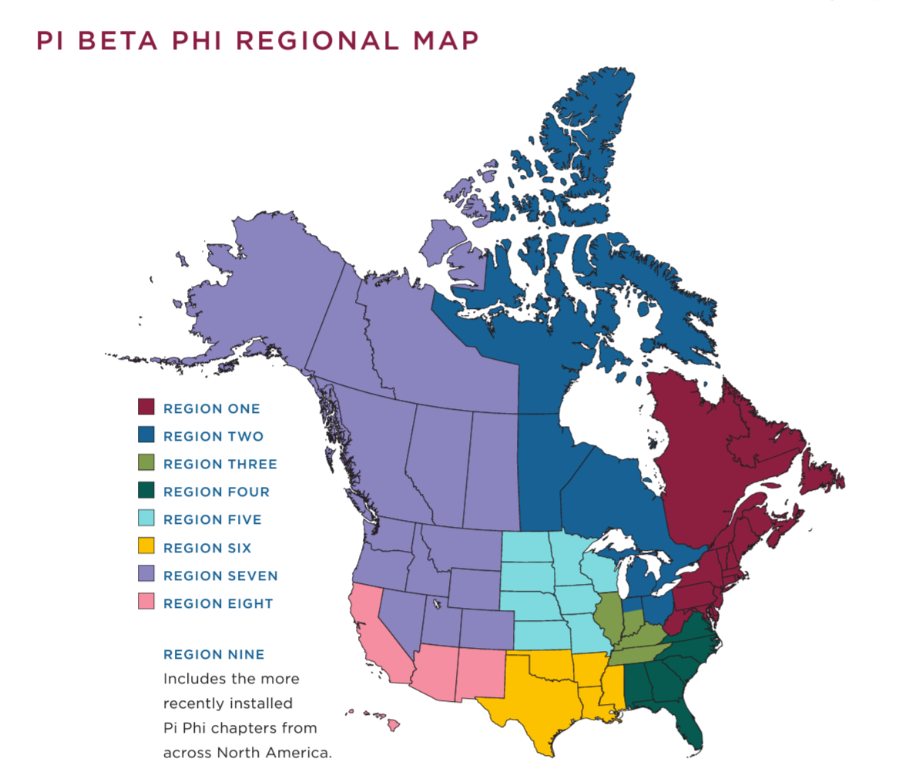
Pretend this map is on the floor and stand where your campus is located.
Don’t forget your workbook & pen!

Slide 125
Activity
Pair up with someone
Introduce yourselves
Share ideas
Brainstorm resources
Record suggestions

Slide 126
Elections Process

Slide 127
Timeline
Major chapter elections take place during the fall.
LNC should plan to begin the elections process in August or September.
Elections must be held between October 15 and February 1.

Slide 128
Activity
Try to put the steps of the elections process in order with your table!

Slide 129
Elections Process
Review the progress made in the spring.
Determine if any current LNC members plan to apply for a leadership role.
Discuss plans for the upcoming term.
Gather member input.

Slide 130
Gathering Member Input
Personal Interest Form
Members can express how they can best serve the chapter
Ideal Slate Form
Members can suggest sisters for positions
Exit Interviews
LNC can get insight from outgoing officers
Office Hours
Members can ask questions and learn more about the process from LNC

Slide 131
How can LNC educate the chapter?

Slide 132
Elections Process
5. Release applications to the chapter.
*Should be due within two weeks!
6. Meet to solidify interview questions and evaluation criteria.

Slide 133
What are some good open-ended questions to ask all applicants?

Slide 134
Elections Process
7. Ensure all candidates are eligible to hold chapter office.
* Fully meeting all financial obligations to the chapter
* Not currently on academic support, financial or general probations by the chapter or campus
* Meeting any local chapter bylaws requirements
If a candidate is ineligible, they must be notified and should not move forward in the process.
If special circumstances apply, dispensation requests may be considered by the regional Operational Specialist.

Slide 135
Elections Process
8. Hold interviews
* Should be held in a private and comfortable space
* All LNC members should be present
* At least one AAC member should be present
* Should be scheduled for 15-20 minutes each
* Questions should be asked by all LNC members
* Don’t forget to take notes!

Slide 136
Elections Process
9. Evaluate and prepare the slate
* Can use the Evaluation Criteria Form in LNC Elections Guide
* An AAC member should be present
* Must produce a slate with one nominee for each position on the Chapter Leadership Team AND Member Conduct Committee
* Should prepare a list of members to be considered for appointed positions (Director Leadership and Panhellenic Delegate)

Slide 137
Elections Process
10. Present the slate to AAC/Exec
* Utilize the script in the Elections Guide
* Focus on the positives
* AAC/Exec vote to approve if the process was followed correctly

Slide 138
What happens if the slate is not approved by AAC/Exec?

Slide 139
Options
LNC can reconvene and provide the same slate.
LNC can re-slate for all positions with eligible candidates that applied.
LNC can slate for the positions they believe they have eligible and qualified candidates for and begin the overall process again.

Slide 140
Elections Process
11. Once approved, notify slated candidates of their positions​.
*If a candidate does not accept their slated role, LNC must deliberate to discuss a new candidate to serve in that role.​
*That new candidate must be approved by AAC/Exec prior to being notified​.
*Ensure all slated candidates accept their positions before notifying candidates that they were not selected for a position!

Slide 141
Elections Process
12. Announce slate to the chapter
* Members can challenge

Slide 142
True or False
After the slate has been announced, a member has up until the next chapter meeting to express their intent to challenge.

Slide 143
True or False
After the slate has been announced, a member has up until the next chapter meeting to express their intent to challenge.

Slide 144
True or False
If a member challenges a position on the slate, they must have applied and interviewed for that position.

Slide 145
True or False
If a member challenges a position on the slate, they must have applied and interviewed for that position.

Slide 146
True or False
Challengers and slated candidates may campaign for votes prior to the election at a chapter meeting.

Slide 147
True or False
Challengers and slated candidates may campaign for votes prior to the election at a chapter meeting.

Slide 148
True or False
LNC should discourage challenging the slate.

Slide 149
True or False
LNC should discourage challenging the slate.

Slide 150
Challenger Process
If a member challenges, LNC should host a “Meet the Candidates” event.
Can be a formal Q&A or informal meet & greet
Resumes and statements should be available to members

Slide 151
Elections Process
13. Hold elections
* Prepare ballots
* Tally votes for Chapter President to read

Slide 152
Mid-Term Vacancies
If a position opens, LNC must quickly determine an election timeline.​
The same application and interview process must be followed for a mid-term vacancy.​
Inform your regional Operations Specialist of any mid-term vacancies that occur.

Slide 153
What happens when confidentiality is broken by an LNC member?

Slide 154
Activity – Take Two!
Try to put the steps of the elections process in order with your table again!

Slide 155
Order of the Elections Process
Review progress made the preceding spring​
Discuss whether any LNC members plan to run for office and notify Executive Council for replacement​
Create timeline and dates for upcoming elections​
Distribute Personal Interest Form and Ideal Slate Form​
Conduct Exit Interviews​
Educate the chapter on positions and the application & elections process​
Identify and approach potential members​
Agree on interview questions and evaluation criteria​
Release applications and have them due within two weeks​
Determine eligibility of all candidates​
Conduct interviews​
Create the slate and recommendations for appointed officer positions​
Present slate to AAC/Executive Council for approval​
Notify candidates of slated position
Present slate at chapter meeting
Chapter vote on approved slate​
AAC/Exec appoint members to appointed officer positions

Slide 156
Operations Bingo!
Get ready to review!

Slide 157
Instructions!
We will provide a definition, and you will need to find the term on your Bingo Card!
Example:
We would call out “The Exec member responsible for maintaining an accurate chapter roster and taking minutes at every chapter meeting.”
You would then find “Vice President Operations” on your Bingo card!

Slide 158
Reflection

Slide 159
One More Thing!
Tomorrow you will receive a follow-up email with a survey link to provide feedback on this weekend.

Slide 160
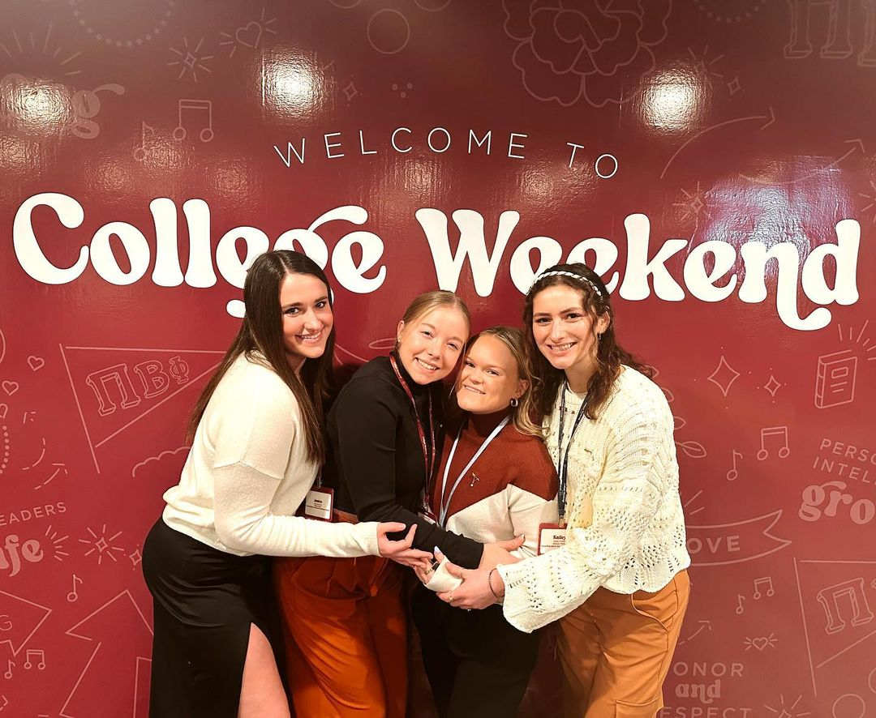
We did it!!!

