Slide 1
Find your seat!
Alabama Beta | 2 | California Theta | 12 | Florida Beta | 3 | Illinois Theta | 10 | Iowa Zeta | 12 | Minnesota Alpha | 15 | New York Epsilon | 1 | Ontario Gamma | 1 | Texas Alpha | 13 | Virginia Epsilon | 15
Arizona Alpha | 3 | California Zeta | 8 | Florida Delta | 4 | Illinois Zeta | 6 | Kansas Alpha | 9 | Mississippi Beta | 2 | New York Eta | 13 | Oregon Alpha | 15 | Texas Beta | 3 | Virginia Gamma | 11
Arizona Beta | 7 | Colorado Alpha | 3 | Florida Epsilon | 9 | Indiana Alpha | 10 | Kansas Beta | 2 | Mississippi Gamma | 9 | North Carolina Delta | 14 | Pennsylvania Eta | 1 | Texas Delta | 4 | Virginia Theta | 11
Arkansas Alpha | 7 | Colorado Delta | 11 | Florida Eta | 13 | Indiana Beta | 9 | Kentucky Alpha | 14 | Missouri Alpha | 3 | Ohio Epsilon | 6 | Pennsylvania Gamma | 14 | Texas Epsilon | 12 | Virginia Zeta | 6
California Delta | 8 | Colorado Gamma | 5 | Georgia Alpha | 2 | Indiana Delta | 15 | Kentucky Beta | 2 | Missouri Gamma | 10 | Ohio Iota | 6 | South Carolina Alpha | 7 | Texas Eta | 12 | Washington Alpha | 15
California Epsilon | 4 | Connecticut Alpha | 1 | Georgia Beta | 13 | Indiana Gamma | 6 | Louisiana Alpha | 4 | Montana Alpha | 5 | Ohio Kappa | 5 | South Carolina Beta | 4 | Texas Gamma | 7 | Washington Beta | 9
California Eta | 12 | Connecticut Gamma | 11 | Idaho Alpha | 5 | Indiana Zeta | 1 | Louisiana Beta | 3 | Nebraska Beta | 15 | Ohio Theta | 10 | South Dakota Alpha | 5 | Texas Zeta | 8 | Washington Gamma | 11
California Kappa | 8 | D.C. Alpha | 13 | Illinois Alpha | 10 | Iowa Beta | 10 | Michigan Alpha | 5 | Nebraska Gamma | 14 | Oklahoma Alpha | 7 | Tennessee Delta | 8 | Utah Alpha | 8 | West Virginia Alpha | 14
California Nu | 12 | Delaware Alpha | 4 | Illinois Kappa | 13 | Iowa Gamma | 6 | Michigan Gamma | 9 | Nevada Alpha | 14 | Oklahoma Beta | 2 | Tennessee Gamma | 7 | Virginia Delta | 1

Slide 2
Hello!
Tina Rivard
Pennsylvania Theta
Director Chapter Support
dcs@pibetaphi.org
Cara Stombock
Virginia Zeta
Member Experience Specialist
memberexperience4@
pibetaphi.org
Olivia Kennedy
Michigan Gamma
HQ Assistant Director of Education and Programs
okennedy@pibetaphi.org

Slide 3
Vice President Member Experience
College Weekend 2025

Slide 4
Let's get to know each other
Name
Chapter
College/University
What You're Most Excited For!

Slide 5
Learning Outcomes
Develop practices that effectively contribute to a premier and inclusive member experience.
Discover opportunities for meaningful, values-based program implementation through sisterhood events and Leading with Values® seminars.
Learn how to assess member satisfaction through the Annual Member Evaluation and adapt chapter practices and programming based on the results.
Deepen their understanding of the Member Experience Team’s responsibilities and the tools needed to manage a team and delegate effectively.

Slide 6
Agenda
Part 1 | Friday 8-9 p.m.
Welcome
Benefits of Membership
Part 2 | Saturday 9-11:45 a.m.
The Future of Pi Phi: New Member Education
Connecting Past to Present: Fraternity Heritage
Intentional Programming: Leading with Values Seminars
Part 3 | Saturday 1:15-3 p.m.
Promoting Sincere Friendship: Sisterhood Events
Developing Women of Intellect: Academic Programming
Providing Lifelong Enrichment: Pi Phi for Life
Part 4 | Saturday 4:15-6:15 p.m.
Ensuring A Positive Member Experience: Assessment
Putting Thoughts Into Actions

Slide 7
Reflection
What is my chapter already great at when it comes to programming and enhancing the member experience?
What do I need to do this weekend to make sure I can take this back to my chapter?
How will I work with my Directors to relay the information I learn this weekend?
How do I anticipate this information will help me in my current or future role as a leader within Pi Beta Phi?

Slide 8
Game time!
One person starts by saying their name and an interesting fact about themselves.
If the fact is true for someone else, that person yells, “Link!” and runs up to that person and links arms.
That fact may apply to more than one Pi Phi, so they must be quick to link.
The person who just “linked” then goes next and says their fact and someone else comes up to link with them!

Slide 9
Benefits of Membership

Slide 10
Reflection
What contributed to a lackluster or poor member experience in the past?
What fears do I have about bringing information back to the chapter?
What are some ways of communicating that did not work in the past to get members on board with what was happening?

Slide 11
The "Why"
Three reasons why you believe members remain in the chapter today.
Three reasons why you could see members questioning if they should remain a Pi Phi.
Why are you VPME?

Slide 12
As true friends, we honor the uniqueness of each sister. We empower one another, through meaningful relationships grounded in empathy. We promise an inclusive sisterhood, where every member feels welcome, is supported, and knows they belong.
As the first fraternity for women, we own our role and responsibility in the fraternal movement. We recognize our power and privilege as college-educated women, to work for an equitable society. We commit to develop the servant leaders our diverse world needs.

Slide 13
Tip #1
Identify what motivates your chapter to engage.

Slide 14
Tip #2
Lighten up!

Slide 15
Tip #3
Communicate a little differently this time.

Slide 16
Tip #4
Be clear about what is happening and why.

Slide 17
Tip #5
What problem are you going to solve for them?

Slide 18
Tip #6
Involve members in the process.

Slide 19
Tip #7
Provide meaningful, enjoyable programs that are worth your members’ time.

Slide 20
Key Takeaways

Slide 21
Vice President Member Experience
College Weekend 2025

Slide 22
The Future of Pi Phi
New Member Experience

Slide 23
New Member Education Program
Six-lesson introduction to the Fraternity
Led by the Director New Member Experience
Opportunity to connect to Pi Phi while learning about member obligations and Pi Phi’s core values
Focus is on building affinity for Pi Phi – not frills or gifts!

Slide 24
What pieces of the New Member Education Program have shaped me?

Slide 27
Top NMEP Reminders
The DNME plans Bid Day in consultation with the VPR.
New Member Appraisals must occur at Weeks 3 and 6 of the program.
Big/Little Reveal should take place no later than four weeks into the program.
The DNME is responsible for Continuing New Member programming, if applicable.

Slide 28
Let's chat!
How can we utilize the New Member Appraisals to be proactive about their progress toward Initiation?
What are some ways I can contribute to a successful NMEP?
How can I help the DNME make the NMEP inclusive?
How can I support the DNME throughout the year?

Slide 29
What are five things I need to bring back to my Director New Member Experience?

Slide 30
Connecting Past to Present
Fraternity Heritage

Slide 31
What does Honor and Respect mean to you?

Slide 32
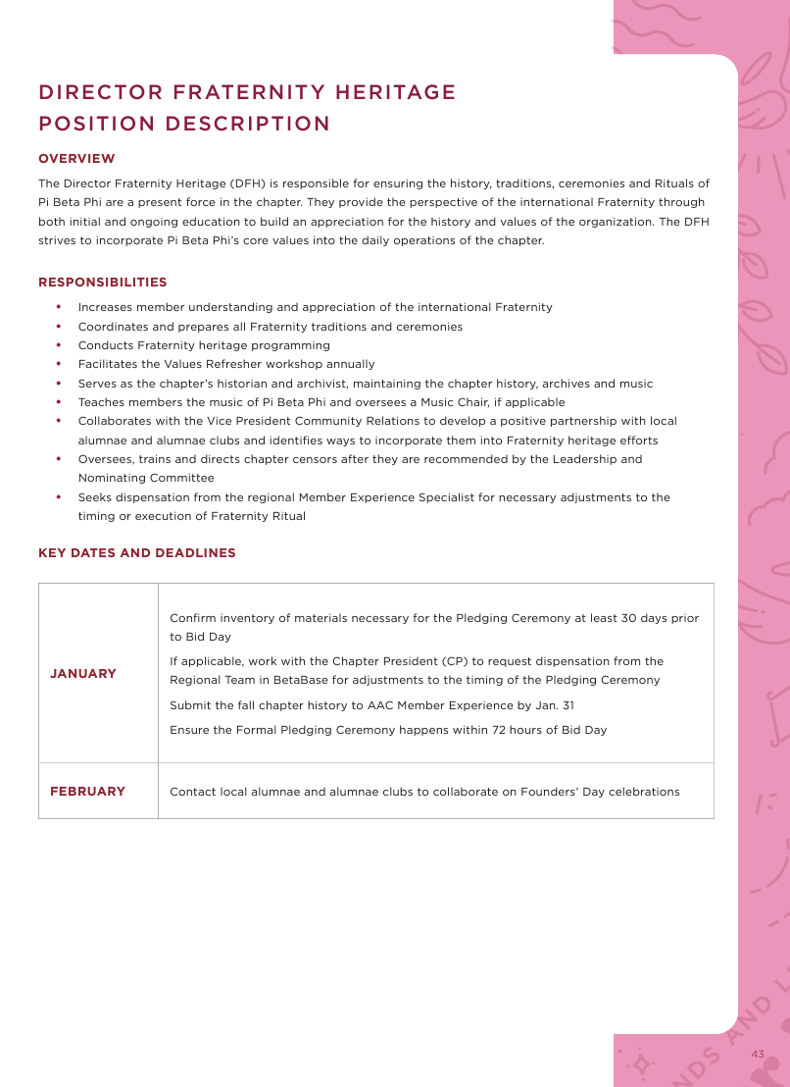

Slide 33
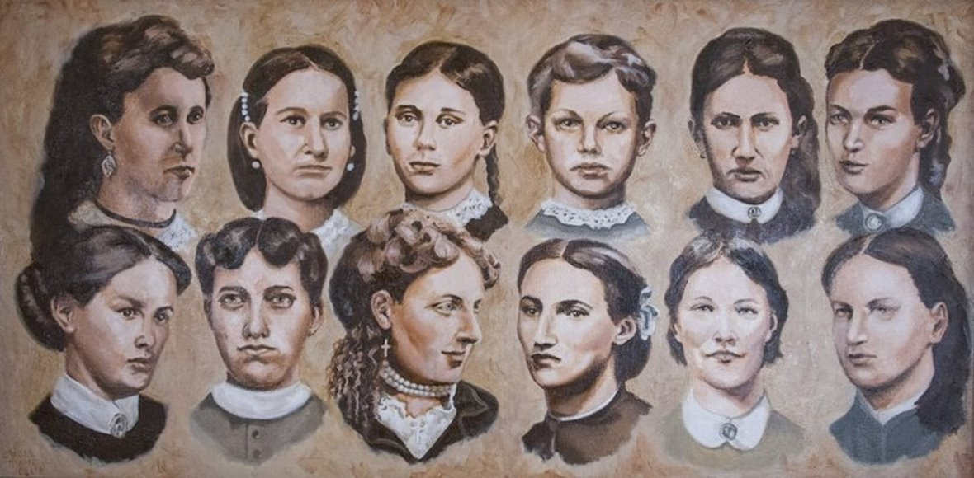

Slide 34
Let's chat!
Choose one thing your chapter does to celebrate Fraternity Heritage.
Think about how your chapter could approach it differently.

Slide 35
Special Guest!
Historian And Archivist, Fran DeSimone Becque, New York Alpha

Slide 36
The Tenuous Early Years of our Fraternity

Slide 37
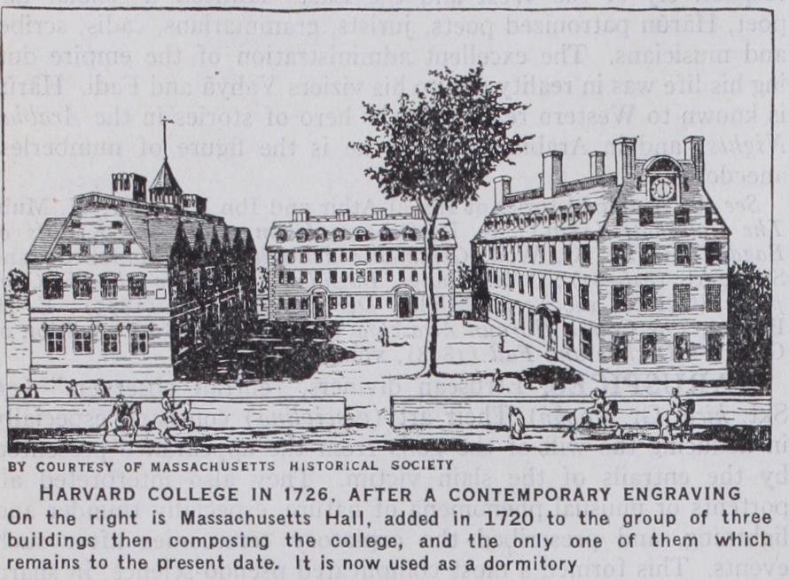
Harvard College (University) was chartered in 1636.
It took women another 200 years to enter any form of American higher education.

Slide 38
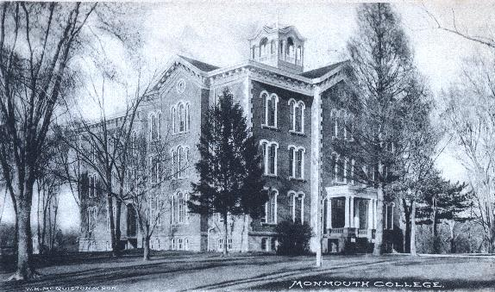
Our story begins in Illinois 158 years ago

Slide 39
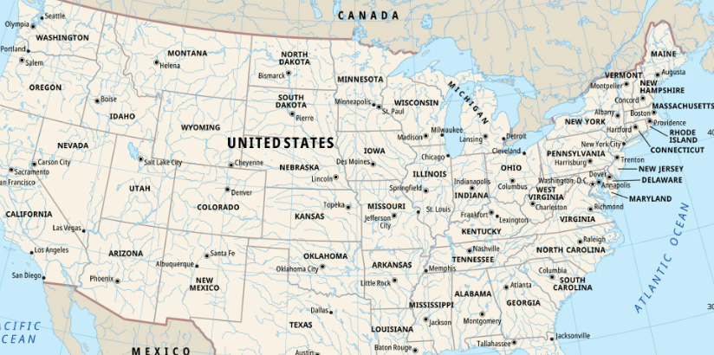
Where exactly is Monmouth, Illinois?

Slide 40
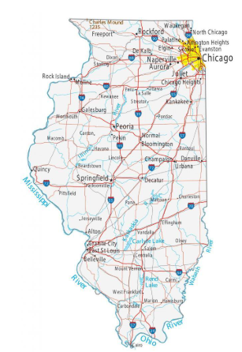
Monmouth is near the Mississippi River in the western part of the state.

Slide 41
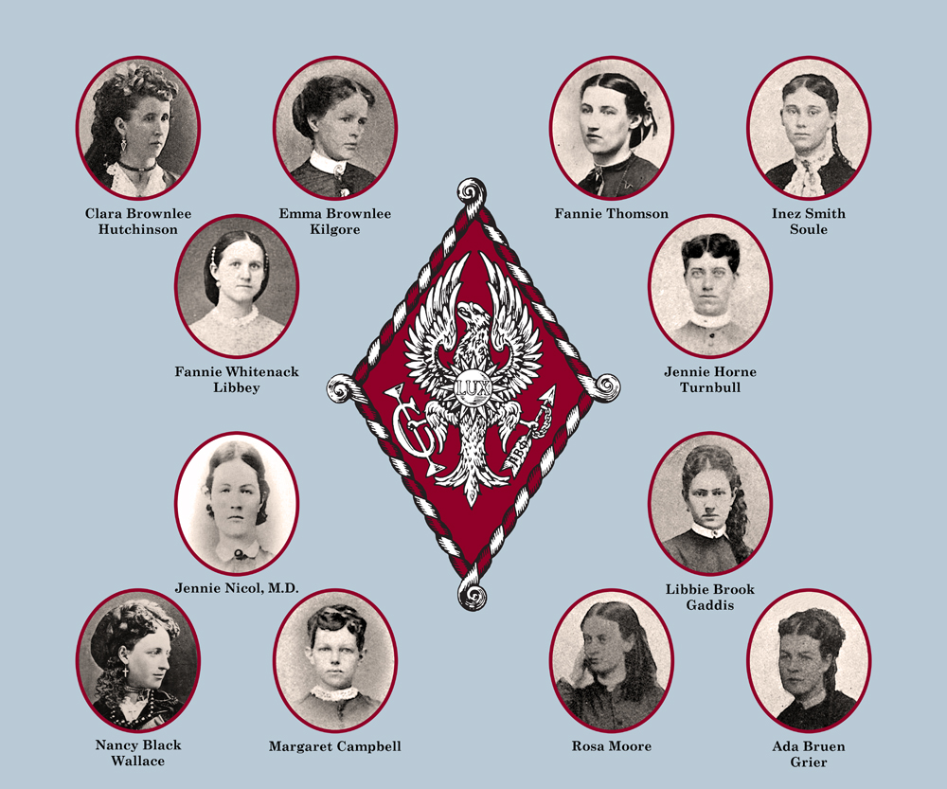

Slide 42
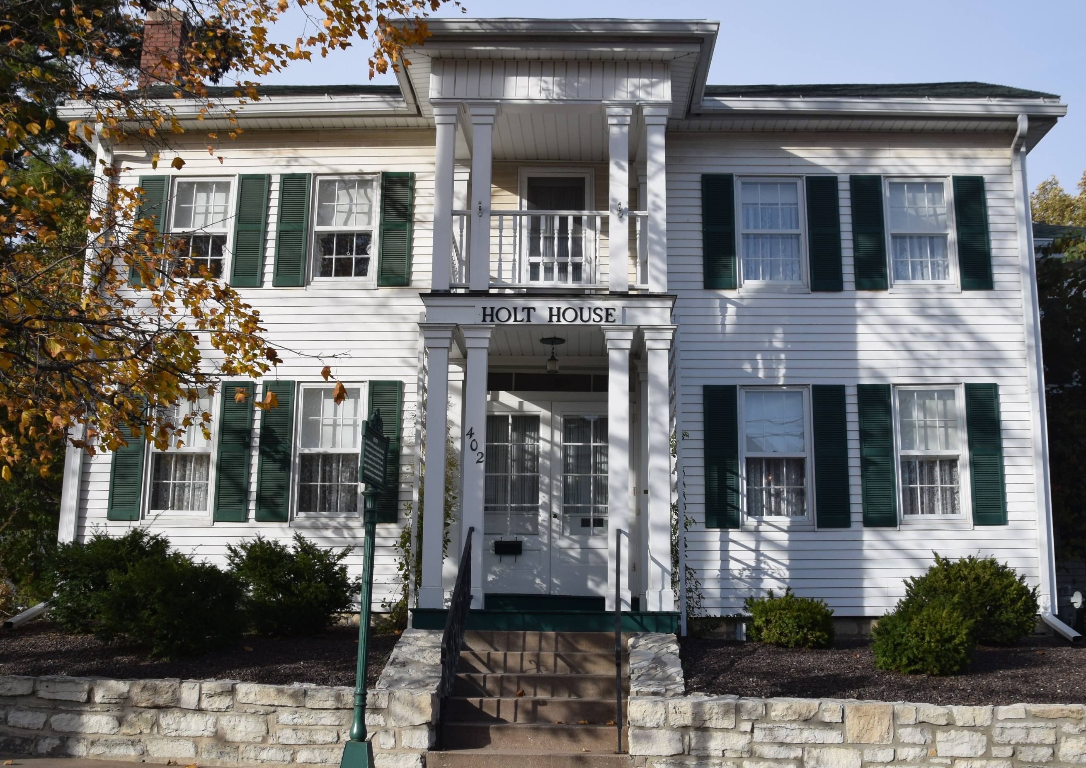
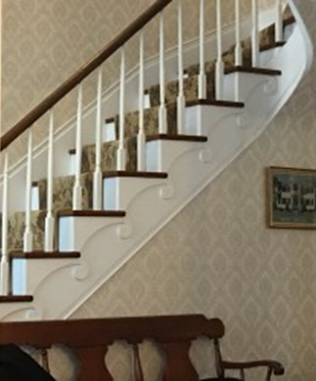
I.C. Sorosis was founded at Holt House on April 28, 1867.

Slide 43
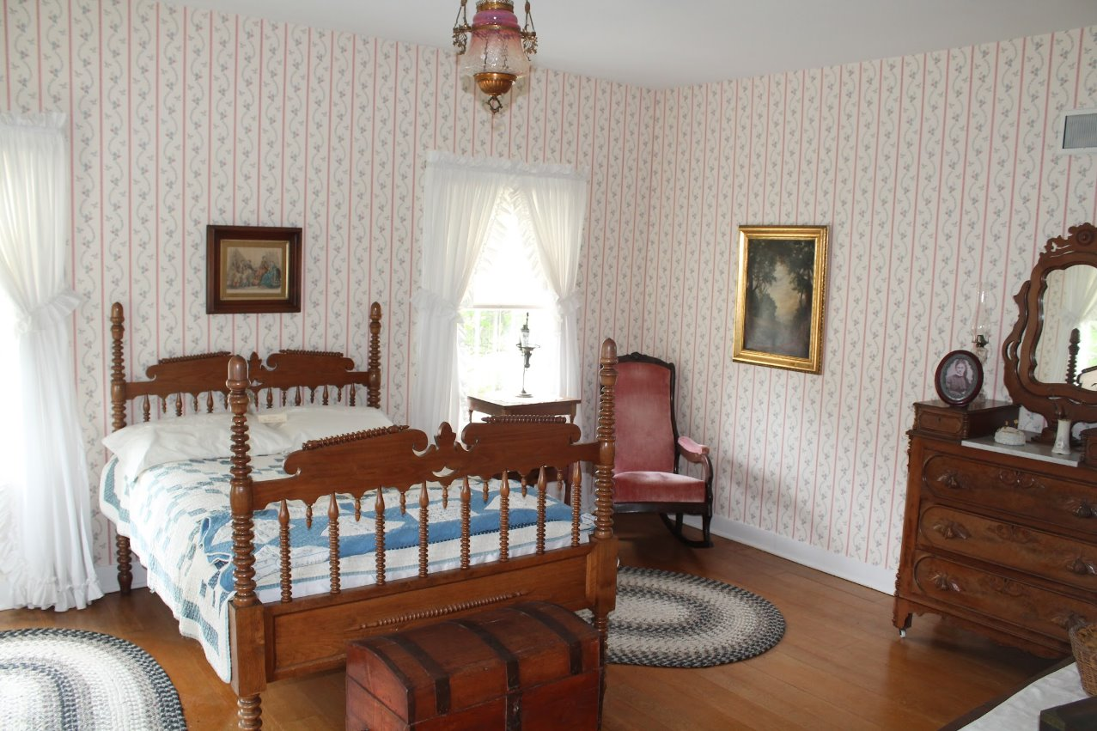

Slide 44
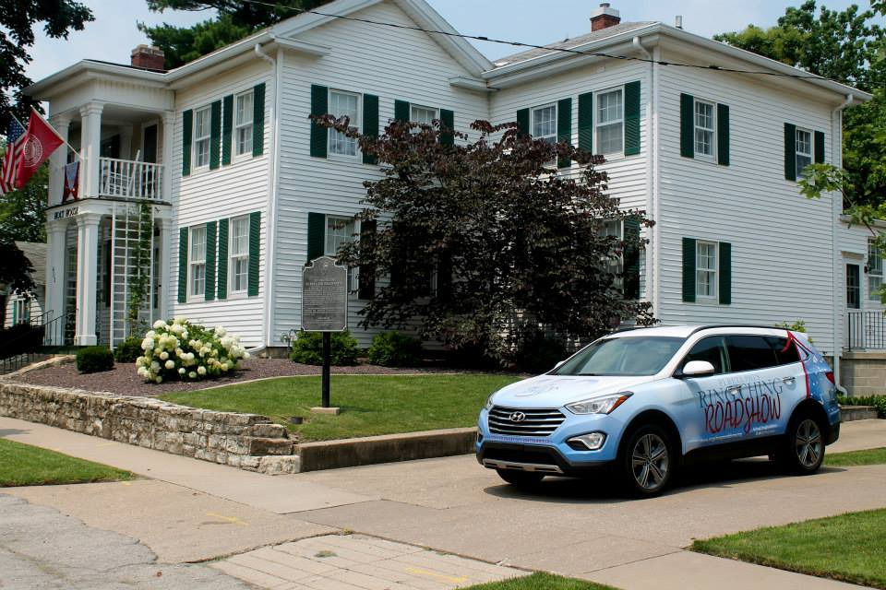
Put Holt House on your bucket list!

Slide 45
On October 13, 1870, Kappa Kappa Gamma was founded at Monmouth College.

Slide 46
Pi Phi and Kappa are known as the Monmouth Duo.

Slide 47
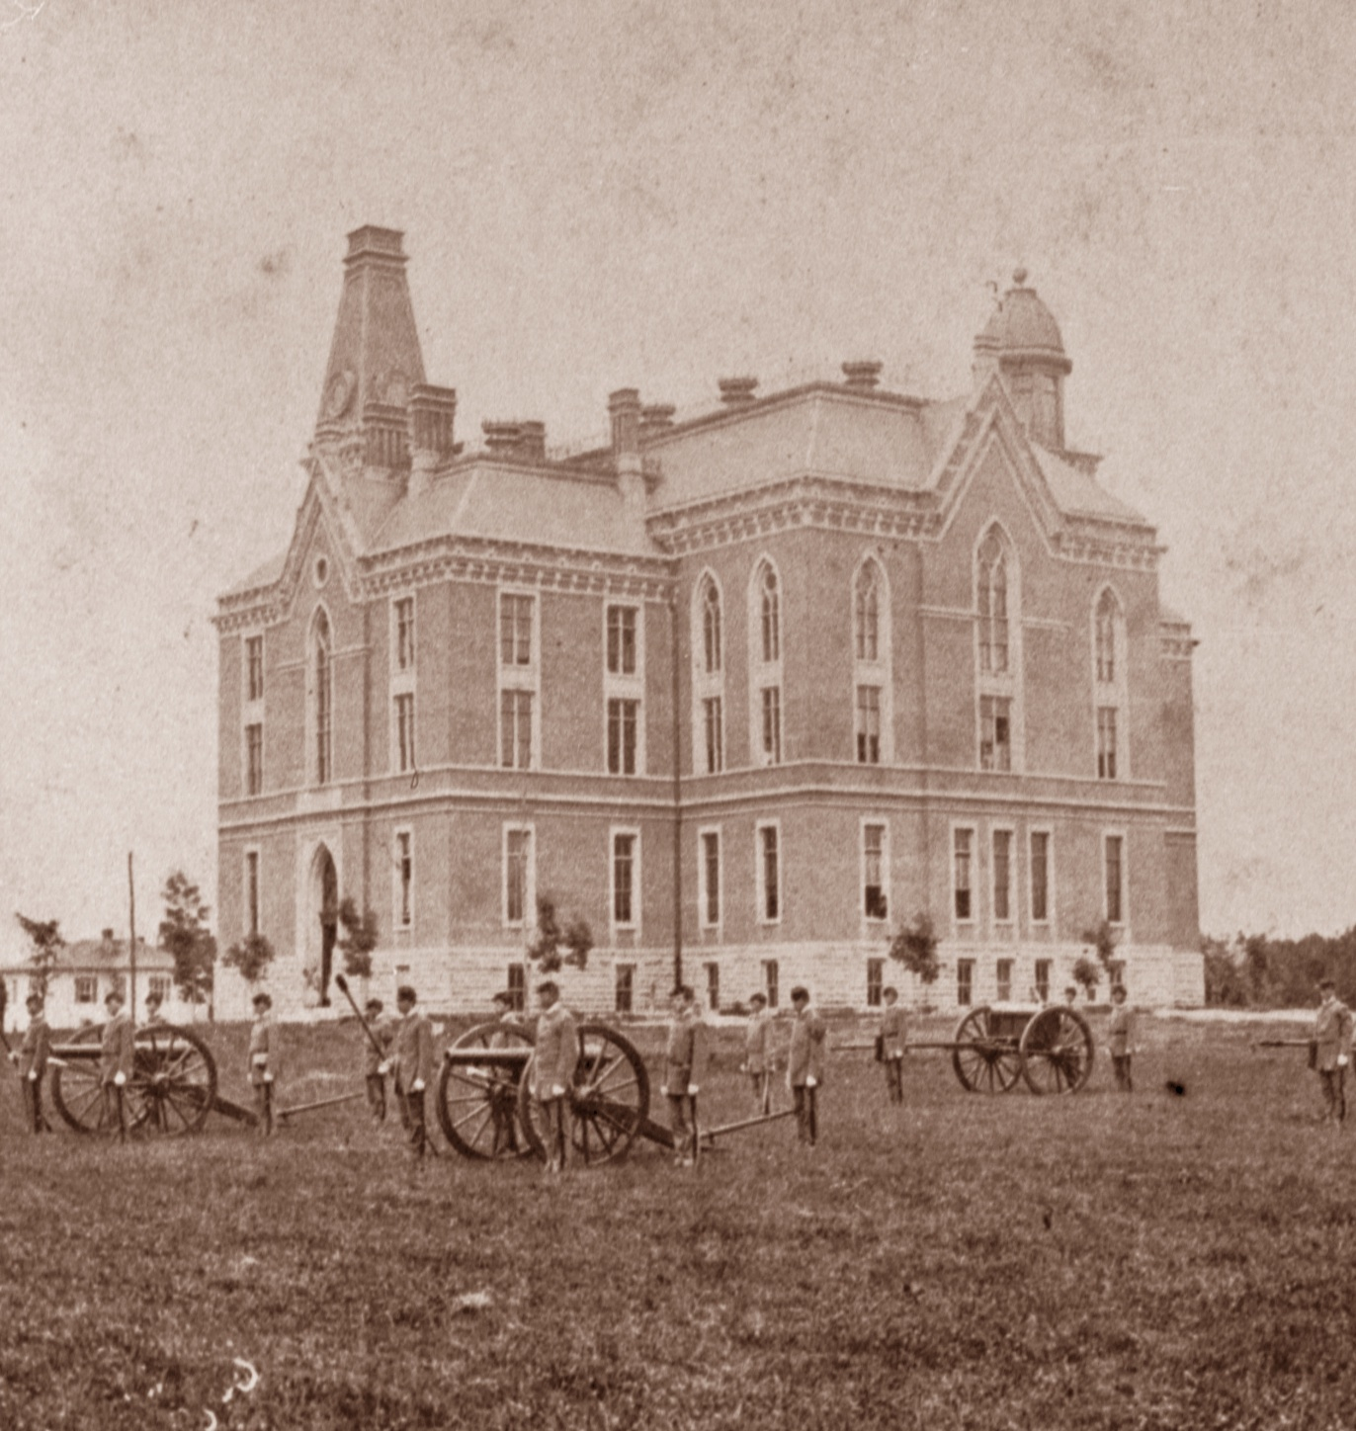
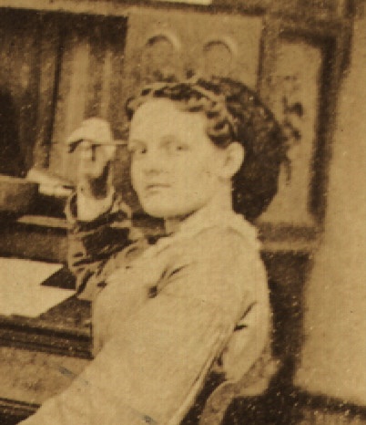
Kappa Alpha Theta was founded on January 27, 1870, between the Monmouth Duo organizations.

Slide 48
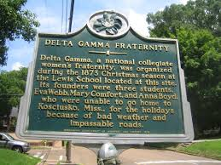
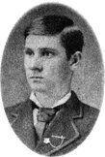
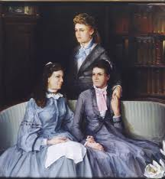
Delta Gamma was founded in December 1873.
George Banta, Phi Delta Theta, was instrumental in bringing Delta Gamma north. He was a Delta Gamma as well as
Phi Delt.

Slide 49
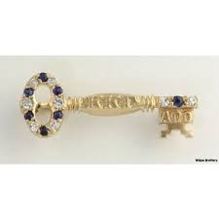
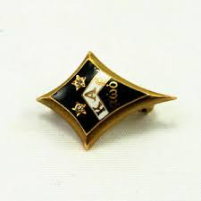
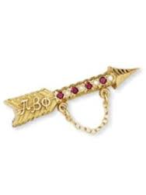
Between 1867 and 1881, only four of today’s NPC groups were chartering chapters on other campuses.

Slide 50
Time out for an explanation of “The Firsts”
April 28, 1867, Pi Beta Phi is the first women’s fraternity based upon the men’s fraternity model.
January 27, 1870, Kappa Alpha Theta is the first Greek-letter women’s fraternity.
Further complicating matters….
Two organizations founded at Wesleyan College in Macon, Georgia, the “Macon Magnolias,” Alpha Delta Pi and Phi Mu.

Slide 51
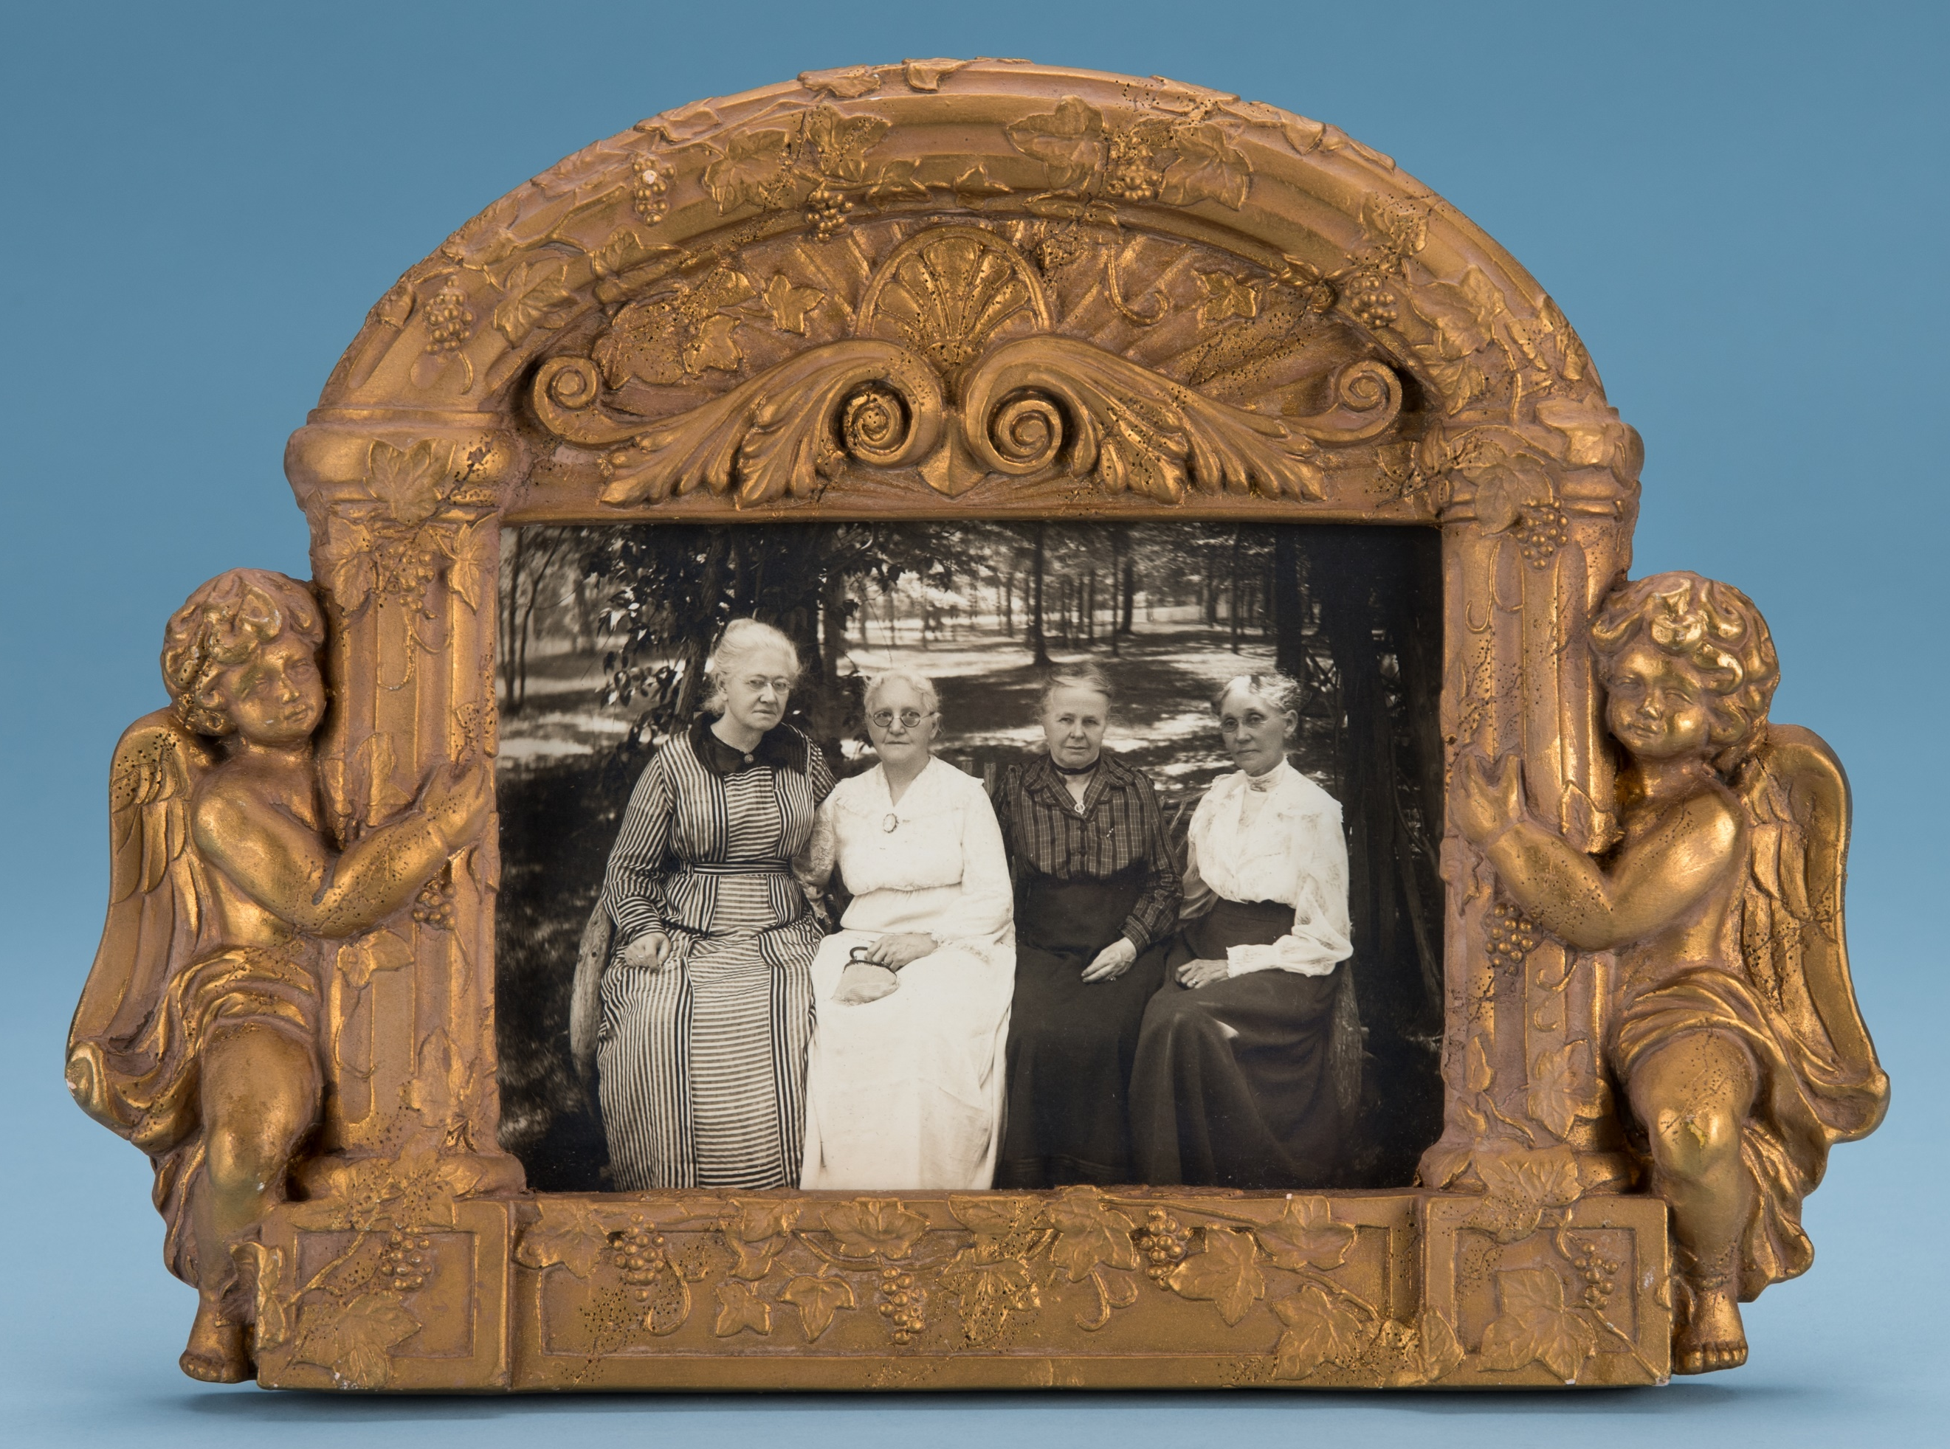
Our Founders Were Visionaries (and Teenagers)

Slide 52
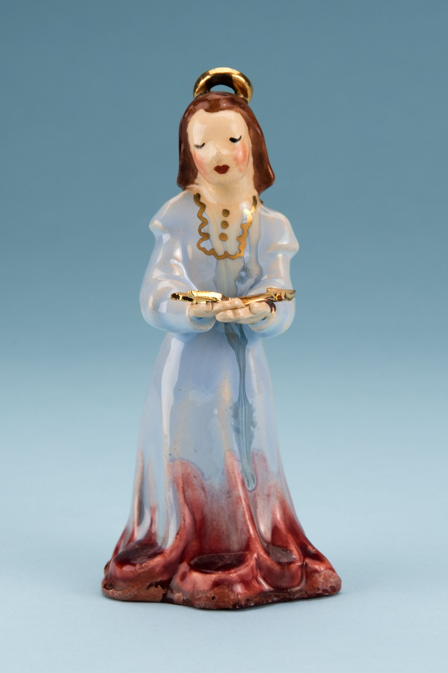
Had our 12 Founders chosen the Greek motto Pi Beta Phi...
We would be the oldest Greek-letter organization for women.

Slide 53
Monmouth College forced all GLOs to close in the late 1870s.
This should have been the end of Pi Beta Phi and Kappa Kappa Gamma.

Slide 54
Luckily both Pi Phi and Kappa, established chapters:
1870, Kappa Kappa Gamma, Monmouth College
1871-74, St. Mary’s College
1872, Indiana University
1872-75, Smithson
1873, Illinois Wesleyan College
1874-76, Rockford Seminary
1875, University of Wisconsin
1875, DePauw University
1875, University of Missouri
1876, Wooster College
1877, University of Akron
1878, Butler University
1879-84, Franklin College *****
1880, University of Minnesota
1880-90, Simpson College
1880-85, UC Berkeley
1881, St. Lawrence University
1881, Hillsdale College
1867, Pi Beta Phi Monmouth College,
chapter closed mid-1870s-1920s
1868, Iowa Alpha, Iowa Wesleyan University
1869, Mt. Pleasant Seminary
1870-79, DePauw University
1870-71, Baptist Young Ladies Seminary
1872, Illinois Beta, Lombard College
1873, Kansas Alpha, Kansas University
1874, Iowa Beta, Simpson College
1877, Iowa Gamma, Iowa State University
1881-83, Dearborn Seminary
1881-87, South Iowa Normal
1881-84, Jacksonville Female Academy
1881-92, Iowa Normal East

Slide 55
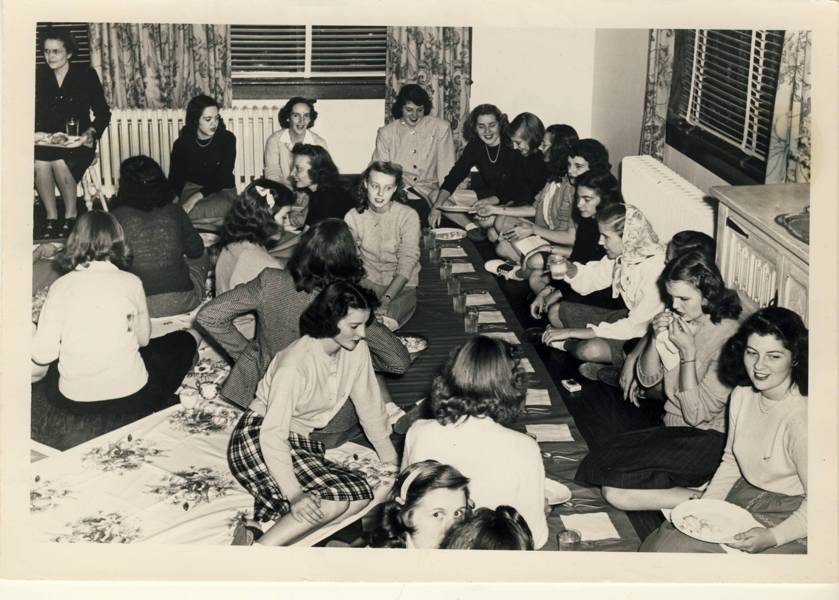
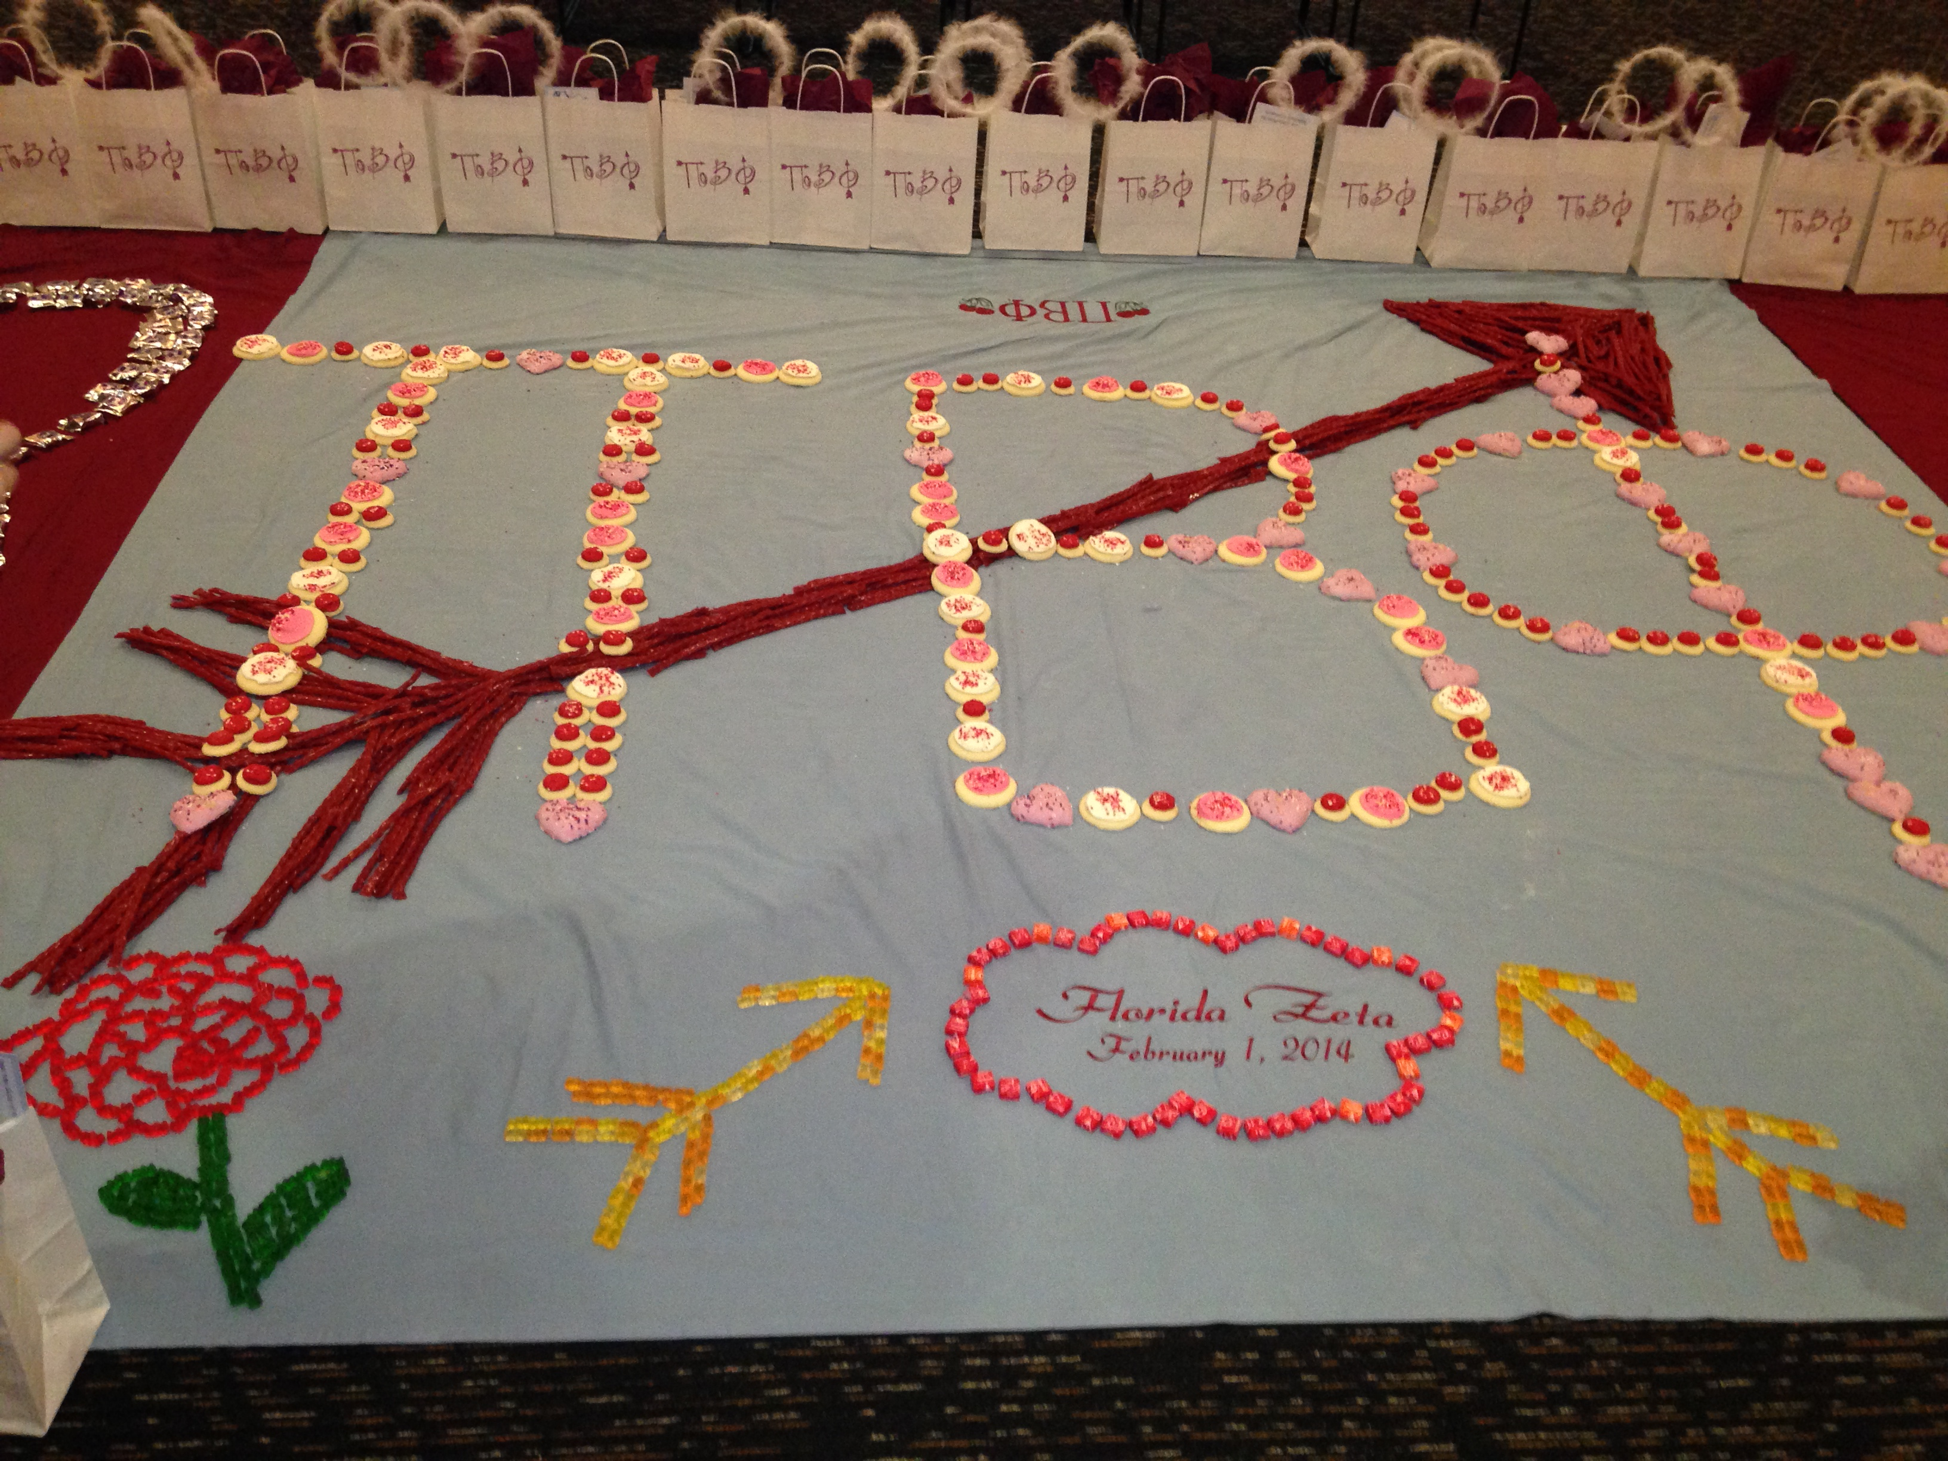
Our oldest continuous chapter
Kansas Alpha is Pi Beta Phi’s oldest, continuous chapter. It has been in existence since 1873!
A Pi Phi tradition dates to 1873—six years after our founding—and also involves Kansas Alpha.

Slide 56
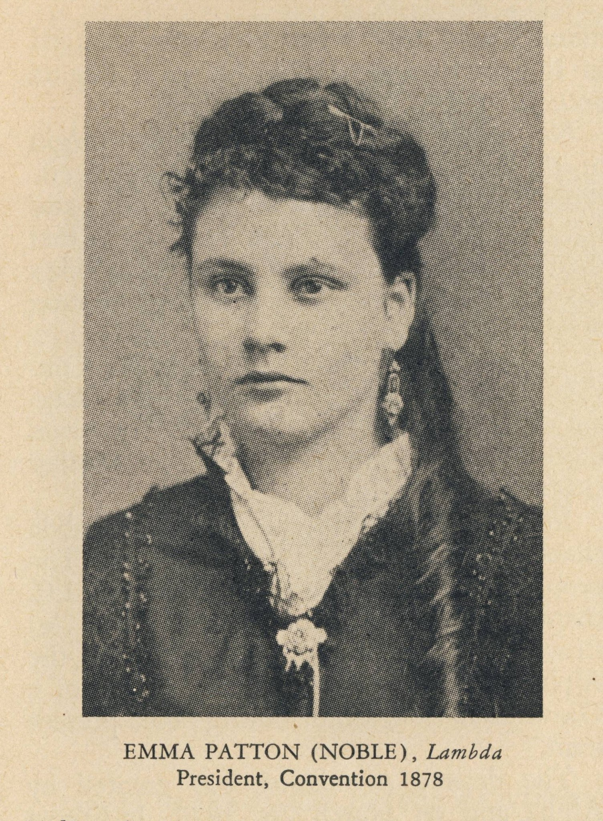
Collegians presided at conventions
In 1878, Emma Patton, Iowa Beta, presided at the 1878 Indianola, Iowa, convention.

Slide 57
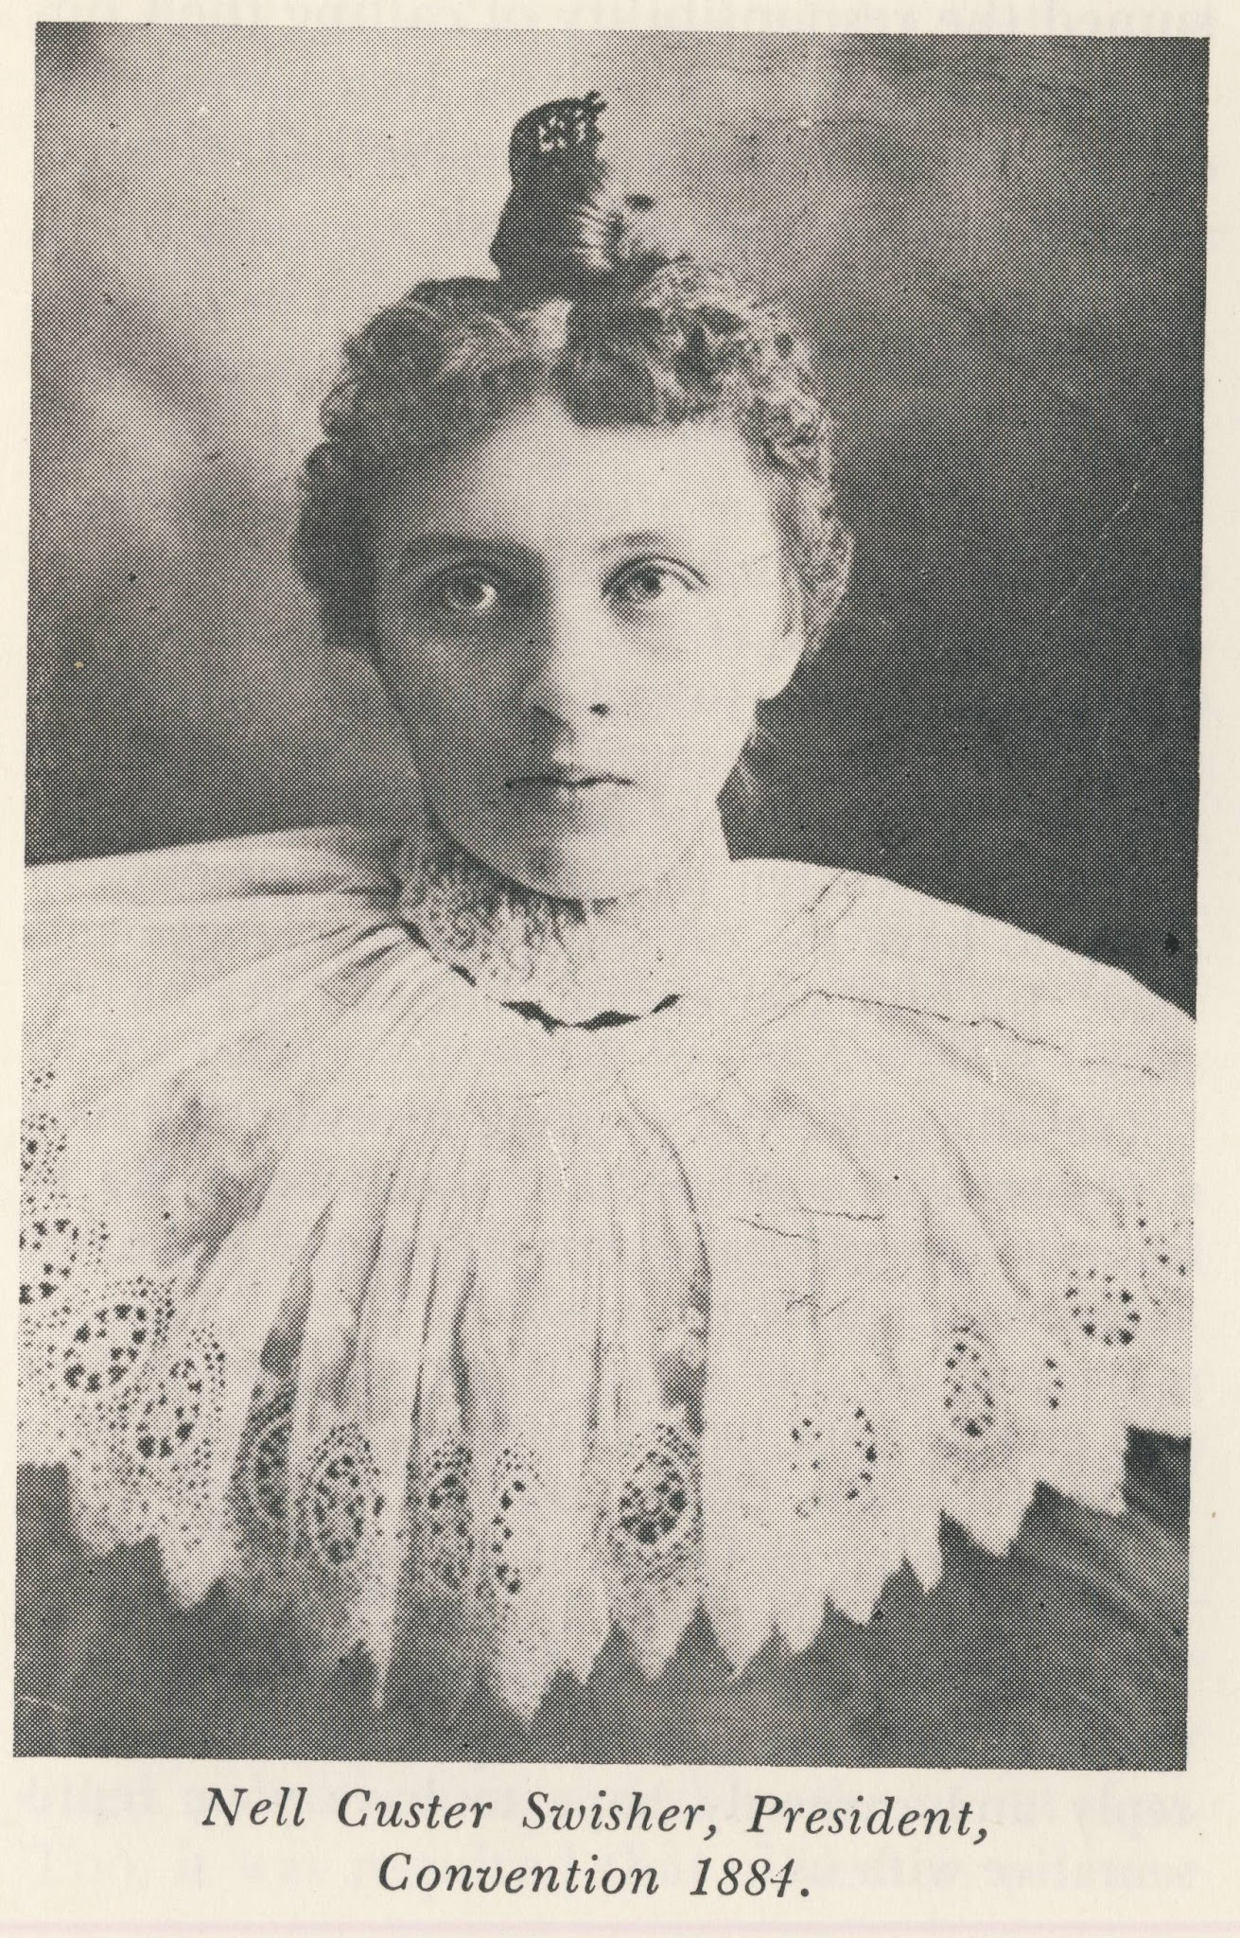
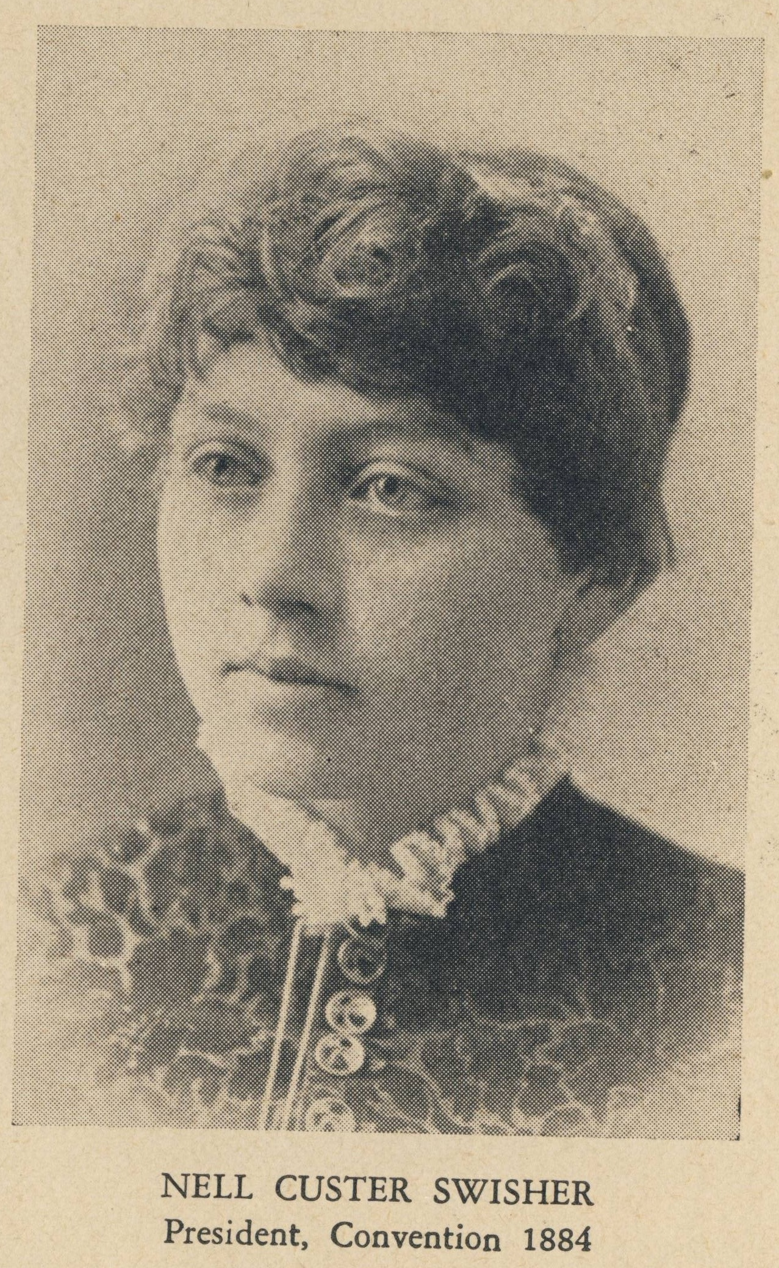
Nell Custer, Iowa Zeta, was our first Grand President from 1884-1885.

Slide 58
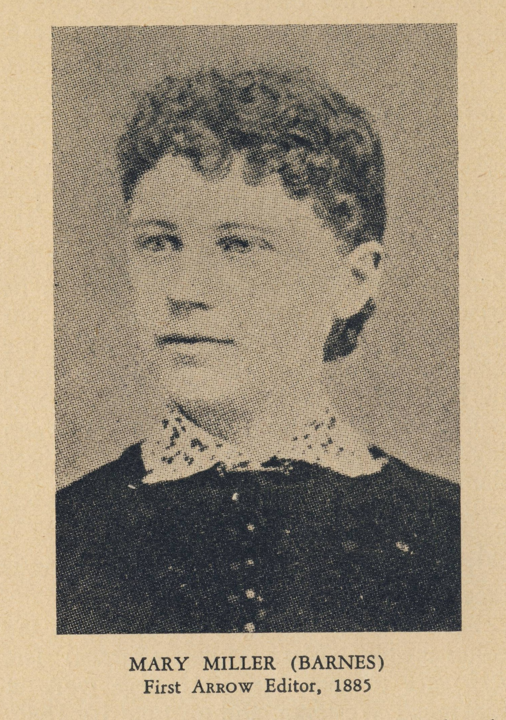
By the early 1880s, chapter sentiment strongly favored the adoption of the Greek letters.

Slide 59
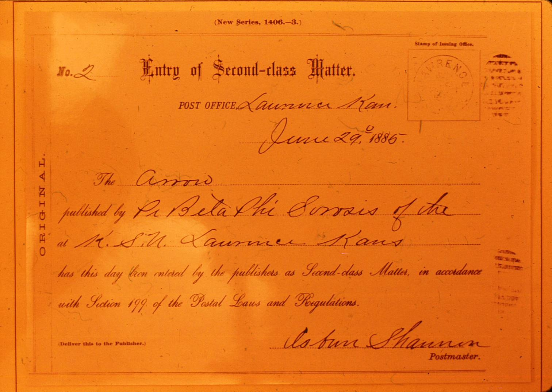

Slide 60
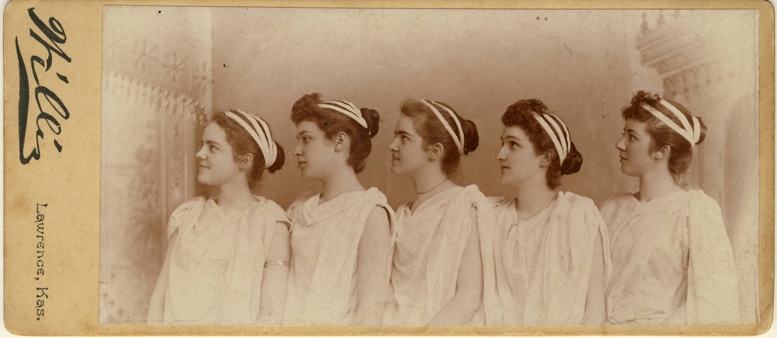
Do not try this today!

Slide 61
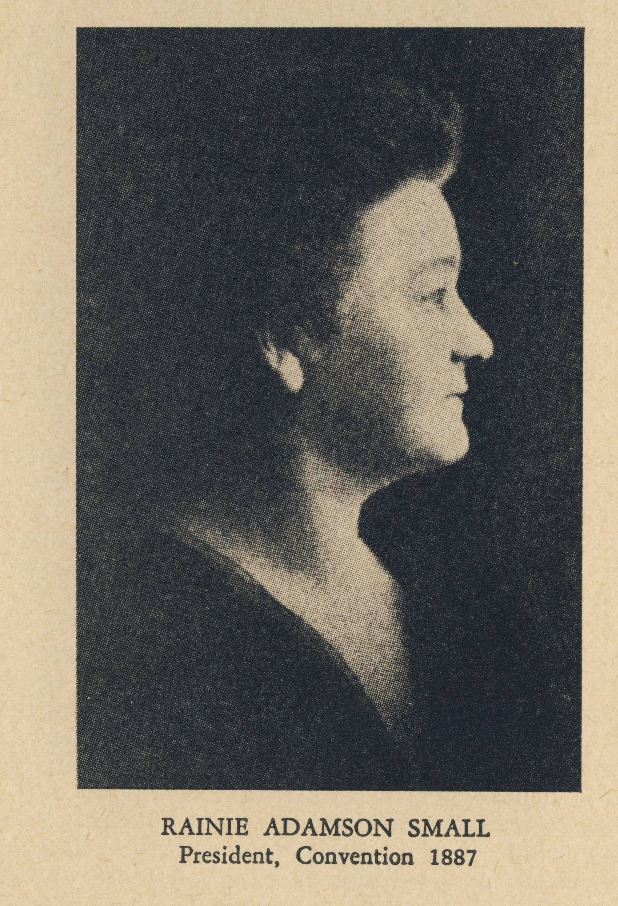
Rainie Adamson Small, Illinois Beta, was Grand President 1885-1890.

Slide 62
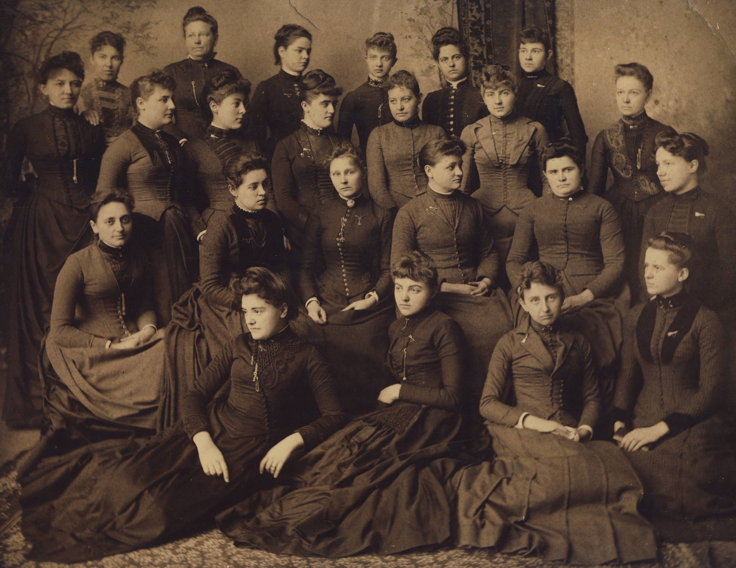

Slide 64
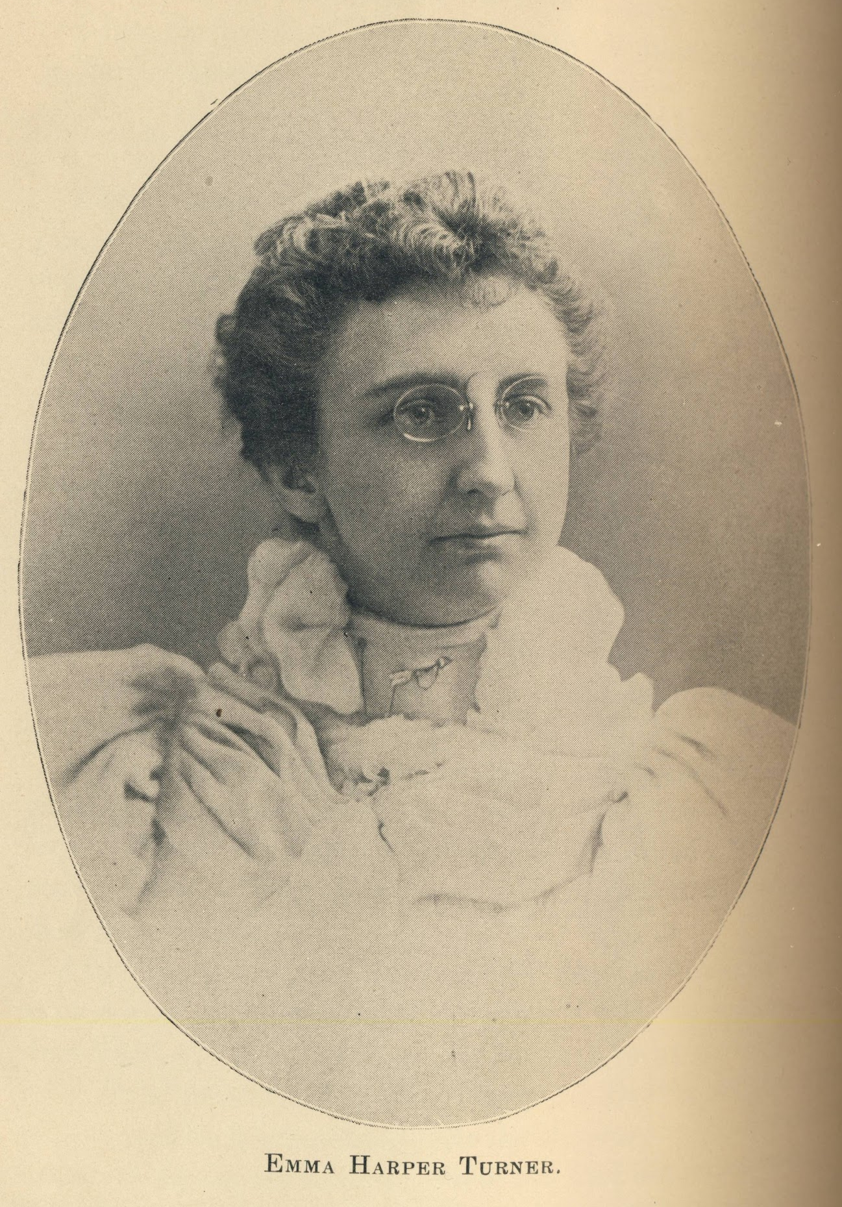
Enter... Emma Harper Turner

Slide 65
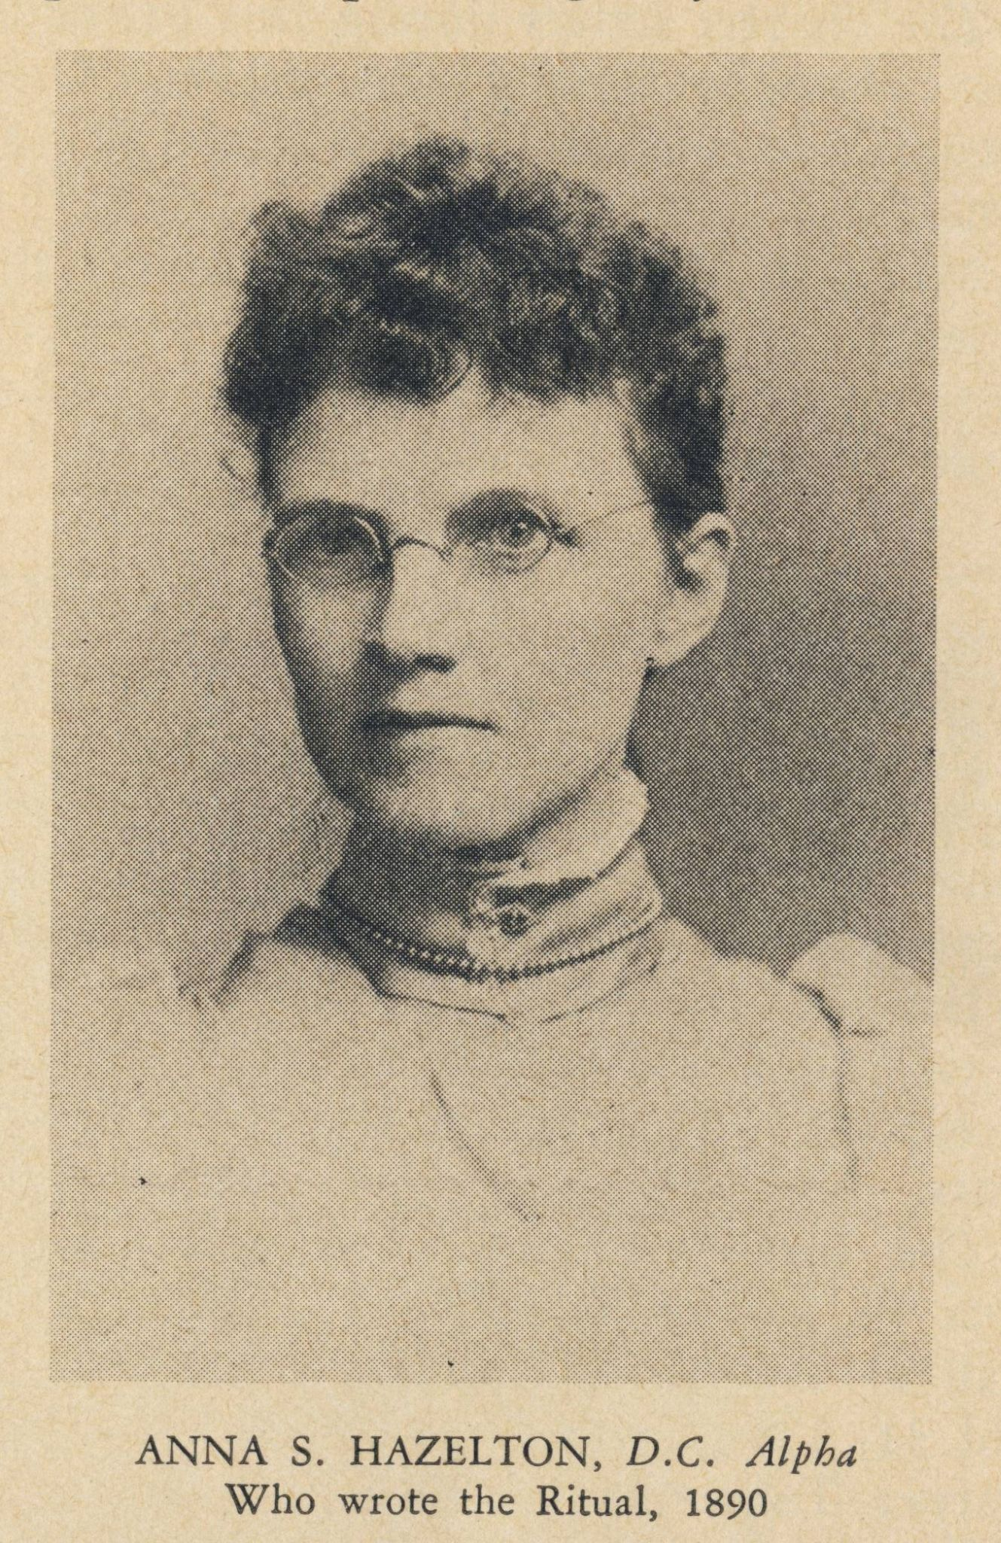
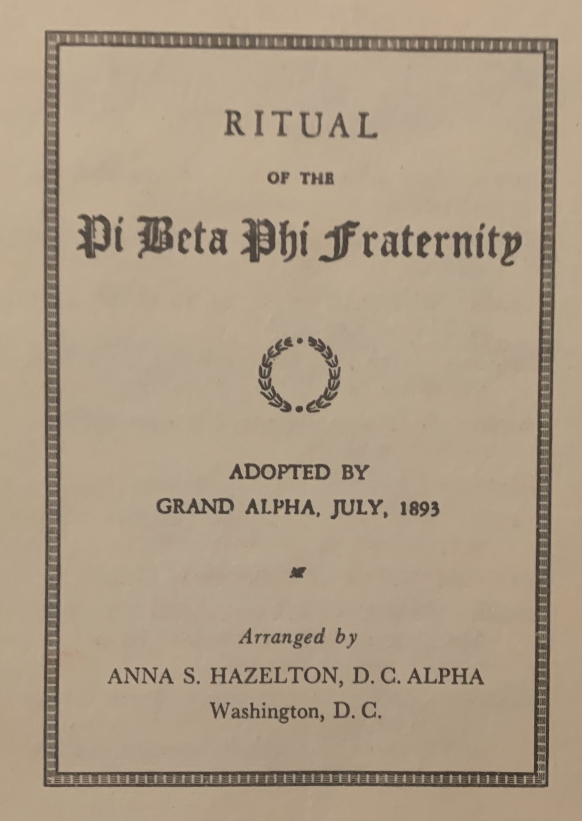

Slide 66
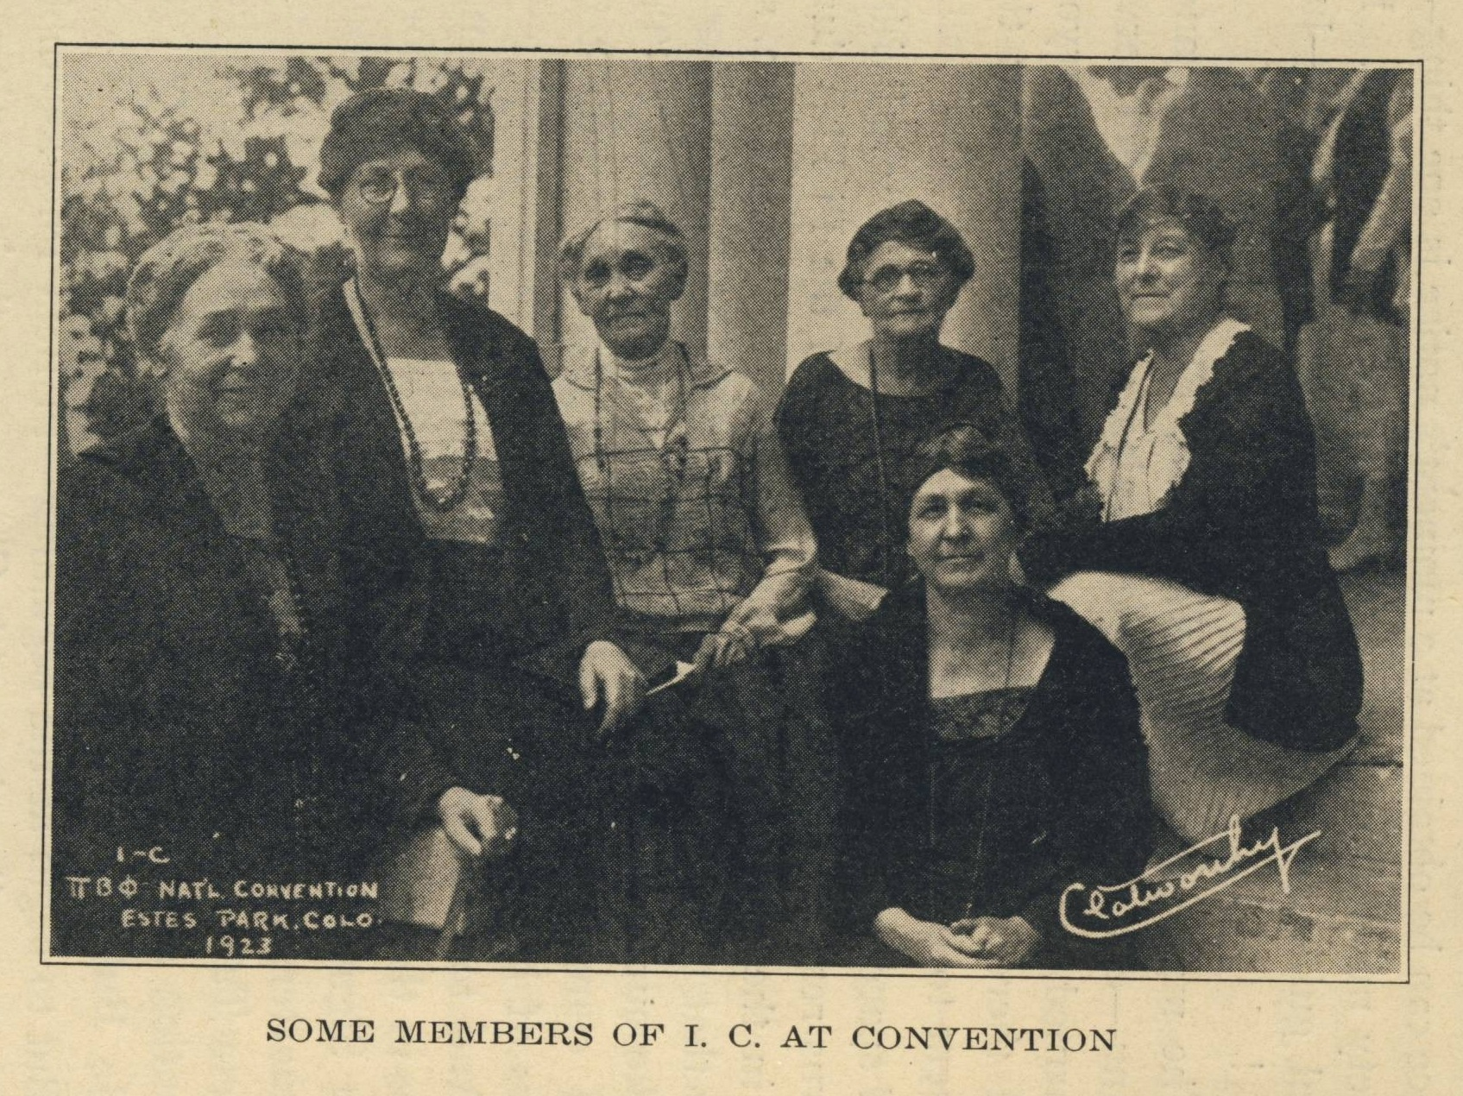

Slide 67
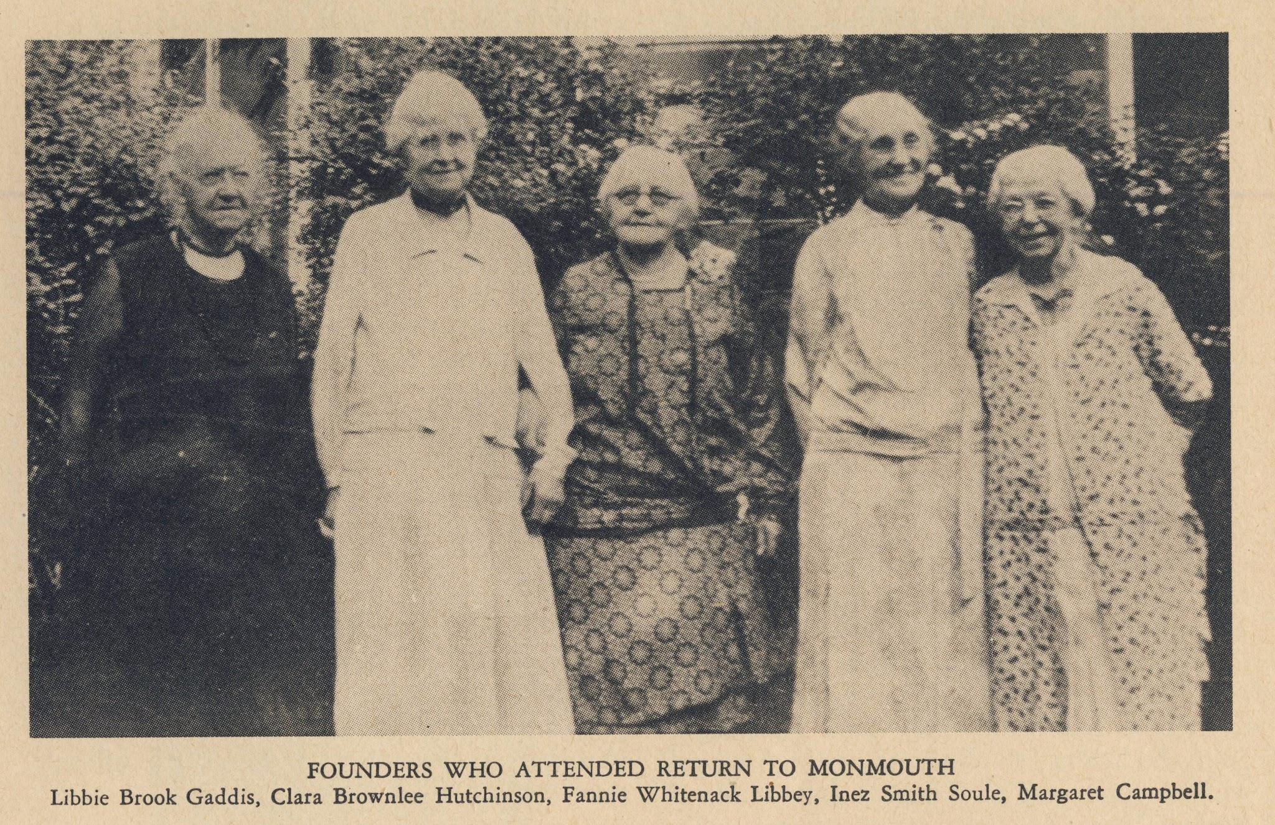

Slide 70
Meeting Ritual Update College Weekend 2025

Slide 71
The Origin of Our Meeting Ritual
Historical Significance:
Meeting Ritual adopted in 1893, 26 years after our founding.
Emma Harper Turner determined we need a uniformed opening and closing to our meetings.
Purpose:
Connect all members in shared, unifying practice of saying meeting Ritual.
Modern Challenges:
Not consistently used across chapters.
Some members feel disconnected or face challenges in practicing it.
Misalignment with the beliefs or feelings of members.
Our Commitment:
Pi Beta Phi is focused on empowering one another and creating a sisterhood where our members feel seen, understood, supported, and valued.

Slide 72
Evolving Meeting Ritual
Informed Decision
Result of a two-year process of feedback, research, and dialogue.
Preserving Tradition
Evolution honors our traditions.
Aims to ensure every sister feels connected, welcomed, and valued.
Purpose Remains Unchanged
Sets a unified tone for conducting Fraternity business.

Slide 73
The Journey to Evolve
The 7 Guardrails for Ritual Evolution:
The Creed (phrases beginning with "Whatsoever") remains unchanged and used in the closing
Removes references to Christ, God, and Trinity
Infers core values without explicitly listing them.
Maintains tone, cadence, and elevated language.
Remains simple, short, and memorable.
Aligns with Ritual's original purpose.
Preserves historical significance.

Slide 74
Reflect on what it means to live our Pi Phi values

Slide 75
What if this was how I felt?

Slide 76
What this Means for You
Pi Phi is sharing with alumnae clubs, members at large in phased communication plan
Current Ritual remains in use until Fall 2025.
Does not impact Initiation
Meeting Ritual Evolution Guide to follow.

Slide 77
Quotes from members last week...
"A tradition is just a tradition because it carries on. Soon, this new Ritual will be our tradition" - Chapter Officer
"While it's hard to personally let go of a long-standing tradition because its near and dear to my heart, it's worth it to make those that feel conflicted more included." - Chapter President
"I may need help in supporting our members who do identify as Christian or Catholic as this continues to roll out." - Chapter President
"I just attended the meeting Ritual zoom and wanted to say thank you for all the work Grand Council and HQ have put into this. Beyond the fact that I'm personally excited to see these changes that seem well thought out – I really appreciate how this is being announced and that the Fraternity is giving members a chance to feel heard and take time to process." - AAC Chair
"Our chapter has been using a meeting Ritual they have written, which they love. My biggest concern is getting them to adapt the new meeting Ritual." - AAC Chair
"I welcome these changes, and I appreciate the way this has been handled by the Fraternity. We learned from past experience, and we are sensitive to those afraid of change. Pi Phi is growing!" – Foundation volunteer and past Fraternity Officer

Slide 78
Meeting Ritual Update College Weekend 2025

Slide 79
What are five things I need to bring back to my Director Fraternity Heritage?

Slide 80
Intentional Programming
Leading with Values® seminars

Slide 81
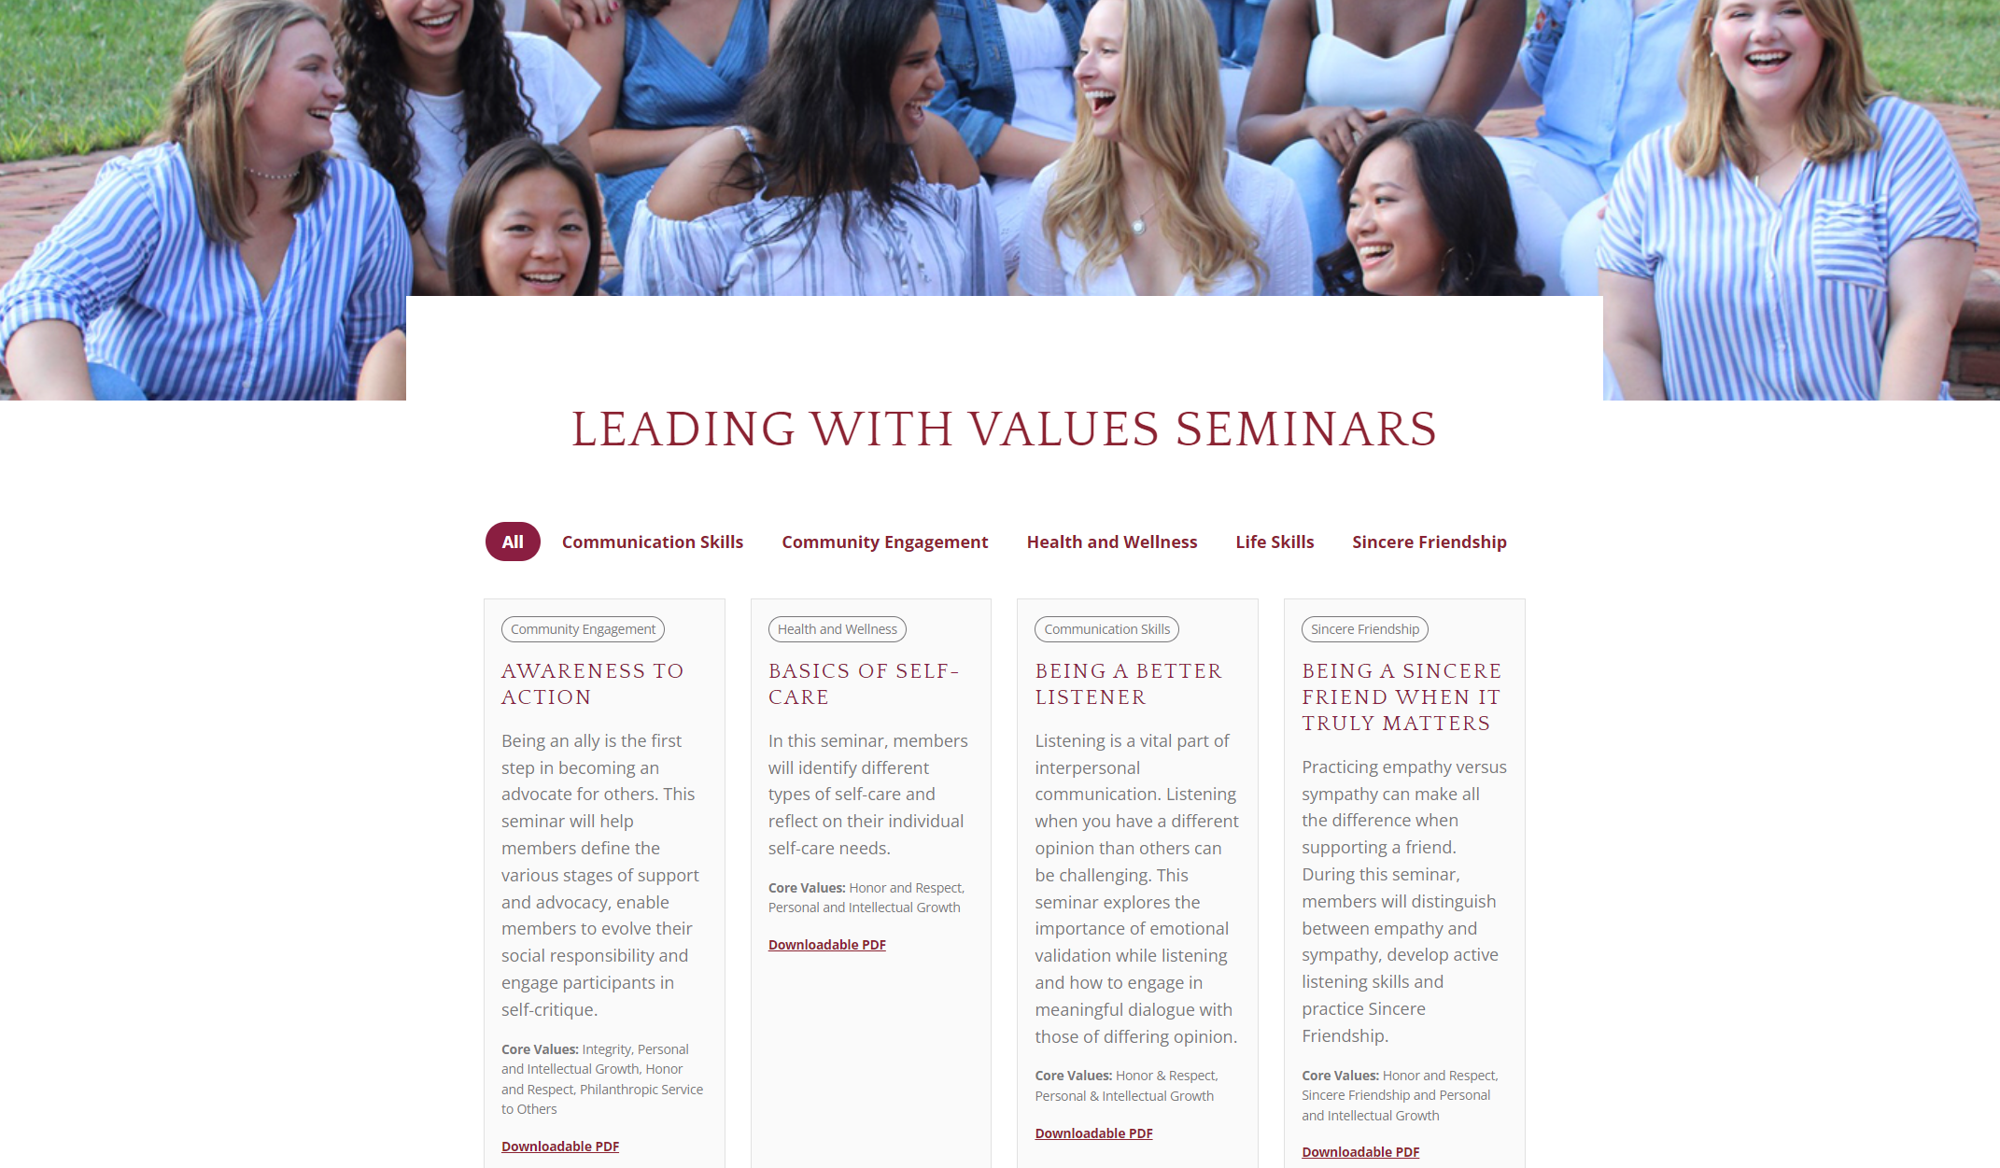

Slide 82
Activity Time!
Choose a seminar category.
Head to that station and discuss why you've selected that category.

Slide 83
Activity Time!
Review each of the seminars in your category.
Choose one seminar for your chapter.
Chat about these questions:
How can I explain why I've picked this seminar to my chapter?
What modifications would I need to make to suit my chapter?
Who should facilitate this seminar, and how can I prepare them?
What challenges might I face, and how can I prepare to address them?

Slide 84
NEW Seminar!
What is it?
Navigating Difficult Conversations Around Bias
Who facilitates?
Vice President Inclusion
Want to learn more?
Webinar on February 12 at 6 p.m. CT

Slide 85
Lunchtime!
See you at 1:15 p.m.!

Slide 86
Promoting Sincere Friendship
Sisterhood Events

Slide 87
What makes a successful sisterhood event?

Slide 88
What could prevent members from participating?

Slide 89
Activity Time!
Come up with a sisterhood event idea.
Share your idea with a partner.
Give your partner 3 suggestions.
Move to a new partner.
Give your new partner 2 things to look up.
Move to a new partner.
Give your partner 1 potential challenge/consideration.

Slide 90
Don't forget!
Collaborate with your Director Social Events when planning sisterhood events.
While you're responsible for planning, they have great resources and tips!
Learn more at our webinar on
Tuesday, February 4.

Slide 91
Let's get more ideas!
Write down sisterhood ideas:
Outdoor
Self-care
Mixing friend groups
Budget-friendly
Small chapter
Large chapter
Stick them to the appropriate poster.

Slide 92
Intellect & Integrity
Academic Support

Slide 93
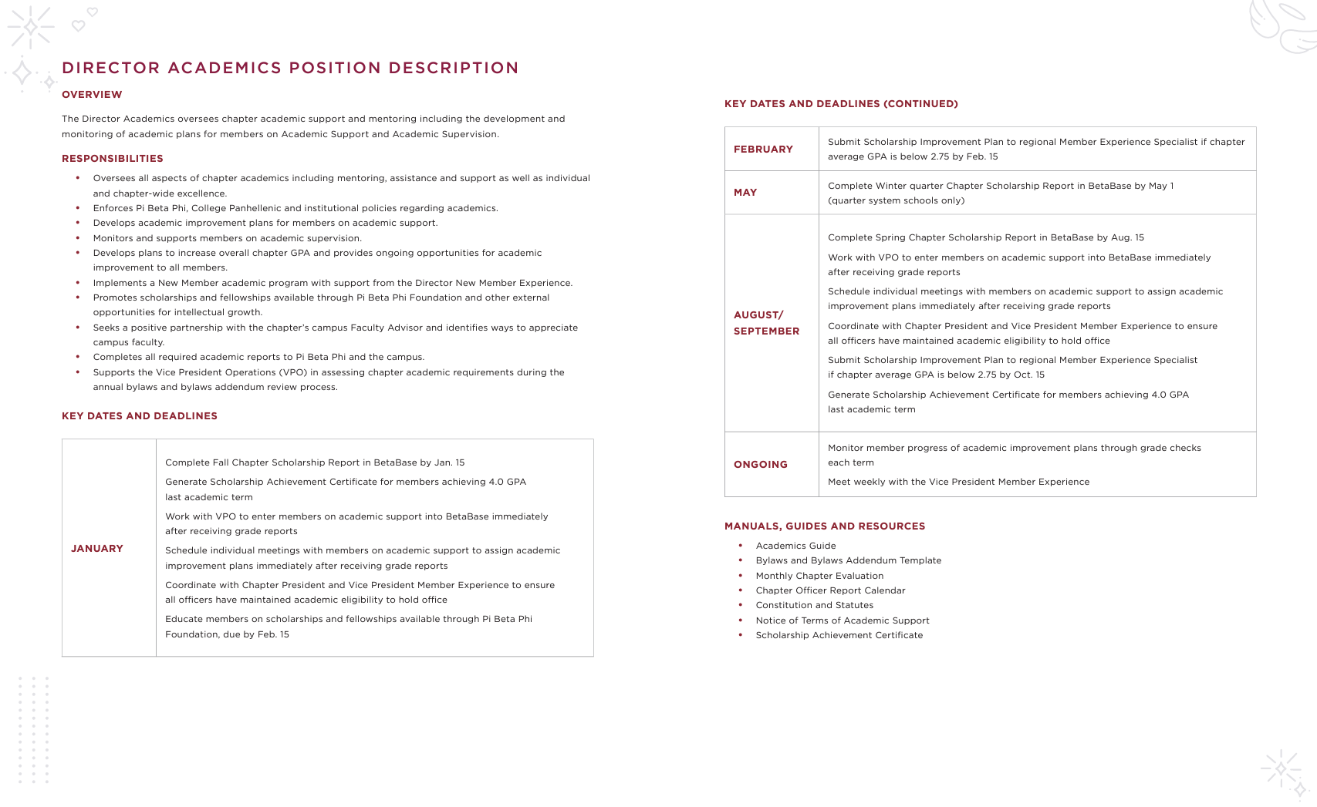

Slide 94
Learning Styles
Kinesthetic
Auditory
Reading and Writing
Logical
Solitary

Slide 95
Share your tips and tricks!
Managing Academic Support
Engaging Academic Programs for the Entire Chapter
Academic Programming for Seniors

Slide 96
What are five things I need to bring back to my Director Academics?

Slide 97
Lifelong Enrichment
Pi Phi for Life

Slide 98
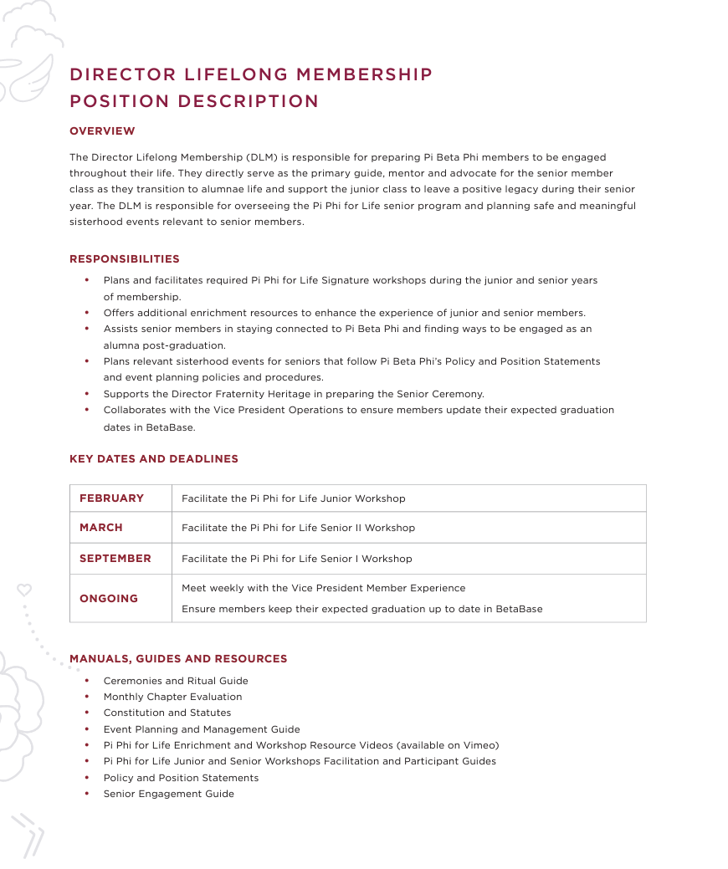

Slide 99
Reflection
The biggest thing that sticks out to me about last year's senior class is...
When the current seniors come to events, I feel...
A chapter without seniors would be...
How can I support senior members...
When I'm a senior, I hope my experience is...

Slide 100
What do seniors need most?

Slide 101
What obstacles do we face with seniors?

Slide 102
How can we meet seniors' needs while dodging the obstacles?

Slide 103
Pair & Share
What questions do you have about senior member engagement?
What do you think is in it for seniors?

Slide 104
What are five things I need to bring back to my Director Lifelong Membership?

Slide 105
Break Time!
See you at 4:15 p.m.!

Slide 106
What is one self-care commitment you can make?

Slide 107
Ensuring a Positive Experience
Assessment

Slide 108
Annual Member Evaluation
Every chapter is required to participate.
To meet expectations on the MCE, 75% of eligible members must complete the AME.

Slide 109
Why do you think Pi Phi has the Annual Member Evaluation?

Slide 110
Purposes of AME
Collect demographic information for collegiate initiated members.
Assess collegiate initiated member satisfaction with local and international activities, programming and support.
Understand the realities and opportunities of the collegiate housing experience.

Slide 111
Next steps
In early February, your members will be invited to complete the AME.
In March, you’ll receive a summary of the data.

Slide 112
Activity Time!
Pick five strips of paper from the bowl.
Create a plan that addresses your data.
What does this data say about the chapter?
Which chapter leaders and AAC members would be most interested in this data?
How could they use the data to set mid-term goals and plan the fall calendar?

Slide 113
Let’s make it real!
Read through your chapter’s results.
Highlight 3-5 key data points.

Slide 114
Why should I care about the Annual Member Evaluation?

Slide 115
Putting Thoughts Into Actions
Next Steps

Slide 116
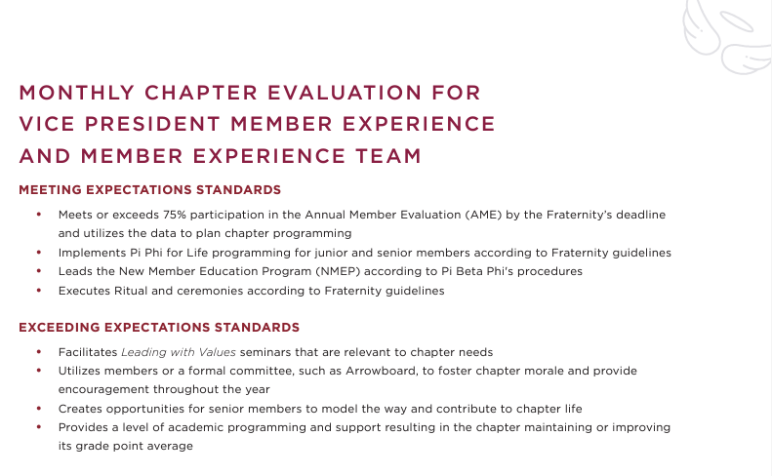

Slide 117
Reflection
Reflect on the questions on Page 73 ☺ of your workbook.
Spend 10 minutes creating an action plan.
Reflect on the last few questions with a new partner.

Slide 118
Let’s bring the team together!

Slide 119
Remember...
Member experience is the foundation of Pi Beta Phi!
YOU are the foundation of your chapter.
Find one person to be your VPME sister!

Slide 120
Thank You!
See you at dinner!

